Slide 1
Correr para obtener
I Corintios 9:24-27
Notes:
I Corinthians 9:24-27 - Do you not know that in a race all the runners run, but only one receives the prize? So run that you may obtain it. Every athlete exercises self-control in all things. They do it to receive a perishable wreath, but we an imperishable. So I do not run aimlessly; I do not box as one beating the air. But I discipline my body and keep it under control, lest after preaching to others I myself should be disqualified.

Slide 2
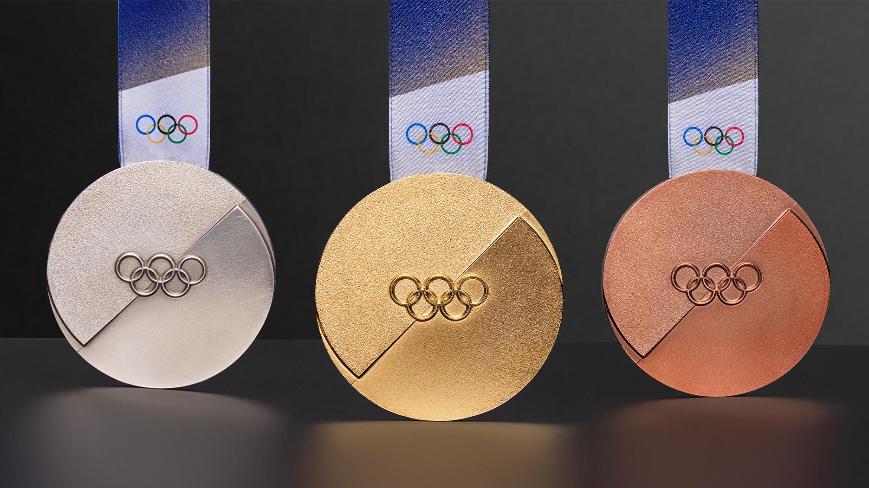
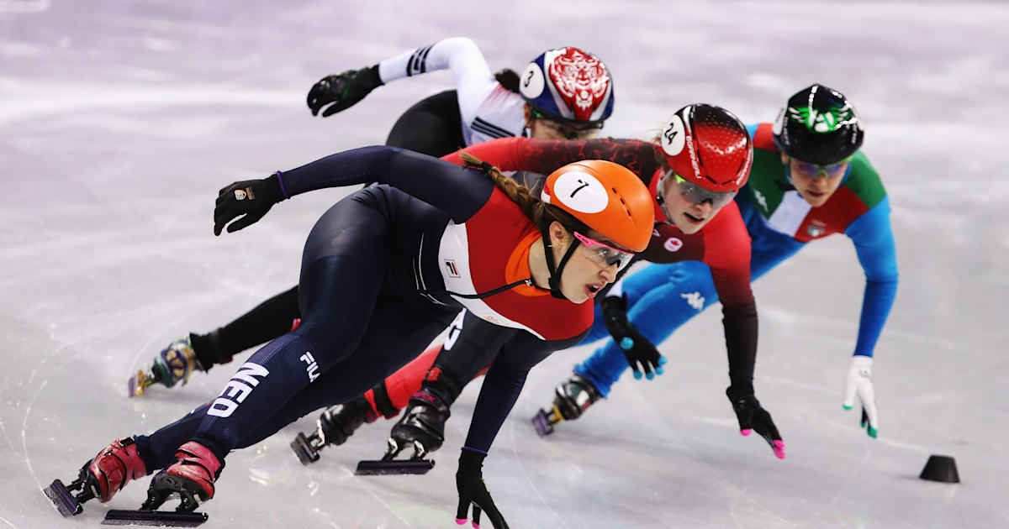
Correr para obtener
Los atletas olímpicos deben:
Trabaja con dedicación en su deporte
Mantente totalmente concentrado
Den lo mejor de sí

Slide 3
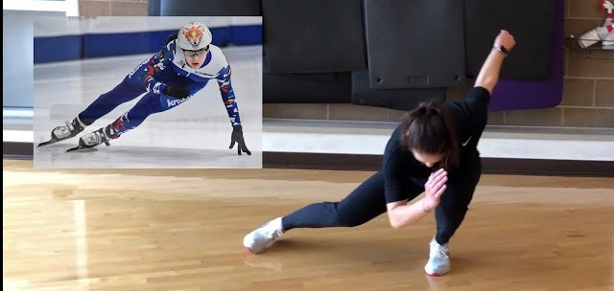
Trabajando con Dedicación
Eclesiastés 9:10 – Trabajad duro mientras tengamos la oportunidad
Colosenses 3:23-24 – Trabajad duro para el Señor
Efesios 2:10 – Haz las obras que Dios quiere que hagamos
I Corintios 15:58 – SIEMPRE debemos trabajar con dedicación
Notes:
Ecclesiastes 9:10 - Whatever your hand finds to do, do it with your might, for there is no work or thought or knowledge or wisdom in Sheol, to which you are going.
Colossians 3:23-24 - Whatever you do, work heartily, as for the Lord and not for men, knowing that from the Lord you will receive the inheritance as your reward. You are serving the Lord Christ.
Ephesians 2:10 - For we are his workmanship, created in Christ Jesus for good works, which God prepared beforehand, that we should walk in them.
I Corinthians 15:58 - Therefore, my beloved brothers, be steadfast, immovable, always abounding in the work of the Lord, knowing that in the Lord your labor is not in vain.

Slide 4
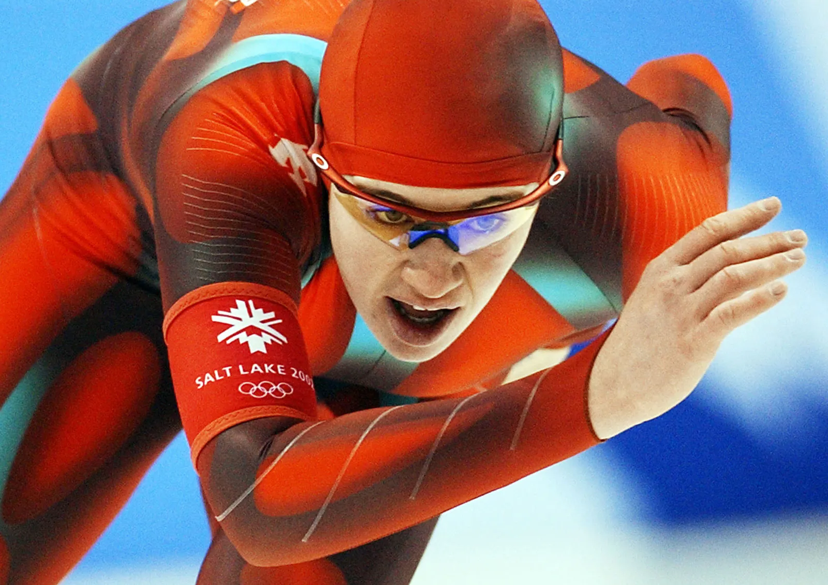
Totalmente concentrado
Mateo 6:24 – No se puede servir a más de un maestro
Josué 24:15 – Debemos centrarnos en servir al Señor
Mateo 22:36-37 – Debemos poner nuestro corazón y alma en servir a Dios
Notes:
Matthew 6:24 - No one can serve two masters, for either he will hate the one and love the other, or he will be devoted to the one and despise the other. You cannot serve God and money.
Joshua 24:15 - And if it is evil in your eyes to serve the LORD, choose this day whom you will serve, whether the gods your fathers served in the region beyond the River, or the gods of the Amorites in whose land you dwell. But as for me and my house, we will serve the LORD.
Matthew 22:36-37 - Teacher, which is the great commandment in the Law? And he said to him, "You shall love the Lord your God with all your heart and with all your soul and with all your mind.

Slide 5
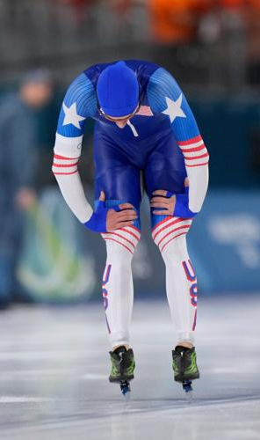
Da lo mejor de sí
Malaquías 1:6-8 – Dios quiere lo mejor de nosotros
Mateo 25:14-27 – Debemos aprovechar cada oportunidad que se nos presente
Apocalipsis 3:15-18 – Tenemos que estar totalmente sirviendo a Dios
Notes:
Malachi 1:6-8 - A son honors his father, and a servant his master. If then I am a father, where is my honor? And if I am a master, where is my fear? says the LORD of hosts to you, O priests, who despise my name. But you say, 'How have we despised your name?' By offering polluted food upon my altar. But you say, 'How have we polluted you?' By saying that the LORD's table may be despised. When you offer blind animals in sacrifice, is that not evil? And when you offer those that are lame or sick, is that not evil? Present that to your governor; will he accept you or show you favor? says the LORD of hosts.
Matthew 25:14-27 - For it will be like a man going on a journey, who called his servants and entrusted to them his property. To one he gave five talents, to another two, to another one, to each according to his ability. Then he went away. He who had received the five talents went at once and traded with them, and he made five talents more. So also he who had the two talents made two talents more. But he who had received the one talent went and dug in the ground and hid his master's money. Now after a long time the master of those servants came and settled accounts with them. And he who had received the five talents came forward, bringing five talents more, saying, 'Master, you delivered to me five talents; here, I have made five talents more.' His master said to him, 'Well done, good and faithful servant. You have been faithful over a little; I will set you over much. Enter into the joy of your master.' And he also who had the two talents came forward, saying, 'Master, you delivered to me two talents; here, I have made two talents more.' His master said to him, 'Well done, good and faithful servant. You have been faithful over a little; I will set you over much. Enter into the joy of your master.' He also who had received the one talent came forward, saying, 'Master, I knew you to be a hard man, reaping where you did not sow, and gathering where you scattered no seed, so I was afraid, and I went and hid your talent in the ground. Here, you have what is yours.' But his master answered him, 'You wicked and slothful servant! You knew that I reap where I have not sown and gather where I scattered no seed? Then you ought to have invested my money with the bankers, and at my coming I should have received what was my own with interest.
Revelation 3:15-18 - I know your works: you are neither cold nor hot. Would that you were either cold or hot! So, because you are lukewarm, and neither hot nor cold, I will spit you out of my mouth. For you say, "I am rich, I have prospered, and I need nothing," not realizing that you are wretched, pitiable, poor, blind, and naked. I counsel you to buy from me gold refined by fire, so that you may be rich, and white garments so that you may clothe yourself and the shame of your nakedness may not be seen, and salve to anoint your eyes, so that you may see.

