Slide 1
Hear, O my people, and I will speak; O Israel, I will testify against you. I am God, your God.
Psalm 50:7
Notes:
God tell Israel that he is not pleased with them
He reminds them that he is God, their God
This statement is the root of the problem
They have forgotten who God is

Slide 2
Mark this, then, you who forget God, lest I tear you apart, and there be none to deliver!
Psalm 50:22
Main problem
  They forgot God

Slide 3
Not for your sacrifices do I rebuke you; your burnt offerings are continually before me. I will not accept a bull from your house or goats from your folds.
Psalm 50:8-9
The issues wasn’t with the sacrifices they were making
  They were doing the required “works”
But God wasn’t going to accept their sacrifices
Why?

Slide 4
For every beast of the forest is mine, the cattle on a thousand hills. I know all the birds of the hills, and all that moves in the field is mine. If I were hungry, I would not tell you, for the world and its fullness are mine. Do I eat the flesh of bulls or drink the blood of goats?
Psalm 50:10-13
The first problem was their attitude
They thought they were doing something for God
  God makes it clear that they weren’t
  Everything sacrificed was his to start with, he didn’t need the sacrifices, the Israelites did

Slide 5
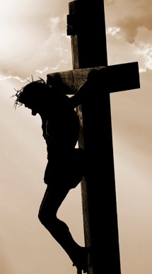
For by grace you have been saved through faith. And this is not your own doing; it is the gift of God, not a result of works, so that no one may boast.
Ephesians 2:8-9

Slide 6
But to the wicked God says: What right have you to recite my statutes or take my covenant on your lips? For you hate discipline, and you cast my words behind you. If you see a thief, you are pleased with him, and you keep company with adulterers. You give your mouth free rein for evil, and your tongue frames deceit.
Psalm 50:16-19
Their second problem was they weren’t living righteous lives.
  Hated discipline – Wouldn’t change
  Allowed others to be taken advantage of
  Kept company with adulterers
  Were liars

Slide 7
You sit and speak against your brother; you slander your own mother's son. These things you have done, and I have been silent; you thought that I was one like yourself. But now I rebuke you and lay the charge before you.
Psalm 50:20-21
  Brought false witness
  Slandered others
  Thought they are like God

Slide 8
Mark this, then, you who forget God, lest I tear you apart, and there be none to deliver! The one who offers thanksgiving as his sacrifice glorifies me; to one who orders his way rightly I will show the salvation of God!
Psalm 50:22-23
Keep God top of mind
Thank God for everything
Walk Rightly

Slide 9
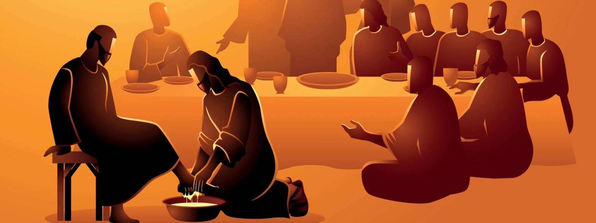
What God wants from us
Thankfulness – Psalm 100:2-5
Love and Knowledge of him - Hosea 6:6
A Humble Heart – Psalm 51:17
Mercy – Matthew 9:13
Listening and Obedience – I Samuel 15:22
Acknowledgment, Praise, Care for Others – Hebrews 13:15-16
Notes:
Psalm 100:2-5 - Serve the LORD with gladness! Come into his presence with singing! Know that the LORD, he is God! It is he who made us, and we are his; we are his people, and the sheep of his pasture. Enter his gates with thanksgiving, and his courts with praise! Give thanks to him; bless his name! For the LORD is good; his steadfast love endures forever, and his faithfulness to all generations.
Hosea 6:6 - For I desire steadfast love and not sacrifice, the knowledge of God rather than burnt offerings.
Psalm 51:17 - The sacrifices of God are a broken spirit; a broken and contrite heart, O God, you will not despise.
Matthew 9:13 - Go and learn what this means: 'I desire mercy, and not sacrifice.' For I came not to call the righteous, but sinners.“
I Samuel 15:22 - And Samuel said, "Has the LORD as great delight in burnt offerings and sacrifices, as in obeying the voice of the LORD? Behold, to obey is better than sacrifice, and to listen than the fat of rams.
Hebrews 13:15-16 - Through him then let us continually offer up a sacrifice of praise to God, that is, the fruit of lips that acknowledge his name. Do not neglect to do good and to share what you have, for such sacrifices are pleasing to God.

Slide 10
This is good, and it is pleasing in the sight of God our Savior, who desires all people to be saved and to come to the knowledge of the truth. For there is one God, and there is one mediator between God and men, the man Christ Jesus, who gave himself as a ransom for all, which is the testimony given at the proper time.
I Timothy 2:3-6

