Slide 1
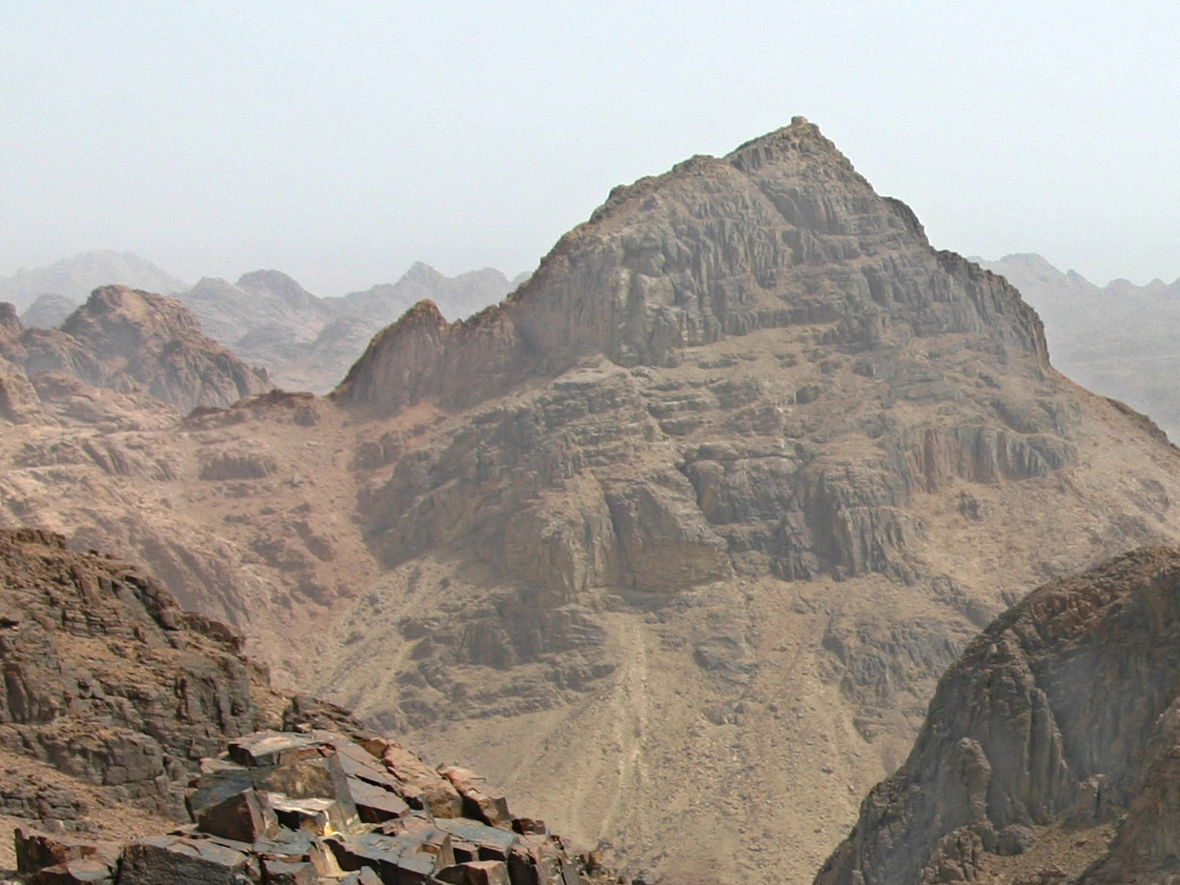
Standing Firm
Exodus 32:21-29

Slide 2
Exodus 19:9-13 God tells Moses he is coming to him in a thick cloud “That the people may hear when I speak with you, and may believe you forever.”
Exodus 16-20 Mount Sinai was wrapped in smoke and trembled when God came down.
Exodus 20: 1-17 God speaks the 10 commandments to Moses
Exodus 20:18 “When all the people saw the thunder and the flashes of lightning and the sound of the trumpet and the mountain smoking, the people were afraid and trembled,”
Exodus 20:20 Moses tells them that God is testing them, “that the fear of him may be before you, that you may not sin.”
Standing Firm

Slide 3
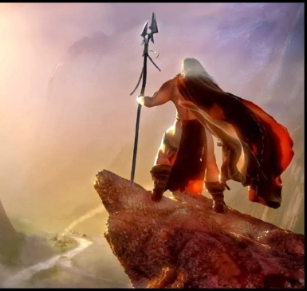
Standing Firm
Exodus 24:3 Moses shares what God has told him “All the people answered with one voice and said, all the words that the lord has spoken we will do.”
Exodus 24:7 Moses read the book of the covenant to the people and the told him “all that the Lord has spoken we will do and be obedient.”
Exodus 24:14 Moses prepares to return to Mount Sinai and puts Aaron and Hur in charge.

Slide 4
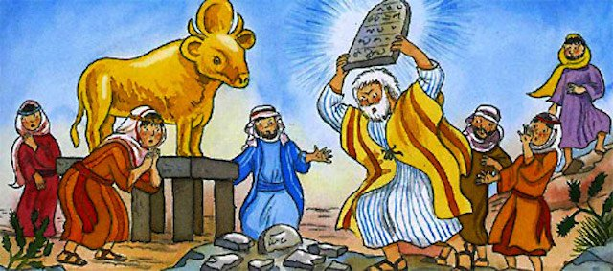
Standing Firm
Aaron
Moses
Exodus 32:1 Because Moses has been gone, the people ask Aaron to “make us gods (idols) to go before us.”
Exodus 32:2-6 Aaron does what they ask and declares “Tomorrow shall be a feast to the Lord”
Exodus 32:21 Moses ask him what they did to him “that you have brough such a great sin upon them?”
Exodus 32:22 Aaron blames the people, says “they are set on evil.”
Exodus 32:25 Moses looks around and sees that the people are out of control
Exodus 32:11-14 Moses intercedes so that God relents from destroying the Israelites.
Exodus 32:19-20 Moses saw what was going on and gets angry and destroys the golden calf
Exodus 32:26-28 Moses calls for those on the Lord’s side and orders them to kill who are not. About 3,000 men are killed.
Exodus 32:30-32 Moses asks God to forgive those who remained

Slide 5
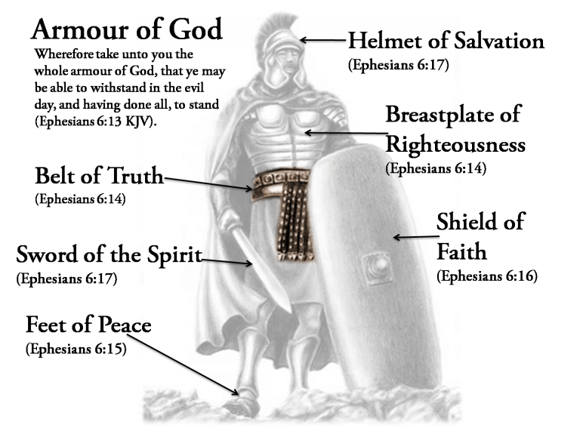
Standing Firm
Takeaways
We must determine who we are going to serve – Joshua 24:15
We can’t be “unequally yoked” – II Corinthians 6:14-18
  We can’t let our relationships allow us to be deceived – I Corinthians 6:9-10
  We can’t allow others to lead us astray – Colossians 2:8
We must Stand Firm – I Corinthians 16:13
  We need a good foundation – Matthew 7:24-27
  We have to set boundaries and stick to them – Proverbs 22:6
We need to put on the whole armor of God – Ephesians 6:13-15

