Slide 1
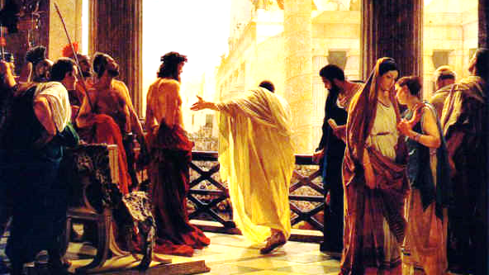
The 7 Trials of Jesus Christ

Slide 2
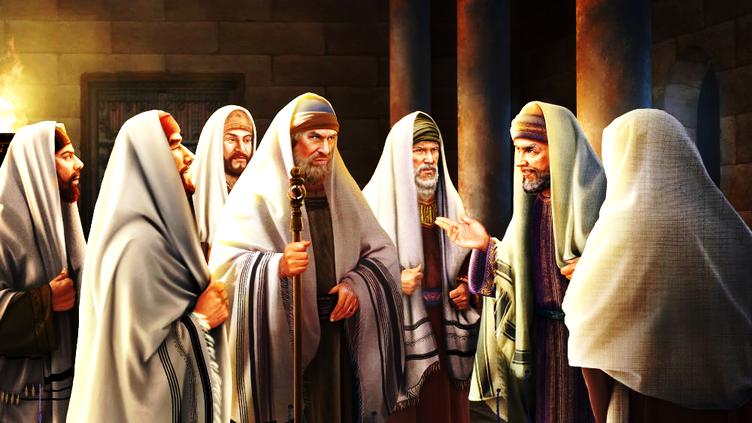
CONSPIRACY PLOT TO KILL JESUS
John 11:49-50

Slide 3
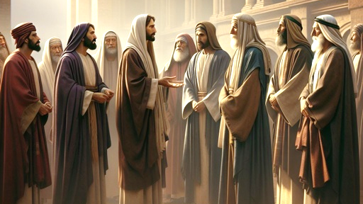
THE PLOT THICKENS
John 5:18
John 7:1,19,25,30,32,44

Slide 4
THE PLOT THICKENS
John 8:37-40, 58-59

Slide 5
THE PLOT THICKENS
John 10:30-33,39
John 11:48-53

Slide 6
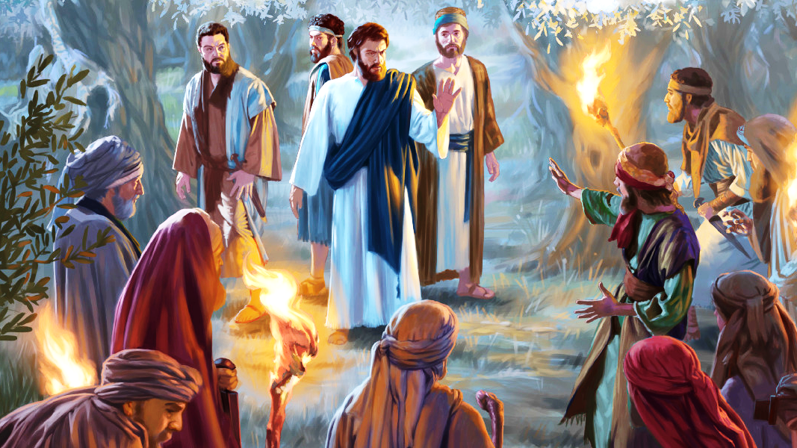
The Cowardly Arrest

Slide 7
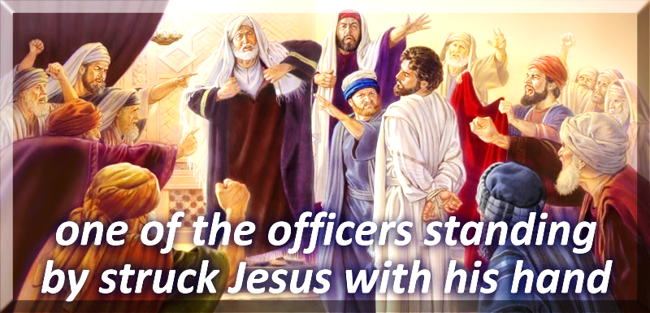
TRIAL 1
Who? ANNAS
Where? House of
High Priest
Jn 18:12-14

Slide 8
TRIAL 1
Who? ANNAS (HP)
Where? House of
High Priest
John 18:19-23
Decision: Guilty!

Slide 9
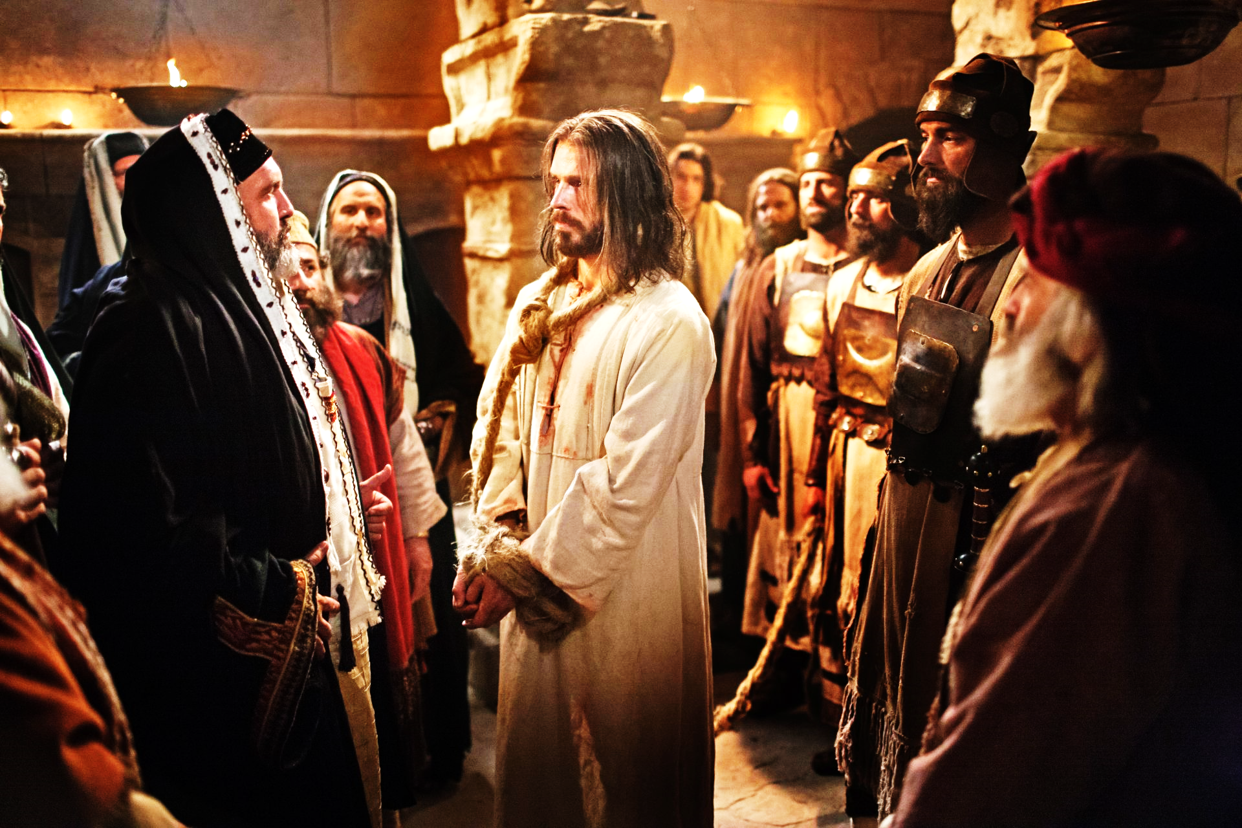
TRIAL 2
Who? Caiaphas
Where? House of
High Priest
Matt. 26:51-68

Slide 10
TRIAL 2
Who? Caiaphas
Where? House of
High Priest
Matt. 26:51-68
Decision: Guilty!

Slide 11
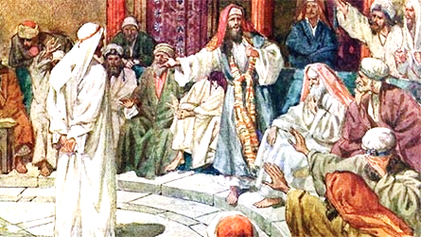
Trial 3
Where? Sanhedrin
What? Full Trial
Luke 22:66-71

Slide 12
Trial 3
Where? Sanhedrin
What? Full Trial
Decsiion: Guilty !
“NO”: Joseph
Lk 23:50-51
Mark 15:1
Matt 27:1-2

Slide 13
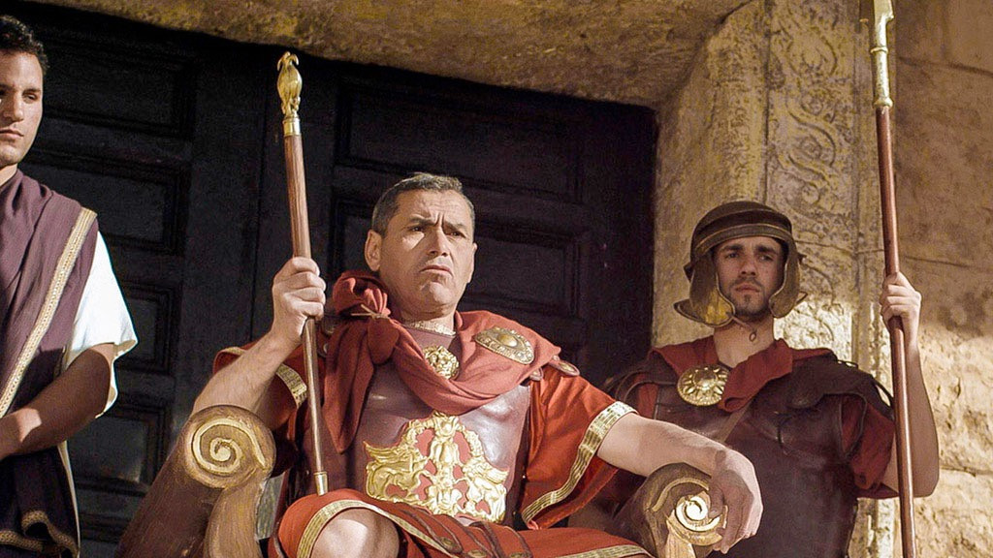
Trial 4 – Civil
Roman Court: Pilate
John 18:28 – 19:13

Slide 14
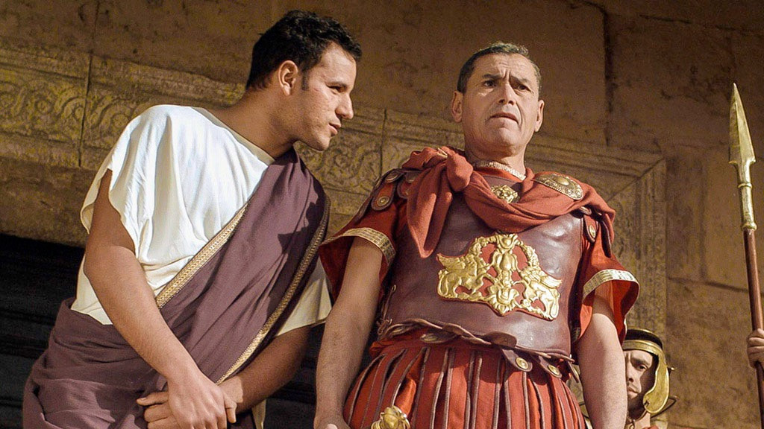
Trial 4 – Civil
“Are you the King?”
John 18:36

Slide 15
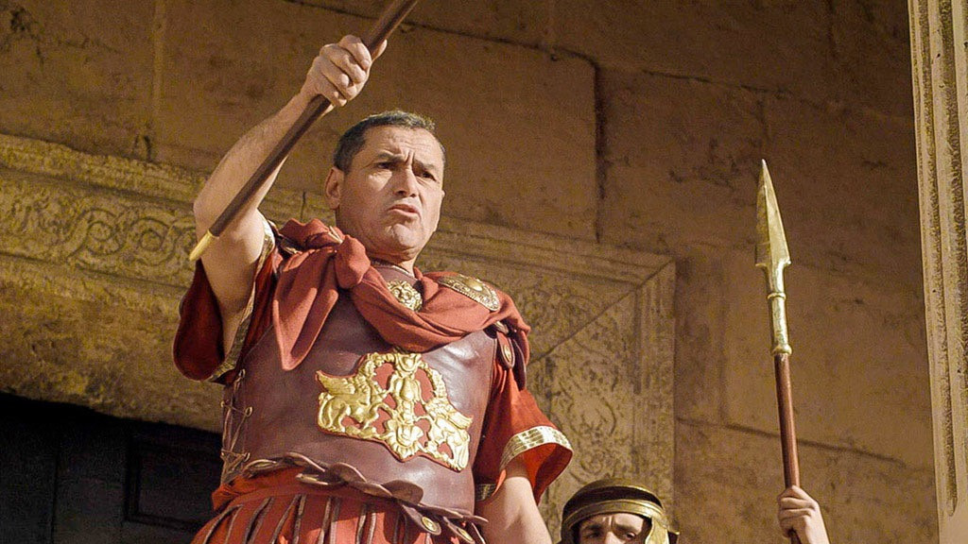
Trial 4 – Civil
Decision: NOT GUILTY
“What is truth?
“I find no fault in Him”

Slide 16
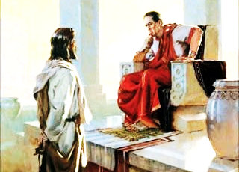
Trial 5 – Civil
Herod’s Court
Luke 23:4-12

Slide 17
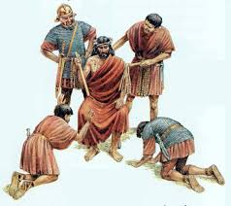
Trial 5 – Civil
Herod’s Court
Decision:
Not Guilty
Then Herod, with his men of war, treated Him with contempt and mocked Him, arrayed Him in a gorgeous robe, and sent Him back to Pilate. Luke 23:11

Slide 18
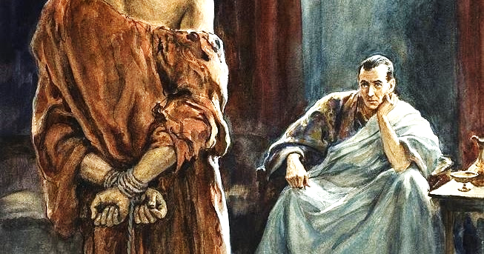
Trial 6 – Civil
Pilate’s Court
Luke 23:13-16
And indeed, having examined Him in your presence, I have found no fault in this Man concerning those things of which you accuse Him; no, neither did Herod...Luke 23:13-16

Slide 19
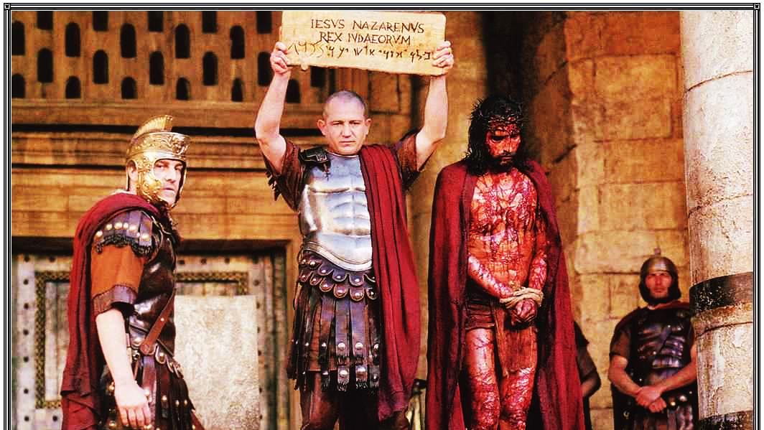
“Let Him be
crucified”
John 19:14-19

Slide 20
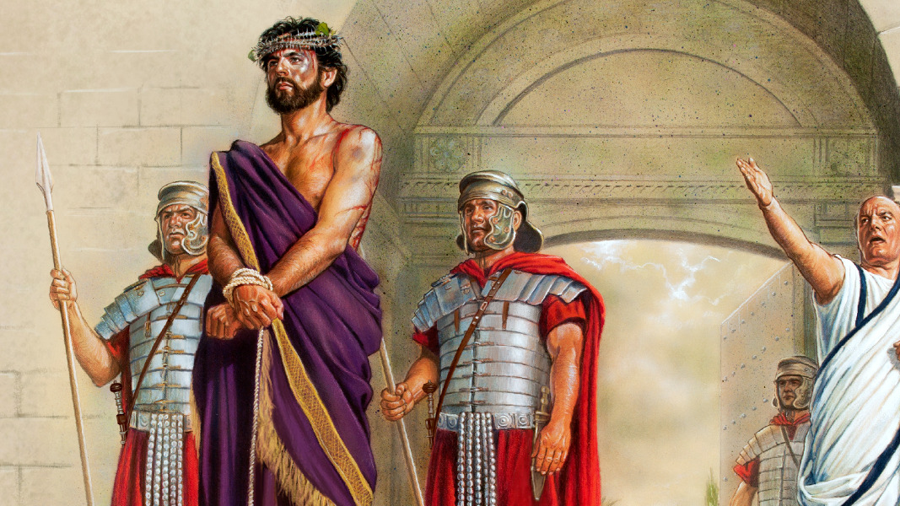
Trial 6 – Civil
Pilate’s Court
“NOT GUILTY!”

Slide 21
“I Find No Fault In This Man”
1. After first meeting with Jesus:
"I find no fault in this man" (Jn. 18:29-38; Lk. 23:4).
2. After Jesus returned to Pilate from Herod,
"Behold, I, having examined him before, have found no fault
in this man touching those things whereof ye accuse him:
No, nor yet Herod . . ." (Lk. 23:6-15).
3. After offering to release a prisoner to the Jews, and offering
to scourge Jesus and then release Him,
"And he said unto them the third time, ‘Why, what evil hath he
done? I have found no cause of death in him’ . . ." (Lk 23:22).

Slide 22
“I Find No Fault In This Man”
4. When he washed his hands before the multitude:
"I am innocent of the blood of this just person" (Mt. 27:24).
5. After Jesus had been mocked, whipped, and the robe put
on Him:
"Behold, I bring him forth to you, that ye may know that I
find no fault in him" (Jn. 19:4).

Slide 23
“I Find No Fault In This Man”
6. When Pilate gave permission for His crucifixion:
"Take ye him, and crucify him:
for I find no fault in him" (Jn. 19:6).
7. After Pilate learned of Jesus' claim to be the Son
of God, he talked with Jesus for the last time.:
"Upon this Pilate sought to release him..."
(Jn. 19:7-12)

Slide 24
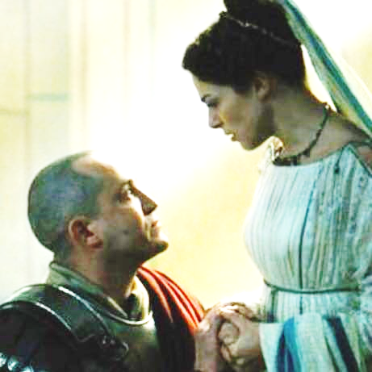
Pilate’s Wife’s Testimony
¹⁹ While he was sitting on the judgment seat, his wife sent to him, saying,
“Have nothing to do with that just Man, for I have suffered many things today in a dream because of Him.”
Matthew 27:19

Slide 25


Slide 26
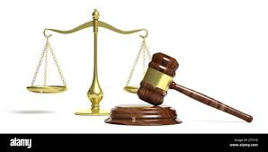
The 7th Trial ?
Today
I am the Judge
Texts: The whole Bible (1 Corinthians 15:1-4)
Decision: Innocent? Jesus is Lord and Savior
Guilty? Jesus is Liar (or) Lunatic
Result: I one day stand before Jesus as my Judge
What will He say to me? Matthew 25:31-46
“Well done, good and faithful servant”
“Depart from Me, I do not know you?

