Slide 1
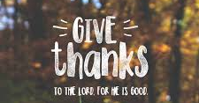
Oh give thanks to the LORD, for he is good; for his steadfast love endures forever!
I Chronicles 16:34

Slide 2

Give Thanks
Notes:
Luke 12:13-21
13 Someone in the crowd said to him, "Teacher, tell my brother to divide the inheritance with me."
14 But he said to him, "Man, who made me a judge or arbitrator over you?"
15 And he said to them, "Take care, and be on your guard against all covetousness, for one's life does not consist in the abundance of his possessions."
16 And he told them a parable, saying, "The land of a rich man produced plentifully,
17 and he thought to himself, 'What shall I do, for I have nowhere to store my crops?’
18 And he said, 'I will do this: I will tear down my barns and build larger ones, and there I will store all my grain and my goods.
19 And I will say to my soul, "Soul, you have ample goods laid up for many years; relax, eat, drink, be merry.“’
20 But God said to him, 'Fool! This night your soul is required of you, and the things you have prepared, whose will they be?’
21 So is the one who lays up treasure for himself and is not rich toward God."

Slide 3
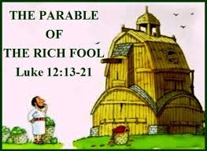
Give Thanks
11 - references to self
0 - references to God
The rich man:
Never considered that he had been blessed
Never considered thanking God for the blessings he had received
Never thought how his good fortune could be shared with others
Never considered that the blessings received could be lost
Bottom line is he thought he was the center of everything

Slide 4
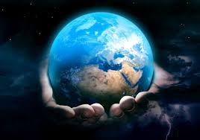
Give Thanks
For by him all things were created, in heaven and on earth, visible and invisible, whether thrones or dominions or rulers or authorities--all things were created through him and for him. And he is before all things, and in him all things hold together.
Colossians 1:16-17
Yours, O LORD, is the greatness and the power and the glory and the victory and the majesty, for all that is in the heavens and in the earth is yours. Yours is the kingdom, O LORD, and you are exalted as head above all. Both riches and honor come from you, and you rule over all. In your hand are power and might, and in your hand it is to make great and to give strength to all. And now we thank you, our God, and praise your glorious name.
I Chronicles 29:11-13
Notes:
Colossians 1:16-17
16 For by him all things were created, in heaven and on earth, visible and invisible, whether thrones or dominions or rulers or authorities--all things were created through him and for him.
17 And he is before all things, and in him all things hold together.
Have you ever considered that everything that exists today, anything that has been invented, anything that seems new, anything we acquire only exists because of God’s creation?
I Chronicles 29:11-13
11 Yours, O LORD, is the greatness and the power and the glory and the victory and the majesty, for all that is in the heavens and in the earth is yours. Yours is the kingdom, O LORD, and you are exalted as head above all.
12 Both riches and honor come from you, and you rule over all. In your hand are power and might, and in your hand it is to make great and to give strength to all.
13 And now we thank you, our God, and praise your glorious name.
Since God created everything, that means that everything that exists, everything invented, everything we have acquired really belongs to God. Nobody on this earth owns the land they live on, it belongs to God. Since it all belongs to God we should be thanking him for providing it, for letting us use it.

Slide 5
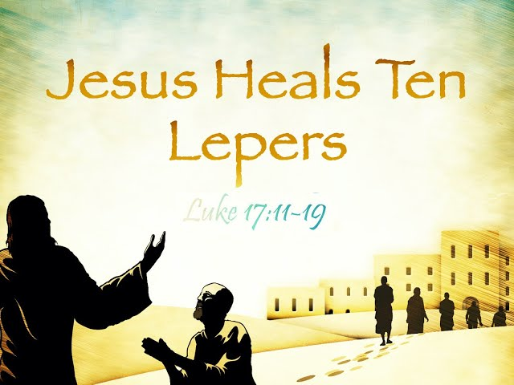
Give Thanks
do not be anxious about anything, but in everything by prayer and supplication with thanksgiving let your requests be made known to God.
Philippians 4:6
Notes:
Luke 17:11-19
11 On the way to Jerusalem he was passing along between Samaria and Galilee.
12 And as he entered a village, he was met by ten lepers, who stood at a distance
13 and lifted up their voices, saying, "Jesus, Master, have mercy on us."
14 When he saw them he said to them, "Go and show yourselves to the priests." And as they went they were cleansed.
15 Then one of them, when he saw that he was healed, turned back, praising God with a loud voice;
16 and he fell on his face at Jesus' feet, giving him thanks. Now he was a Samaritan.
17 Then Jesus answered, "Were not ten cleansed? Where are the nine?
18 Was no one found to return and give praise to God except this foreigner?"
19 And he said to him, "Rise and go your way; your faith has made you well.“
We have all probably studied this passage at some time. 10 men with leprosy approach Jesus and ask for mercy. As they went on their way the were all cleansed of their leprosy but only one returned to give thanks. We talk about how only one man was thankful for what he was given, but do we make application to ourselves? How often are we blessed and never thank God for what he has done? We are blessed in so many ways each and every day, do we stop to consider all of those blessings came from God? Do we take the time to thank him for all that he has done, all that he has provided.
Philippians 4:6
6 do not be anxious about anything, but in everything by prayer and supplication with thanksgiving let your requests be made known to God.
We talk often about putting our trust in God and going to him with prayers when we have a need, but note that this passage says we should do those things with thanksgiving. The point is that we need to be thankful for what God does. We need to recognize what he does for us and be thankful for it. How often do we pray for something, but never offer our thanks for the result?

Slide 6
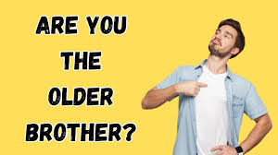
Give Thanks
Prodigal Son: Luke 15:11-32
And he said to him, 'Your brother has come, and your father has killed the fattened calf, because he has received him back safe and sound.' But he was angry and refused to go in. His father came out and entreated him, but he answered his father, 'Look, these many years I have served you, and I never disobeyed your command, yet you never gave me a young goat, that I might celebrate with my friends. But when this son of yours came, who has devoured your property with prostitutes, you killed the fattened calf for him!’
Luke 15:27-30
Notes:
Luke 15:11-32
11 And he said, "There was a man who had two sons.
12 And the younger of them said to his father, 'Father, give me the share of property that is coming to me.' And he divided his property between them.
13 Not many days later, the younger son gathered all he had and took a journey into a far country, and there he squandered his property in reckless living.
14 And when he had spent everything, a severe famine arose in that country, and he began to be in need.
15 So he went and hired himself out to one of the citizens of that country, who sent him into his fields to feed pigs.
16 And he was longing to be fed with the pods that the pigs ate, and no one gave him anything.
17 "But when he came to himself, he said, 'How many of my father's hired servants have more than enough bread, but I perish here with hunger!
18 I will arise and go to my father, and I will say to him, "Father, I have sinned against heaven and before you.
19 I am no longer worthy to be called your son. Treat me as one of your hired servants.“’
20 And he arose and came to his father. But while he was still a long way off, his father saw him and felt compassion, and ran and embraced him and kissed him.
21 And the son said to him, 'Father, I have sinned against heaven and before you. I am no longer worthy to be called your son.’
22 But the father said to his servants, 'Bring quickly the best robe, and put it on him, and put a ring on his hand, and shoes on his feet.
23 And bring the fattened calf and kill it, and let us eat and celebrate.
24 For this my son was dead, and is alive again; he was lost, and is found.' And they began to celebrate.
25 "Now his older son was in the field, and as he came and drew near to the house, he heard music and dancing.
26 And he called one of the servants and asked what these things meant.
27 And he said to him, 'Your brother has come, and your father has killed the fattened calf, because he has received him back safe and sound.’
28 But he was angry and refused to go in. His father came out and entreated him,
29 but he answered his father, 'Look, these many years I have served you, and I never disobeyed your command, yet you never gave me a young goat, that I might celebrate with my friends.
30 But when this son of yours came, who has devoured your property with prostitutes, you killed the fattened calf for him!’
31 And he said to him, 'Son, you are always with me, and all that is mine is yours.
32 It was fitting to celebrate and be glad, for this your brother was dead, and is alive; he was lost, and is found.’”
When we study this passage, we tend to focus on the prodigal son and how he lost his way but recognized his error and returned. We focus on the how the Father rejoiced that his lost son returned. But the real focus of the parable is the older brother and how he reacted to the loss and return of his younger brother. He was angry that his father hadn’t thrown a feast for him. All he cared about was himself. He was not thankful for what his father had done for him. In verse 31 the father points out that all that the father has will belong to the older brother, none of which the brother was owed. He had been fed, housed and cared for by his father but showed absolutely no thankfulness because he was only focused on self.

Slide 7
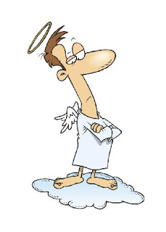
Give Thanks
The Pharisee, standing by himself, prayed thus: 'God, I thank you that I am not like other men, extortioners, unjust, adulterers, or even like this tax collector. I fast twice a week; I give tithes of all that I get.'
Luke 18:11-12
Notes:
Luke 18:10-11
10 "Two men went up into the temple to pray, one a Pharisee and the other a tax collector.
11 The Pharisee, standing by himself, prayed thus: 'God, I thank you that I am not like other men, extortioners, unjust, adulterers, or even like this tax collector.
When we begin to think only of ourselves, it isn’t just the blessings of this life that we cease to be thankful for. We begin to believe our “goodness” is something to be proud of. In the parable of the Pharisee and the Publican, the Pharisee prays to God, but his prayer is all about bragging to God. Now I don’t think many people would actually be so full of themselves to pray to God like this, but sometimes our actions and attitudes very much match those of the Pharisee. If we are not careful we begin to think that we have “earned” our salvation. We can begin to think that our efforts to serve God and live our lives in accordance to his will are what entitles us to a home in heaven. Entitlement by definition means “one believes they are inherently deserving of privileges or special treatment and one of the key problems of entitlement is “a habitual, self-reinforcing cycle of behavior”. In simple terms if we begin to believe we are entitled we don’t believe we need to change, we believe we are “good enough”

Slide 8
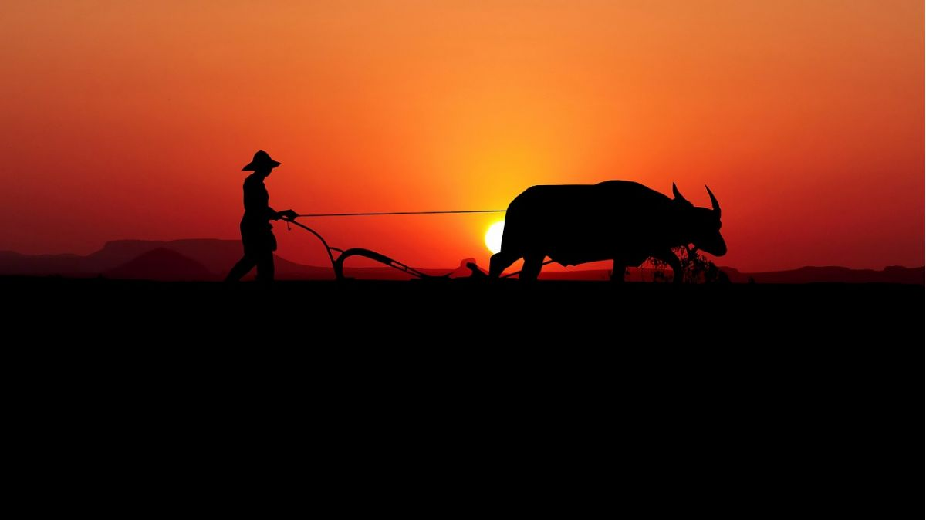
Give Thanks
"Will any one of you who has a servant plowing or keeping sheep say to him when he has come in from the field, 'Come at once and recline at table'? Will he not rather say to him, 'Prepare supper for me, and dress properly, and serve me while I eat and drink, and afterward you will eat and drink'? Does he thank the servant because he did what was commanded? So you also, when you have done all that you were commanded, say, 'We are unworthy servants; we have only done what was our duty.'"
Luke 17:7-10
Notes:
Luke 17:7-10
7 "Will any one of you who has a servant plowing or keeping sheep say to him when he has come in from the field, 'Come at once and recline at table’?
8 Will he not rather say to him, 'Prepare supper for me, and dress properly, and serve me while I eat and drink, and afterward you will eat and drink’?
9 Does he thank the servant because he did what was commanded?
10 So you also, when you have done all that you were commanded, say, 'We are unworthy servants; we have only done what was our duty.’”
Instead of feeling like our behavior entitles us to anything, we need to understand that our efforts to serve God and live our lives in accordance to his will are our duty, it is what is expected of us. We aren’t owed anything because we haven’t done anything and can’t do anything that is worthy of what God has provided for us.

Slide 9

Give Thanks
And so, from the day we heard, we have not ceased to pray for you, asking that you may be filled with the knowledge of his will in all spiritual wisdom and understanding, so as to walk in a manner worthy of the Lord, fully pleasing to him: bearing fruit in every good work and increasing in the knowledge of God; being strengthened with all power, according to his glorious might, for all endurance and patience with joy; giving thanks to the Father, who has qualified you to share in the inheritance of the saints in light.
Colossians 1:9-12
Notes:
Colossians 1:9-12
9 And so, from the day we heard, we have not ceased to pray for you, asking that you may be filled with the knowledge of his will in all spiritual wisdom and understanding,
10 so as to walk in a manner worthy of the Lord, fully pleasing to him: bearing fruit in every good work and increasing in the knowledge of God;
11 being strengthened with all power, according to his glorious might, for all endurance and patience with joy;
12 giving thanks to the Father, who has qualified you to share in the inheritance of the saints in light.
Notice the wording in verse 12…”Qualified You”. If you think about this what it tells us is that without God’s assistance we did not have path to salvation. We had disqualified ourselves because we failed to live perfect lives, we failed to live according to the commandments of God.

Slide 10
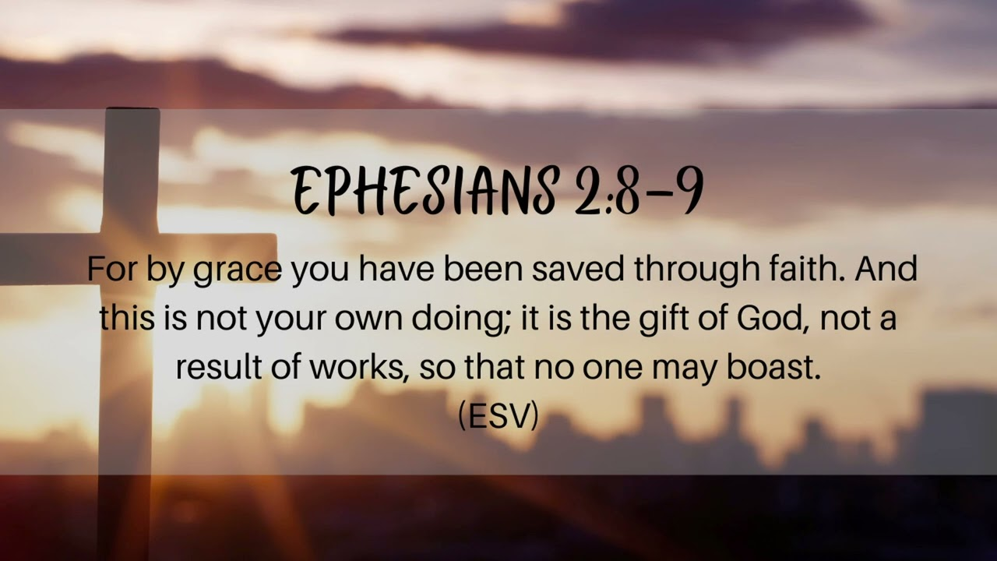
Give Thanks
Notes:
Ephesians 2:8-9
8 For by grace you have been saved through faith. And this is not your own doing; it is the gift of God,
9 not a result of works, so that no one may boast.
This passage is one that we need to remember and I don’t mean memorize. We need to focus on the concept. Our salvation comes from the God’s grace, not our own doing. Notice the last part of verse 9…”that no one my boast”. We need to be humble about our situation. We shouldn’t feel superior to others, but most importantly we should be thankful. Thankful to God who has shown us grace.

Slide 11
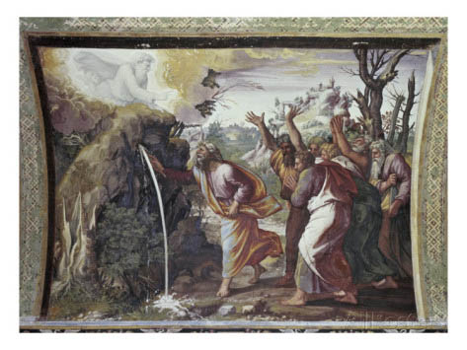
Give Thanks
Then Moses and Aaron gathered the assembly together before the rock, and he said to them, "Hear now, you rebels: shall we bring water for you out of this rock?" And Moses lifted up his hand and struck the rock with his staff twice, and water came out abundantly, and the congregation drank, and their livestock. And the LORD said to Moses and Aaron, "Because you did not believe in me, to uphold me as holy in the eyes of the people of Israel, therefore you shall not bring this assembly into the land that I have given them." These are the waters of Meribah, where the people of Israel quarreled with the LORD, and through them he showed himself holy.,
Numbers 20:10-13
Notes:
Numbers 20:10-13
10 Then Moses and Aaron gathered the assembly together before the rock, and he said to them, "Hear now, you rebels: shall we bring water for you out of this rock?"
11 And Moses lifted up his hand and struck the rock with his staff twice, and water came out abundantly, and the congregation drank, and their livestock.
12 And the LORD said to Moses and Aaron, "Because you did not believe in me, to uphold me as holy in the eyes of the people of Israel, therefore you shall not bring this assembly into the land that I have given them."
13 These are the waters of Meribah, where the people of Israel quarreled with the LORD, and through them he showed himself holy.
This passage provides insight into how good views people who take credit for something he did. Moses had done so much right, but he got puffed up and believed he had something to do with bringing the water out of the rock. Moses couldn’t get water out of a rock any more that you or I could he needed God to accomplish it. If God was displeased with this, how do you think he feels when people behave as if they are responsible for their own salvation?

Slide 12
Give Thanks
He must increase, but I must decrease.
John 3:30
Notes:
We need to remember our place. We are the ones who need help, who are helplessly unable to save ourselves.

