Slide 1
But Simon Peter answered Him, "Lord, to whom shall we go? You have the words of eternal life. (John 6:68)
Words
of
Eternal Life

Slide 2
Romans 8:29-30
For whom He foreknew, He also predestined to be conformed to the image of His Son, that He might be the firstborn among many brethren. Moreover whom He predestined, these He also called; whom He called, these He also justified; and whom He justified, these He also glorified.

Slide 3
“Words of Eternal Life”
Sanctification
Consecration
Redemption
Propitiation / Expiation
Reconciliation
Damnation
Destruction
Foreordination
Predestination
Incarnation
Election
Adoption
Justification
Glorification
SALVATION

Slide 4
Salvation
SOTERIA
“the removal of dangers threatening life, whether physical or spiritual;
deliverance from peril;
divine deliverance from sin and to holiness;
preservation from impending death;
snatch from serious danger.”

Slide 5
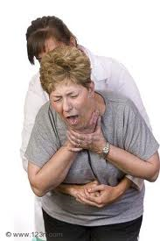

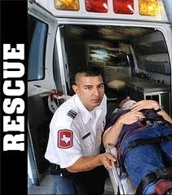
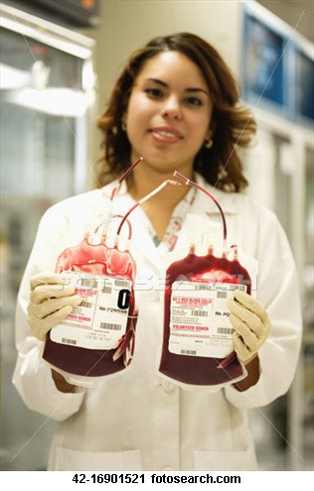
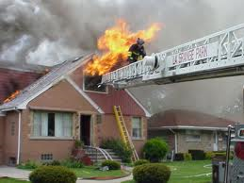
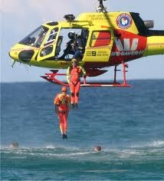
Salvation
Rescued !

Slide 6
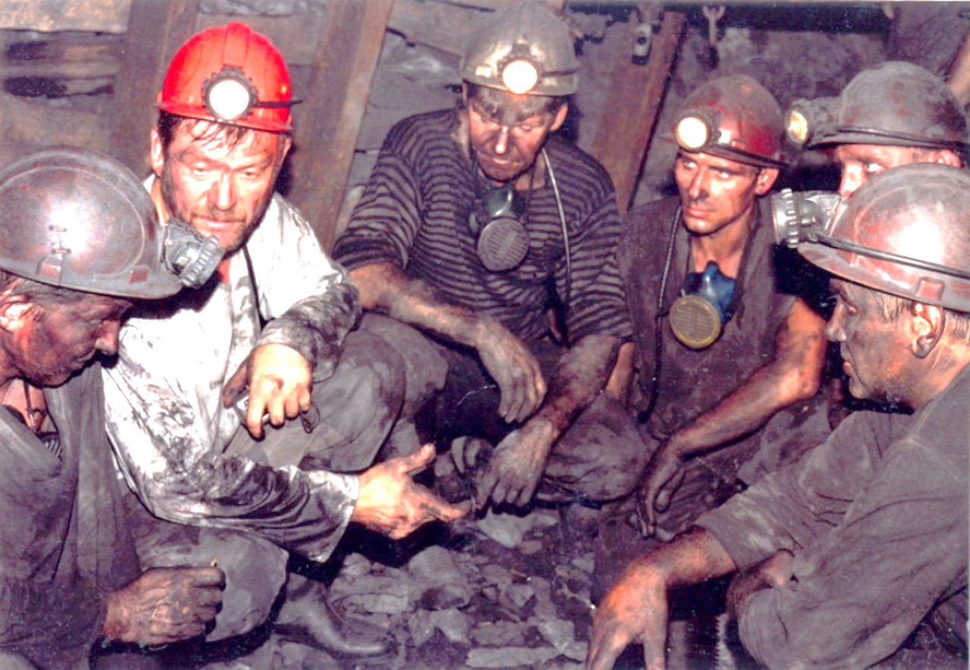
                August 5, 2010 - A collapse of the main ramp into the San Jose mine leaves 33 miners trapped 2,300 feet underground. Emergency officials are unable to communicate with the trapped miners.

Slide 7
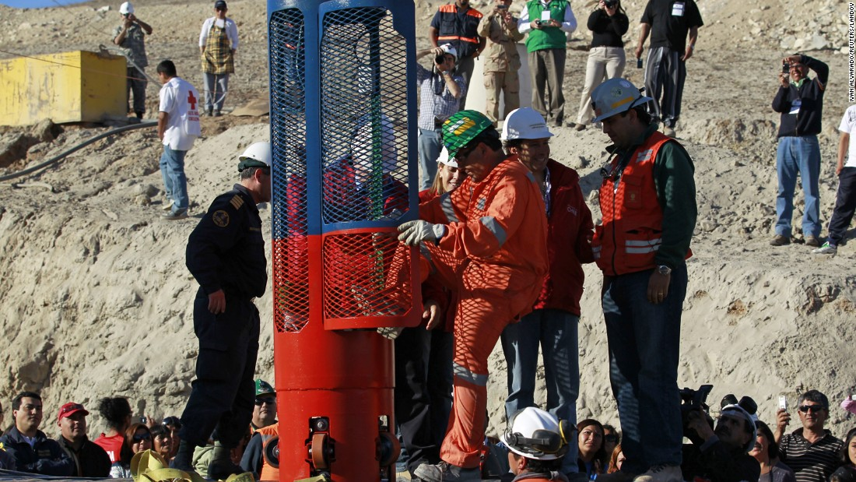
Chili Mine Rescue

Slide 8
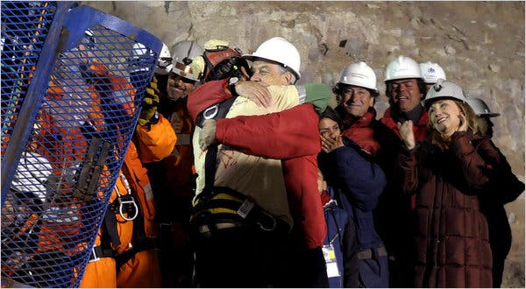
October 13, 2010 - The first miner rescued, Florencio Antonio Avalos Silva, 31, Shift foreman Luis Alberto Urzua Iribarren, 54, is the 33rd and final miner to be rescued, approximately 22 1/2 hours after the rescue operation begins.

Slide 9
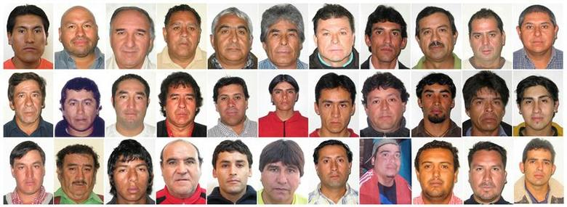
THE 33 RESCUED MINERS

Slide 10
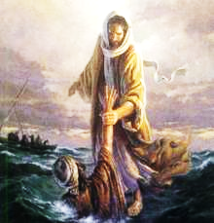
Salvation
Psalm 144:7
“Stretch out Your hand from above; Rescue me and deliver me out of great waters, from the hand of foreigners”

Slide 11
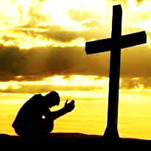
Salvation
1 Timothy 1:15
This is a faithful saying and worthy of all acceptance, that Christ Jesus came into the world to save sinners, of whom I am chief.

Slide 12
David’s Salvation
2 Samuel 22
3 The God of my strength, in whom I will trust; My shield and the horn of my salvation, My stronghold and my refuge; My Savior, You save me from violence.
36 "You have also given me the shield of Your salvation; Your gentleness has made me great.
47 "The LORD lives! Blessed be my Rock! Let God be exalted, The Rock of my salvation!
51 He is the tower of salvation to His king, And shows mercy to His anointed, To David and his descendants forevermore."

Slide 13
David’s Salvation
Psalm 18
To the Chief Musician. A Psalm of David the servant of the LORD, who spoke to the LORD the words of this song on the day that the LORD delivered him from the hand of all his enemies and from the hand of Saul. And he said:
2 The LORD is my rock and my fortress and my deliverer; My God, my strength, in whom I will trust; My shield and the horn of my salvation, my stronghold.
35 You have also given me the shield of Your salvation; Your right hand has held me up, Your gentleness has made me great.
46 The LORD lives! Blessed be my Rock! Let the God of my salvation be exalted.

Slide 14
David’s Salvation
Psalm 51
To the Chief Musician. A Psalm of David when Nathan the prophet went to him, after he had gone in to Bathsheba.
Have mercy upon me, O God, According to Your lovingkindness; According to the multitude of Your tender mercies, Blot out my transgressions.
12 Restore to me the joy of Your salvation, And uphold me by Your generous Spirit.
14 Deliver me from the guilt of bloodshed, O God,
The God of my salvation, And my tongue shall sing aloud of Your righteousness.

Slide 15
Isaiah’s Salvation
Isaiah 12
1 And in that day you will say: "O LORD, I will praise You; Though You were angry with me, Your anger is turned away, and You comfort me.
2 Behold, God is my salvation, I will trust and not be afraid; 'For YAH, the LORD, is my strength and song;
He also has become my salvation.’”
3 Therefore with joy you will draw water From the wells of salvation.

Slide 16
Isaiah’s Messianic Salvation
Isaiah 52
7 How beautiful upon the mountains Are the feet of him who brings good news, Who proclaims peace, Who brings glad tidings of good things, Who proclaims salvation, Who says to Zion, "Your God reigns!"
10 The LORD has made bare His holy arm In the eyes of all the nations; And all the ends of the earth shall see The salvation of our God.

Slide 17
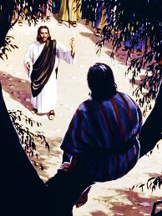
Jesus and Salvation
Luke 19
8 Then Zacchaeus stood and said to the Lord, "Look, Lord, I give half of my goods to the poor; and if I have taken anything from anyone by false accusation,
I restore fourfold."
9 And Jesus said to him, "Today salvation
has come to this house, because he also
is a son of Abraham;
10 "for the Son of Man has come to seek
and to save that which was lost."

Slide 18
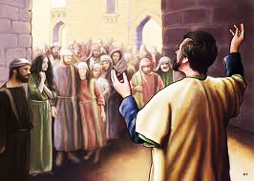
Peter and Salvation
Acts 4
8 Then Peter, filled with the Holy Spirit, said to them, "Rulers of the people and elders of Israel: …
10 "let it be known to you all, and to all the people of Israel, that by the name of Jesus Christ of Nazareth, whom you crucified, whom God raised from the dead, by Him this man stands here before you whole…
12 "Nor is there salvation in any other,
for there is no other name under heaven
given among men by which we must be
saved."

Slide 19
Peter and Salvation
I Peter 1
5 who are kept by the power of God through faith for salvation ready to be revealed in the last time.
9 receiving the end of your faith –
the salvation of your souls.

Slide 20
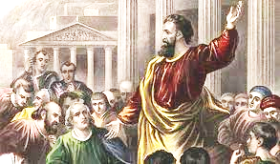
Paul and Salvation (27 x)
Romans
1:16 For I am not ashamed of the gospel of Christ, for it is the power of God to salvation for everyone who believes, for the Jew first and also for the Greek.
10:10 For with the heart one believes unto righteousness, and with the
mouth confession is made unto
salvation.

Slide 21
Paul and Salvation (27 x)
Ephesians 1
3 God …who has blessed us w/ every spiritual blessing
4 He chose us in Him …
5 having predestined us to adoption as sons …
6 He has made us accepted in the Beloved…
7 In Him we have redemption through His blood,
the forgiveness of sins, …

Slide 22
Paul and Salvation (27 x)
Ephesians 1
8 (Grace) which He made to abound toward us …
9 having made known to us the mystery …
10 …He might gather together in one …
11 In Him also we have obtained an inheritance, being
predestined …
12 that we … should be to the praise of His glory.

Slide 23
Paul and Salvation (27 x)
Ephesians 1
13 In Him you also trusted, after you heard the
word of truth, the gospel of your salvation;
in whom also, having believed,
you were sealed with the Holy Spirit of promise,
14 who is the guarantee of our inheritance until
the redemption of the purchased possession,
to the praise of His glory.

Slide 24
Shout It Out !
Revelation
7:10 crying out with a loud voice "Salvation belongs to our God who sits on the throne, and to the Lamb!“
12:10 Then I heard a loud voice saying in heaven, "Now salvation, and strength, and the kingdom of our God, and the power of His Christ have come, for the accuser of our brethren, who accused them before our God day and night, has been cast down.
19:1 After these things I heard a loud voice of a great multitude in heaven, saying, "Alleluia! Salvation and glory and honor and power belong to the Lord our God!

Slide 25
But God
Romans 5:
6 For when we were still without strength, in due time
Christ died for the ungodly.
7 For scarcely for a righteous man will one die; yet perhaps
for a good man someone would even dare to die.
8 But God commendeth his love toward us, in that, while
we were yet sinners, Christ died for us.

Slide 26
But God
1 Corinthians 3:6
I have planted, Apollos watered; but God gave the increase. So then neither is he that planteth any thing, neither he that watereth; but God that giveth the increase.

Slide 27
But God
Ephesians 2
1 And you He made alive, who were dead in trespasses and sins,
2 in which you once walked according to the course of this world, according to the prince of the power of the air, the spirit who now works in the sons of disobedience,
3 among whom also we all once conducted ourselves in the lusts of our flesh, fulfilling the desires of the flesh and of the mind, and were by nature children of wrath, just as the others.
4 But God, who is rich in mercy, because of His great love with which He loved us,
5 even when we were dead in trespasses, made us alive
together with Christ (by grace you have been saved),

Slide 28
Salvation
Matthew 14:30-31
But when he saw that the wind was boisterous, he was afraid; and beginning to sink he cried out, saying, "Lord, save me!" And immediately Jesus stretched out His hand and caught him

Slide 29
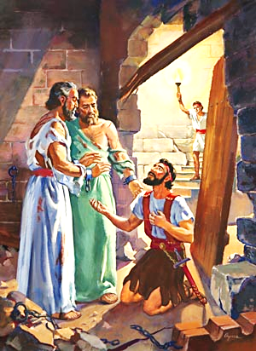
Salvation
Acts 16:30-31
And he brought them out and said, "Sirs, what must I do to be saved?”
So they said,
"Believe on the Lord Jesus Christ, and you will be saved, you and your household."

Slide 30
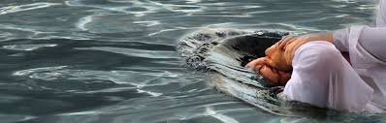
Salvation
Acts 16:32-33
³² Then they spoke the word of the Lord to him and to all who were in his house. ³³ And he took them the same hour of the night and washed their stripes. And immediately he and all his family were baptized.

Slide 31
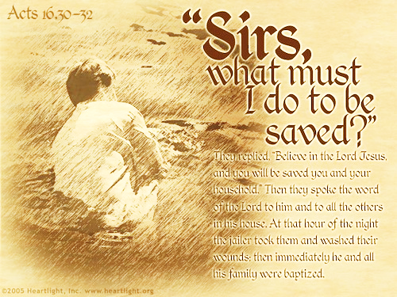
Heard the saving gospel
Believed the saving Lord
Repented of damning sins
Confessed Jesus as Savior
Baptized into Christ’s body
SALVATION

