Slide 1
REDEEMED
How I LOVE TO
PROCLAIM IT
R
E
D
E
M
P
T
I
O
N

Slide 2
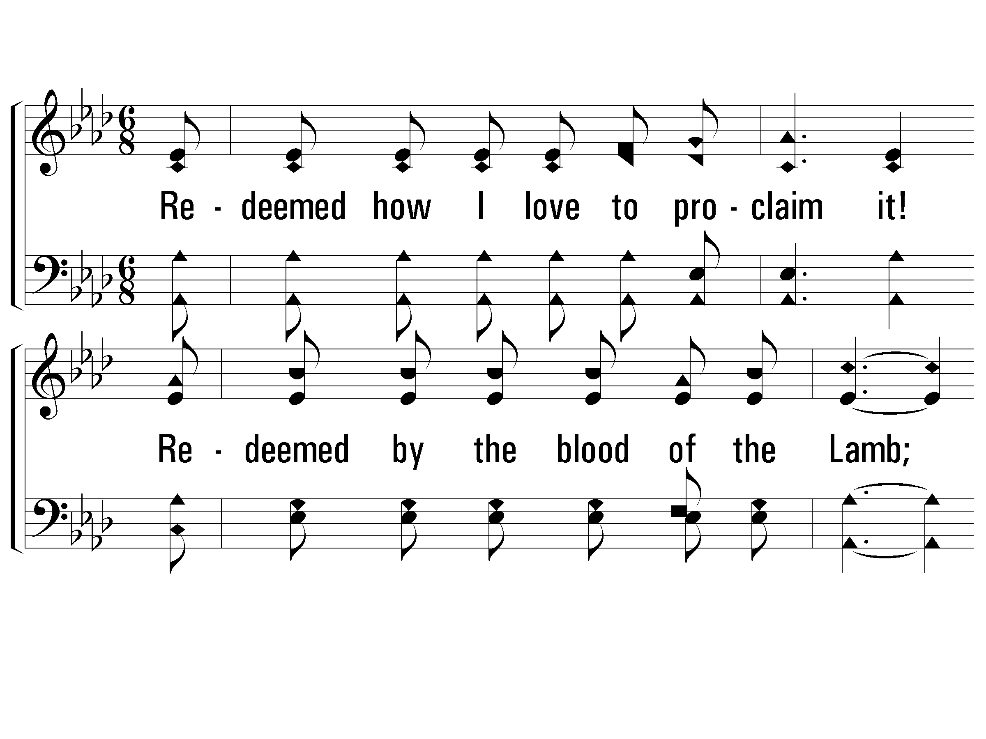
1 - Redeemed
1.
Redeemed how I love to proclaim it!
Redeemed by the blood of the Lamb;
Redeemed thru His infinite mercy,
His child, and forever, I am.
Words by: Fanny J. Crosby
Music by: William J. Kirkpatrick
© 2001 The Paperless Hymnal™

Slide 3
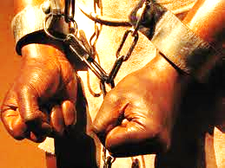
SLAVERY – bondage of Sin
Slaves:

Slide 4

Redeemed
apolutrosis, ap-ol-oo'-tro-sis
(the act) ransom paid in full,
i.e. (figuratively) riddance, or (specially) Christian salvation:--deliverance, redemption.

Slide 5
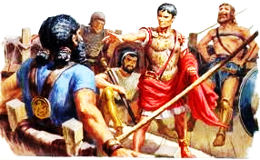
Redeemed
When ransom means "payment", the word comes via Old French rançon from Latin redemptio = "buying back” - Encyclopedia Britannica
Julius Caesar: captured by pirates, demanded 20 talents (he insisted he was worth 50 talent) - Plutarch’s Lives of Caesars

Slide 6

PAID IN FULL
Not just cancel debt
But “Paid in Full”
Amount To Relieve Debt

Slide 7
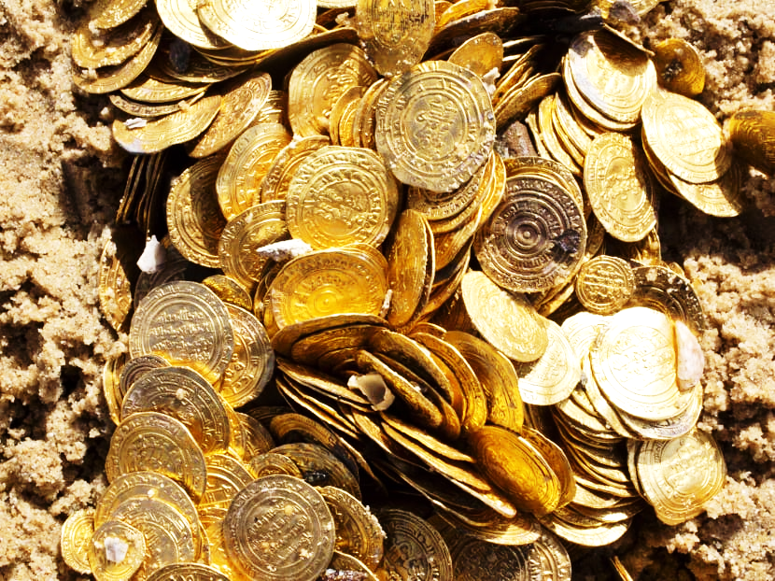
Payment: not with gold
1 Peter 1:18
“knowing that you were not redeemed with corruptible things, like silver or gold, from your aimless conduct received by tradition from your fathers…”

Slide 8
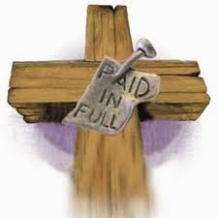
Payment: but with blood
1 Peter 1:19 … but with the precious blood of Christ, as of a lamb without blemish and without spot.

Slide 9
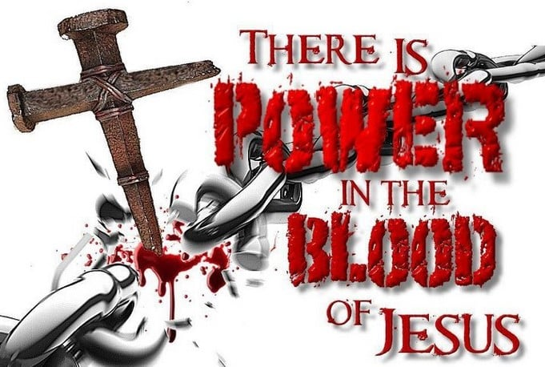
Acts 20:28
"Therefore take heed to yourselves and to all the flock, among which the Holy Spirit has made you overseers, to shepherd the church of God (ie. Jesus) which He purchased with His own blood.

Slide 10
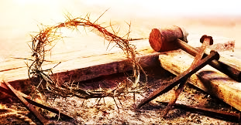
I Corinth. 6:19-20
“Or do you not know that your body is the temple of the Holy Spirit who is in you, whom you have from God, and you are not your own? For you were bought at a price; therefore glorify God in your body and in your spirit, which are God's”

Slide 11
Galatians 3:13
“Christ has redeemed us from the curse of the law, having become a curse for us (for it is written, "Cursed is everyone who hangs on a tree")”
Law said we were SLAVES OF SIN !

Slide 12

Galatians 4:4-5
“But when the fullness of the time had come, God sent forth His Son, born of a woman, born under the law, to redeem those who were under the law, that we might receive the adoption as sons.

Slide 13
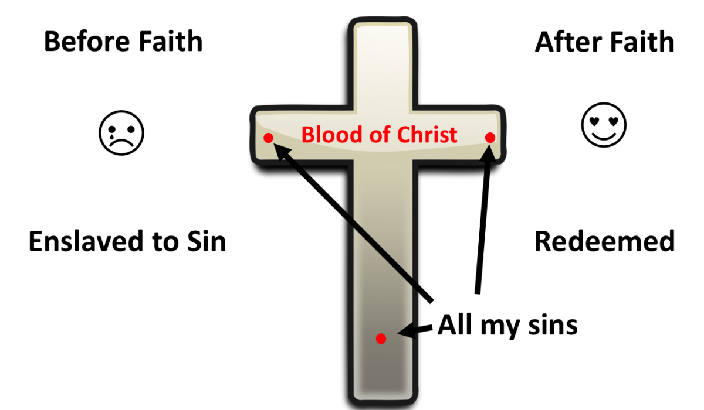
Eph 1:7 / Col 1:14
“In Him we have redemption through His blood, the forgiveness of sins
“in whom we have redemption through His blood, the forgiveness of sins”

Slide 14

I Timothy 2:5-6
“For there is one God and one Mediator between God and men, the Man Christ Jesus, who gave Himself a ransom for all, to be testified in due time”

Slide 15
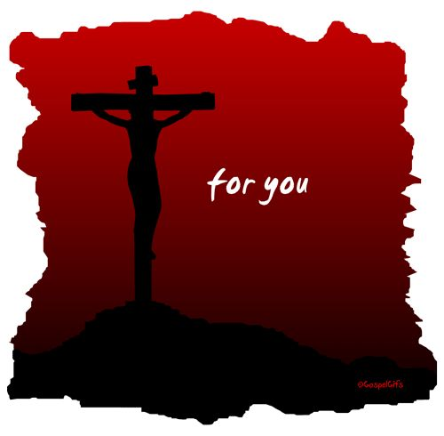
Titus 2:11-14
11 “For the grace of God that
brings salvation has appeared
to all men,…
14 who gave Himself for us,
that He might redeem us from
every lawless deed and purify
for Himself His own special people,
zealous for good works.

Slide 16
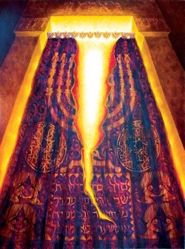
Hebrews 9:12
“Not with the blood of goats and calves, but with His own blood He entered the Most Holy Place once for all, having obtained eternal redemption.

Slide 17
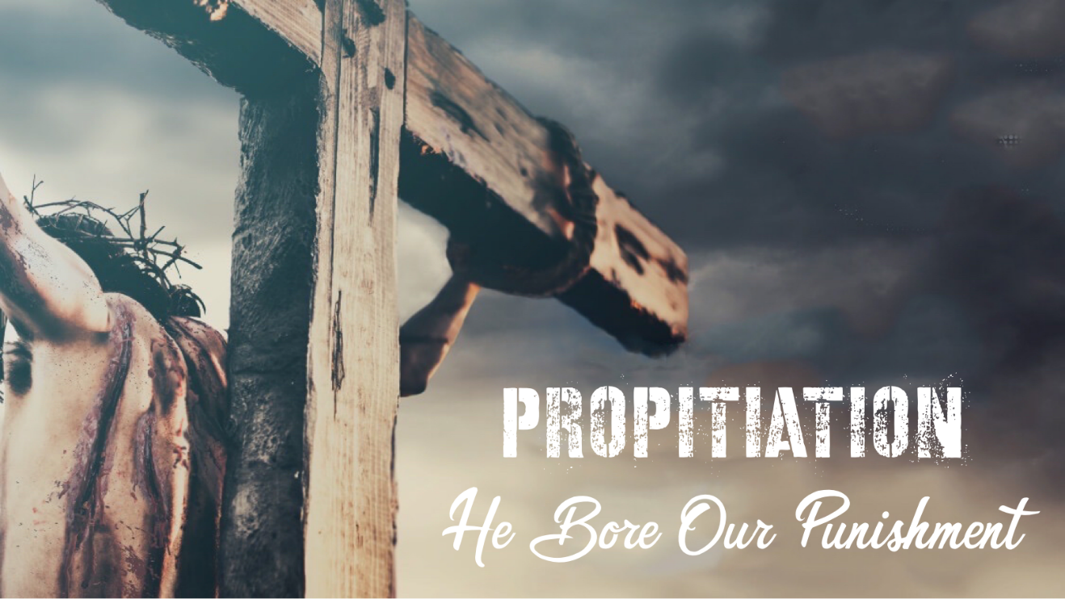
Jesus paid by blood
Rom. 3:23 for all have sinned and fall short of the glory of God,
24 being justified freely by His grace through the redemption that is in Christ Jesus,
25 whom God set forth as a propitiation by His blood

Slide 18
Jesus paid by blood
Eph 1:7 In Him we have redemption through His blood, the forgiveness of sins, according to the riches of His grace
Col 1:13-14 He has delivered us from the power of darkness and conveyed us into the kingdom of the Son of His love, in whom we have redemption through His blood, the forgiveness of sins.

Slide 19
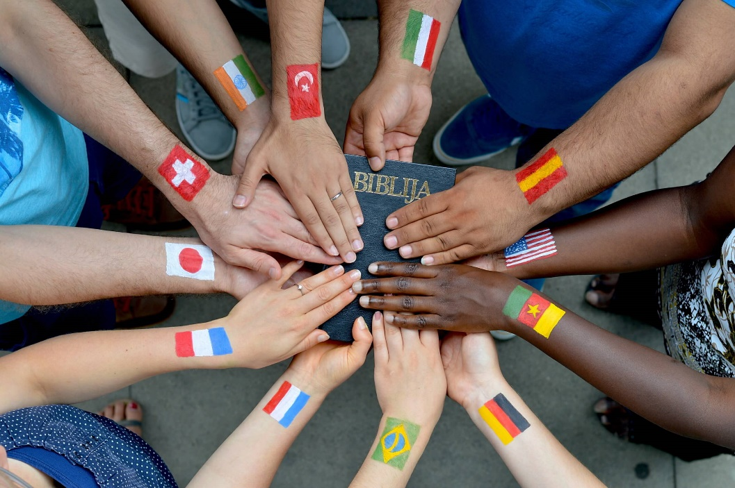
redeemed by blood
Rev. 5:9 And they sang a new song, saying: "You are worthy to take the scroll, and to open its seals; for You were slain, and have redeemed us to God by Your blood out of every tribe and tongue and people and nation

Slide 20
blood: Eternal Redemption
Heb 9:12
Not with the blood of goats and calves, but with His own blood He entered the Most Holy Place once for all, having obtained eternal redemption.
FOREVER

Slide 21

Singing redemption’s sweet song
Rev. 14:3 They sang as it were a new song before the throne, before the four living creatures, and the elders; and no one could learn that song except the hundred and forty-four thousand who were redeemed from the earth.

Slide 22
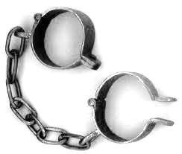
Slaves set free
Rom. 6:17 But God be thanked that though you were slaves of sin, yet you obeyed from the heart that form of doctrine to which you were delivered. 18 And having been set free from sin, you became slaves of righteousness.

Slide 23
Slaves – Freed
Rom. 6:6 knowing this, that our old man was
crucified with Him, that the body of sin might
be done away with, that we should no longer be
slaves of sin.
7 For he who has died has been
freed from sin.

Slide 24
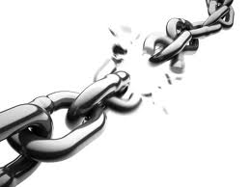
RANSOM - FREED
Gal 5:1 Stand fast therefore in the liberty by which Christ has made us free, and do not be entangled again with a yoke of bondage.
Live Free

