Slide 1
See
Reflect
Learn
Proverbs 24:30-32

Slide 2
See, Reflect, Learn
I passed by the field of a sluggard, by the vineyard of a man lacking sense, and behold, it was all overgrown with thorns; the ground was covered with nettles, and its stone wall was broken down.
Proverbs 24:30-31

Slide 3

See, Reflect, Learn

Slide 4
See, Reflect, Learn
I passed by the field of a sluggard, by the vineyard of a man lacking sense, and behold, it was all overgrown with thorns; the ground was covered with nettles, and its stone wall was broken down. Then I saw and considered it; I looked and received instruction.
Proverbs 24:30-32

Slide 5
See, Reflect, Learn
I passed by the field of a sluggard, by the vineyard of a man lacking sense, and behold, it was all overgrown with thorns; the ground was covered with nettles, and its stone wall was broken down. Then I saw and considered it; I looked and received instruction. A little sleep, a little slumber, a little folding of the hands to rest, and poverty will come upon you like a robber, and want like an armed man.
Proverbs 24:30-34
Saw the uncared-for field and vineyard
Thought about what he saw
Made application to his life

Slide 6
See, Reflect, Learn
We should look for insights from everyday events
  For his invisible attributes, namely, his eternal power and divine nature, have been clearly perceived, ever since the creation of the world, in the things that have been made. So they are without excuse.
  Romans 1:20
  Jesus used parables
    Luke 10:25-37 – Parable of the Good Samaritan
    Luke 13:6-9 – Parable of the Fig Tree
  Nathan used a parable to expose David’s sin - II Samuel 12:1-7
Notes:
Matthew 6:9-13 – The Model Prayer includes the recognition that God’s will comes before our own.

Slide 7
See, Reflect, Learn
We can learn from the experiences of others
  Now these things happened to them as an example, but they were written down for our instruction, on whom the end of the ages has come.
  I Corinthians 10:11
  Old Testament examples
    Numbers 22-24 – Hinderances can make us stop and consider actions
    Esther 4:12-14 – Difficulties are a test for us
Notes:
Matthew 6:9-13 – The Model Prayer includes the recognition that God’s will comes before our own.

Slide 8
See, Reflect, Learn
Need to look at, reflect on and make adjustments to our lives
  Examine yourselves, to see whether you are in the faith. Test yourselves. Or do you not realize this about yourselves, that Jesus Christ is in you?--unless indeed you fail to meet the test!
  II Corinthians 13:5
  Things we need to consider
    James 1:23-25 – Are we slothful in doing God’s will?
    Galatians 6:3-5 – Do we think we are something we are not?
    Matthew 7:3-5 – Do we see faults in others and not in ourselves?
    II Corinthians 10:12 – Are we comparing ourselves to others or to God’s will?
Notes:
Matthew 6:9-13 – The Model Prayer includes the recognition that God’s will comes before our own.

Slide 9
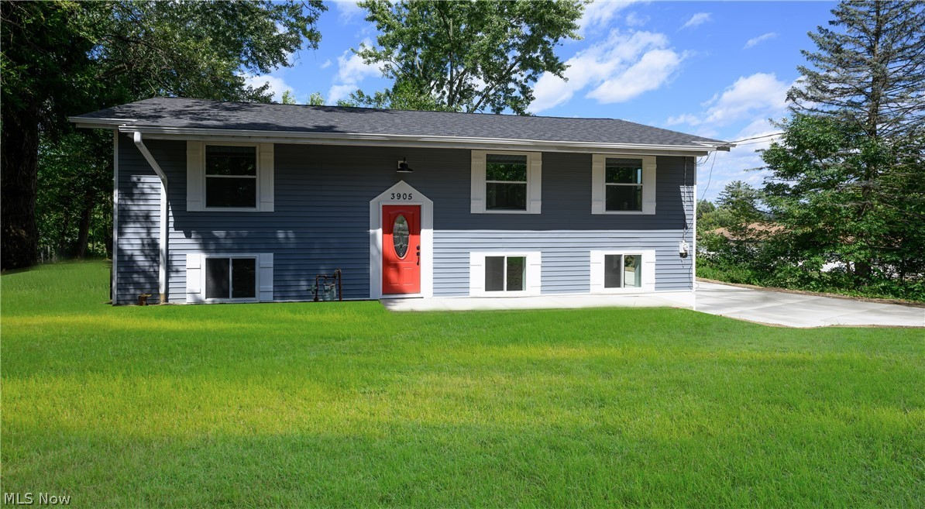
See, Reflect, Learn

