Slide 1
attitudes

Slide 2
Definition of attitude
A predisposition or a tendency to respond positively or negatively toward a certain idea, person or situation
The way in which a person views and evaluates something or someone
A person’s attitude influences what the say, what the think and what they do

Slide 3
4 attitudes important to this congregation
Our attitude toward God
Our attitude about Ourselves
Our attitude toward the other Brethren
Our attitude toward the Work of the Church

Slide 4
Attitudes toward god
Bad Attitudes
Entitlement – The belief that one is inherently deserving of privileges or special treatment
  Examples
    The Jews (John 8:33)
    9 Lepers (Luke 17:11-19)
Who has first given to me, that I should repay him? Whatever is under the whole heaven is mine.
Job 41:11
For by grace you have been saved through faith. And this is not your own doing; it is the gift of God, not a result of works, so that no one may boast.
Ephesians 2:8-9

Slide 5
Attitudes toward god
Bad Attitudes
Complacency – a feeling of smug or uncritical satisfaction with oneself or one’s achievements
  Examples
    The Pharisee (Luke 18:10-14)
    Moses (Numbers 20:8-12)
I know your works: you are neither cold nor hot. Would that you were either cold or hot! So, because you are lukewarm, and neither hot nor cold, I will spit you out of my mouth. For you say, I am rich, I have prospered, and I need nothing, not realizing that you are wretched, pitiable, poor, blind, and naked.
Revelation 3:15-17

Slide 6
Attitudes toward god
Good Attitudes
Love – Unconditional, selfless, focused on serving, willing to sacrifice
  I Corinthians 13:4-7 – Put God before self
  Examples
    Daniel (Daniel 6)
    Shadrach, Meshach, and Abendigo (Daniel 3)
    Joshua (Joshua 24:14-15)
And he said to him, You shall love the Lord your God with all your heart and with all your soul and with all your mind. This is the great and first commandment.
Matthew 22:37-38

Slide 7
Attitudes toward god
Good Attitudes
Thankfulness – Conscious of benefit received
  Examples
    David (Psalm 100:4-5)
    Samaritan Leper (Luke 17:12-16)
    Paul (Philippians 1:3-5)
And whatever you do, in word or deed, do everything in the name of the Lord Jesus, giving thanks to God the Father through him.
Colossians 3:17
giving thanks always and for everything to God the Father in the name of our Lord Jesus Christ,
Ephesians 5:20

Slide 8
Attitudes toward god
Good Attitudes
Trust – Assured reliance on the character, ability, strength and truth of someone
  Examples
    Abraham (Genesis 22:1-19)
    David (I Samuel 17:37)
    Paul (II Timothy 4:6-8)
Commit your way to the LORD; trust in him, and he will act.
Psalm 37:5
Behold, God is my salvation; I will trust, and will not be afraid; for the LORD GOD is my strength and my song, and he has become my salvation.
Isaiah 12:2
Notes:
Abraham: Genesis 22:8 Abraham said, "God will provide for himself the lamb for a burnt offering, my son." So they went both of them together.

Slide 9
Trust god
But when the archangel Michael, contending with the devil, was disputing about the body of Moses, he did not presume to pronounce a blasphemous judgment, but said, "The Lord rebuke you."
Jude 9
Who is archangel Michael?
Where did he come from?
How is he different from other angels?
Why was he disputing with the devil about the body of Moses?
In him we have obtained an inheritance, having been predestined according to the purpose of him who works all things according to the counsel of his will,
Ephesians 1:11
God is in control

Slide 10
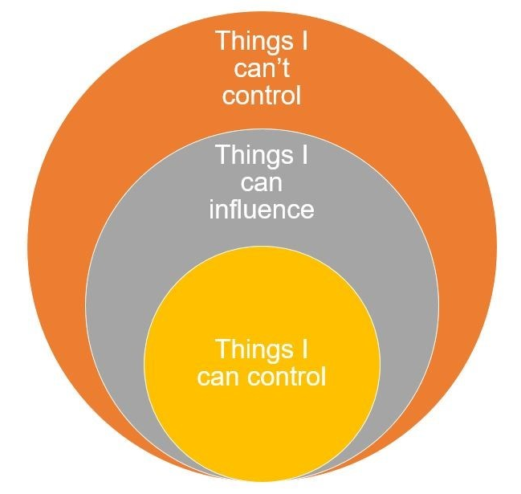
Trust god
When I am afraid, I put my trust in you. In God, whose word I praise, in God I trust; I shall not be afraid. What can flesh do to me?
Psalm 56:3-4
Do not be anxious about anything, but in everything by prayer and supplication with thanksgiving let your requests be made known to God. And the peace of God, which surpasses all understanding, will guard your hearts and your minds in Christ Jesus.
Philippians 4:6-7
Things in our control
What we say
What we do
What we think
Our attitude

