Slide 1
Being a Light to the World
Matthew 5:14-16

Slide 2
I Corinthians 5:11-13
Judging those inside the Church
  The context is a brother who was guilty of having his father’s wife
  Paul is telling them they need to point out the sinful behavior and condemn it
  For if, after they have escaped the defilements of the world through the knowledge of our Lord and Savior Jesus Christ, they are again entangled in them and overcome, the last state has become worse for them than the first. For it would have been better for them never to have known the way of righteousness than after knowing it to turn back from the holy commandment delivered to them.
  II Peter 2:20-21

Slide 3
I Corinthians 5:11-13
Judging those outside the Church
  Paul says they are not ours to judge, God will judge them
  We have a different responsibility to those outside the Church
  And he said to them, Go into all the world and proclaim the gospel to the whole creation.
  Mark 16:15

Slide 4
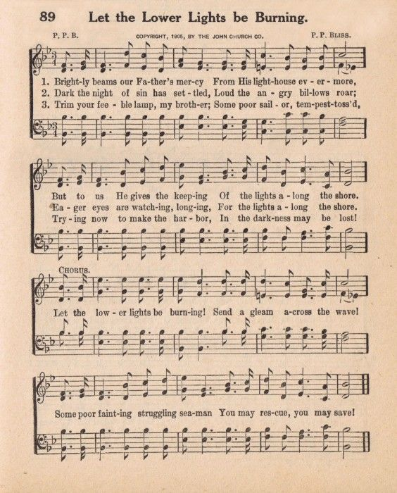
Let the Lower Lights Be Burning
John 8:12
  Jesus is the light that can lead us out of the darkness of sin
Matthew 5:14-16
  Our job is to lead people to Jesus

Slide 5
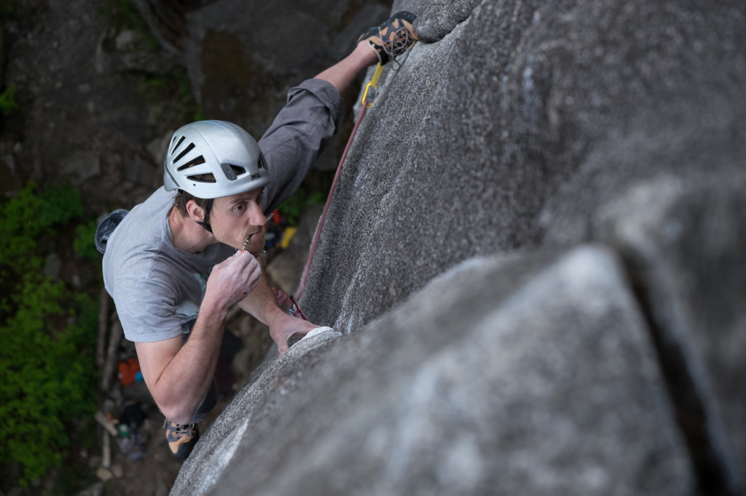
The Crux
The most important point

Slide 6
Examples
Samaritan woman – John 4:4-26
  She had had 5 husbands – verse 18
  Jesus spends his time talking about spiritual things
Philip and the Eunuch – Acts 8:26-39
  The Eunuch asked “See, here is water; what doth hinder me to be baptized?”
  Answer: If thou believest with all thine heart, thou mayest.

Slide 7
Examples
Paul and the Athenians – Acts 17:22-34
  Paul pointed out their worship of “The Unknown God”– verse 23
  He didn’t preach to them about the sin of idol worship, he preached to them about God

Slide 8
Examples
I Corinthians 10:31-32
  So, whether you eat or drink, or whatever you do, do all to the glory of God. Give no offense to Jews or to Greeks or to the church of God, just as I try to please everyone in everything I do, not seeking my own advantage, but that of many, that they may be saved.
II Corinthians 6:3
  We put no obstacle in anyone's way, so that no fault may be found with our ministry,

