Slide 1

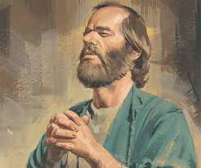

Paul’s Magnum Opus
Epistle of Romans

Slide 2
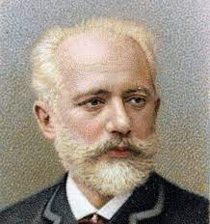


Tchaikovsky’s 1812 Overture

Slide 3
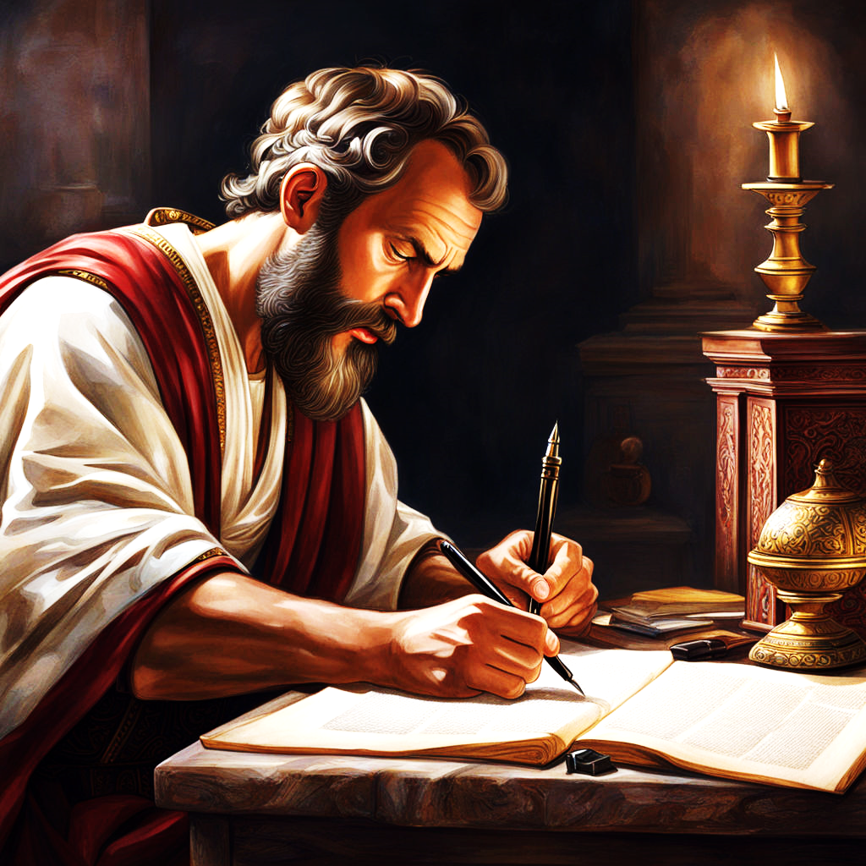
Paul’s 57 Overture
Romans

Slide 4

Romans 8 – The Finale

Slide 5
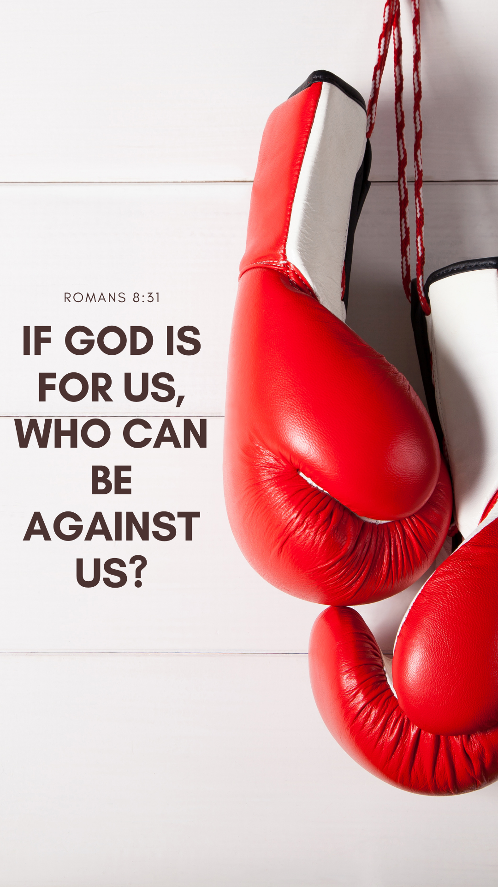
Romans 8:31-39
12 Questions
Every Saint Must Answer

Slide 6
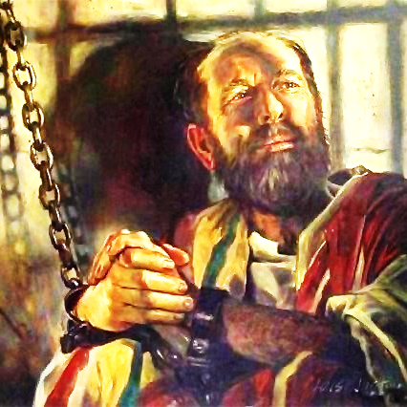
Paul & Me
If this man could talk to us today
Ask 12 Questions
Answer me!

Slide 7

12 Critical Questions
Romans 8:31-34
What then shall we say to these things ?
Who can be against us (if God is for us)?
How shall He not with Christ freely give us all things?
Who shall bring a charge against God’s elect?
Who is he who condemns?

Slide 8

12 Critical Questions
Romans 8:35-39
Who shall separate us from the love of Christ? _______
6. Shall Tribulation ?
7. Shall Distress ?
8. Shall Persecution ?
9 Shall Famine ?
10 Shall Nakedness ?
11 Shall Perils ?
12 Shall Sword ?

Slide 9
“What shall we say to these things?”
Q1
Sufferings As A Saint
“If we suffer with Him, we will be glorified with Him” (v.17)
“The sufferings of this present time are not to be compared with the glory to be revealed in us” (v.18)
“We eagerly wait for the revealing of the sons of God” (v.19)
“We will be delivered from this bondage of corruption into the glorious liberty of the children of God” (v.21)
“We eagerly wait for the adoption and redemption of our body” (v.22-23)
“We eagerly wait for our fulfilled hope with perseverance” (v.24-25)
No Condemnation!

Slide 10
“What shall we say to these things?”
Sufferings As A Saint
“The Holy Spirit will help us in our weaknesses”
(v.26-27)
“All these things (sufferings) work together for our good according to the purpose of God” (v.28)
“God foreknew, predestined, called, justified and will soon glorify all suffering saints” (v.29-30)

Slide 11
“If God is for us, who can be against us?”
Q2
God Is Our Protector
“God is FOR us!”
If the LORD delights in us, then He will bring us into this land and give it to us, … their protection has departed from them, and the LORD is with us. Do not fear them.”
Num. 14:8-9
Wherever you hear the sound of the trumpet, rally to us there.
Our God will fight for us.” Neh. 4:20
"O LORD God of our fathers, are You not God in heaven, and do You not rule over all the kingdoms of the nations, and in Your hand is there not power and might, so that no one is able to withstand You? … but our eyes are upon You.”
(2 Chron. 20:6,12)

Slide 12
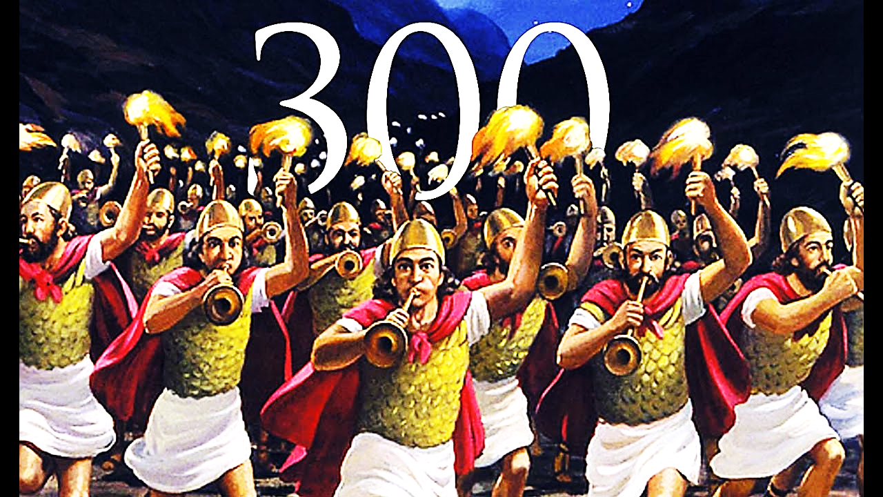
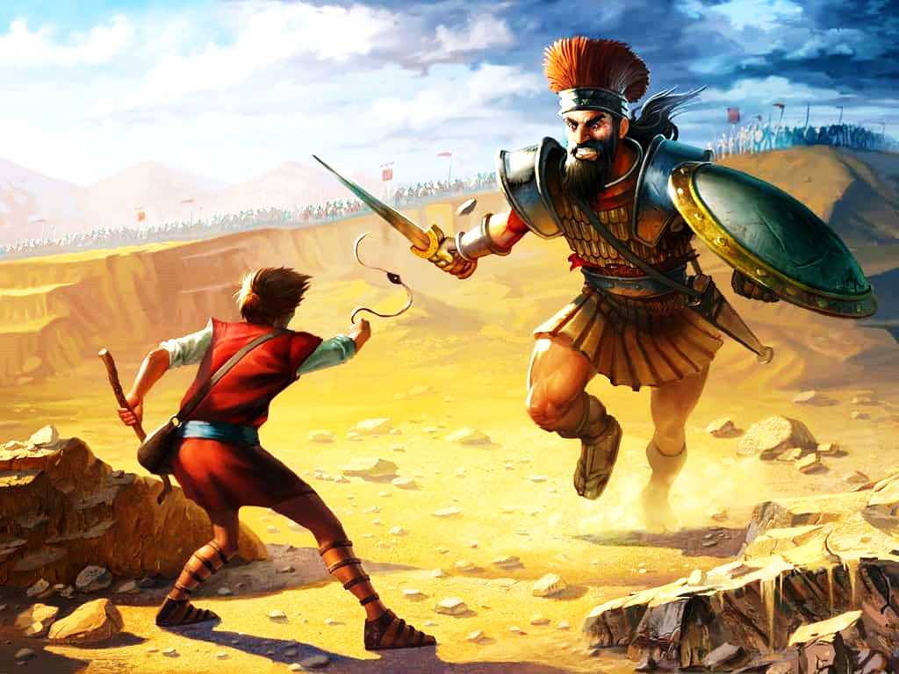
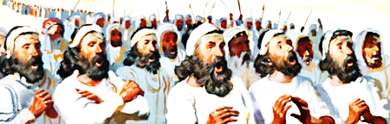
“If God is for us, who can be against us?”
When God takes sides…

Slide 13
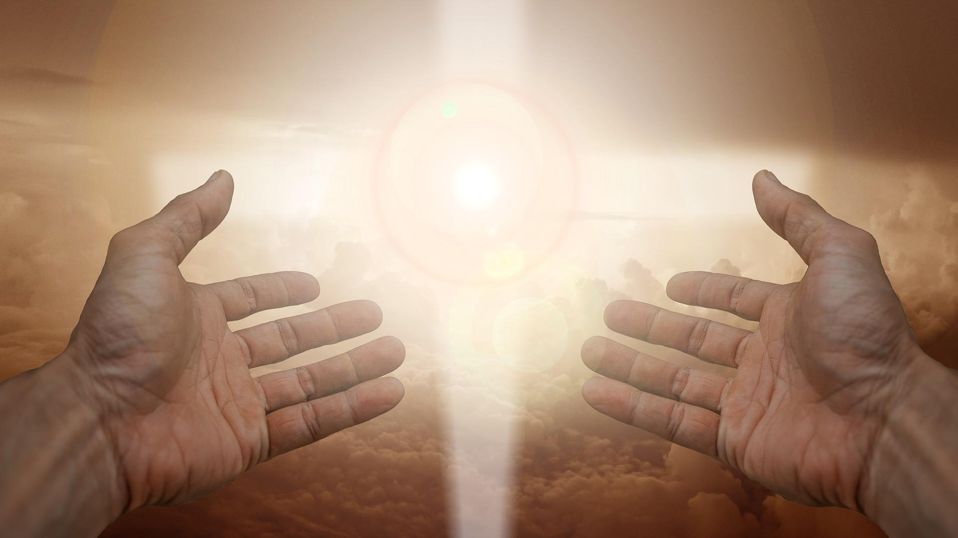
“How shall He not freely give us all things?”
Q3
“Blessed be the God and Father of our Lord Jesus Christ, who has given us every spiritual blessing in the heavenly places, in Christ” Eph. 1:3

Slide 14
“How shall He not freely give us all things?”
Greater to the Lesser
If own Son … then:
1) Spirit’s intercession (Rom 8:26-27)
2) Armor of God (Eph 6:10-17)
3) Fruit of the Spirit (Gal 5:22-23)
4) Every spiritual blessing (Eph 1:3-14)
5) Every good and perfect gift (Jam 1:17)
6) All things to life and godliness (2 Pet 1:3-11)
7) Escape from every temptation (I Cor 10:13)
8) Wisdom as needed (Jam 1:5-8)
He who did not spare His own Son, but delivered Him up for us all…”

Slide 15
“Who shall bring a charge against God’s elect?”
Q4
God is our Defender
Isaiah 50:6-9
6 I gave My back to those who struck Me, And My cheeks to those who
plucked out the beard; I did not hide My face from shame and spitting.
7 "For the Lord GOD will help Me; Therefore I will not be disgraced; Therefore
I have set My face like a flint, And I know that I will not be ashamed.
8 He is near who justifies Me; Who will contend with Me? Let us stand
together. Who is My adversary? Let him come near Me.
9 Surely the Lord GOD will help Me; Who is he who will condemn Me? Indeed
they will all grow old like a garment; The moth will eat them up.
Lk 18:7 And shall God not avenge His own elect who cry out day and night to Him,
though He bears long with them? I tell you that He will avenge them speedily.

Slide 16
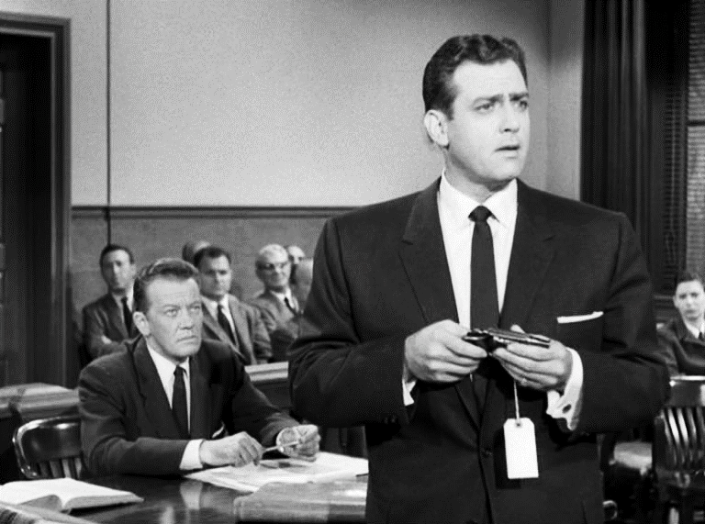
“Who shall bring a charge against God’s elect?”
Perry Mason vs. Hamilton Burger
Jesus Christ vs. Satan, Principalities, Heavenly Powers
“My little children, these things I write to you, so that you may not sin. And if anyone sins, we have an Advocate with the Father, Jesus Christ the righteous. And He Himself is the propitiation for our sins, and not for ours only but also for the whole world.” (I John 2:1-2)

Slide 17
“Who is he who condemns?”
Q5
Christ died, arose, reigns, intercedes for me!
No October Surprise to fear
Hebrews 7:25-26 Our Defense Attorney, Judge & Jury
“Therefore He is also able to save to the uttermost those who come to God through Him, since He always lives to make intercession for them. For such a High Priest was fitting for us, who is holy, harmless, undefiled, separate from sinners, and has become higher than the heavens”

Slide 18

“Who is he who condemns?”
John Bunyan’s Pilgrim’s Progress
Apollyon: “You, Christian, committed this sin, and this sin, and this sin, and this sin! You are not deserving of grace and mercy, but only death!”
Christian: “All this is true. And much more you have left out. I am guilty of all my sins. But the Prince whom I serve and honor is merciful and ready to forgive. I have now obtained pardon from my Prince.”

Slide 19

“Who shall separate us from the love of Christ?”
7 Samples of possible Separators
(via rhetorical questions)
No Separation!

Slide 20
“Who shall separate us from the love of Christ ?”
Q6
Ephesians 3:18-19
“That you may be able to comprehend with all the saints what is the width and length and depth and height—
to know the love of Christ which passes knowledge”

Slide 21

“Who shall separate us from the love of Christ?”
Q6
Shall TRIBULATION?
THLIPSIS – “pressure; pressing together; affliction”
This…
Ephesus: “you have left your first love” (Rev. 2:4)
Sardis: “you are dead” (Rev. 3:1)
Thyatira: “you are lukewarm” (Rev. 3:16)
OR…
Smyrna: “you will have tribulation 10 days, be faithful” (Rev 2:10)
Philadelphia: “you kept My command to persevere” (Rev. 3:10)

Slide 22
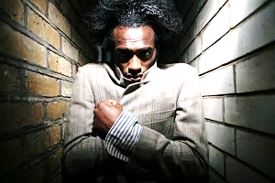
“Who shall separate us from the love of Christ?”
Q7
Shall DISTRESS?
STENOCHORIA – “narrowness; narrow room”
a squeezing of your spirit and emotions
“in stripes above measure, in prisons more frequently, in deaths often. From the Jews five times I received forty stripes minus one. Three times I was beaten with rods; once I was stoned; three times I was shipwrecked; a night and a day I have been in the deep” (2 Cor. 11:23-25)
“Therefore I take pleasure in infirmities, in reproaches, in needs, in persecutions, in distresses, for Christ's sake. For when I am weak, then I am strong.” (2 Cor. 12:10)

Slide 23
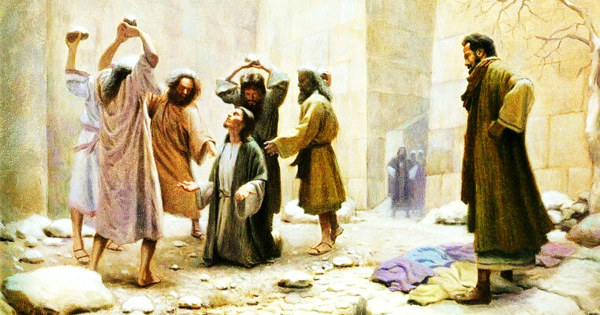
“Who shall separate us from the love of Christ?”
Q8
Shall PERSECUTION?
DIOGMOS – “threatened with harm”
"yet he has no root in himself, but endures only for a while. For when tribulation or persecution arises because of the word, immediately he stumbles.” (Matt. 13:21 – Stony ground)
“We are bound to thank God always for you, brethren, as it is fitting, because your faith grows exceedingly, and the love of every one of you all abounds toward each other, so that we ourselves boast of you among the churches of God for your patience and faith in all your persecutions and tribulations that you endure, … that you may be counted worthy of the kingdom of God, for which you also suffer” (2 Thess. 1:3-5)

Slide 24
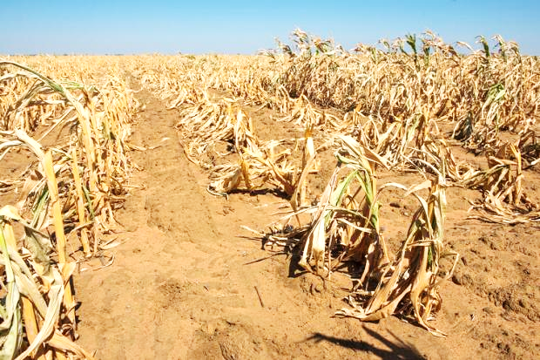
“Who shall separate us from the love of Christ?”
Q9
Shall FAMINE?
LIMOS – “hunger; scarcity of harvest”
"in weariness and toil, in sleeplessness often, in hunger and thirst, in fastings often, in cold and nakedness—” (2 Cor. 11:27)
“Then one of them, named Agabus, stood up and showed by the Spirit that there was going to be a great famine throughout all the world, which also happened in the days of Claudius Caesar. Then the disciples, each according to his ability, determined to send relief to the brethren dwelling in Judea.”
(Acts 11:28-29)

Slide 25
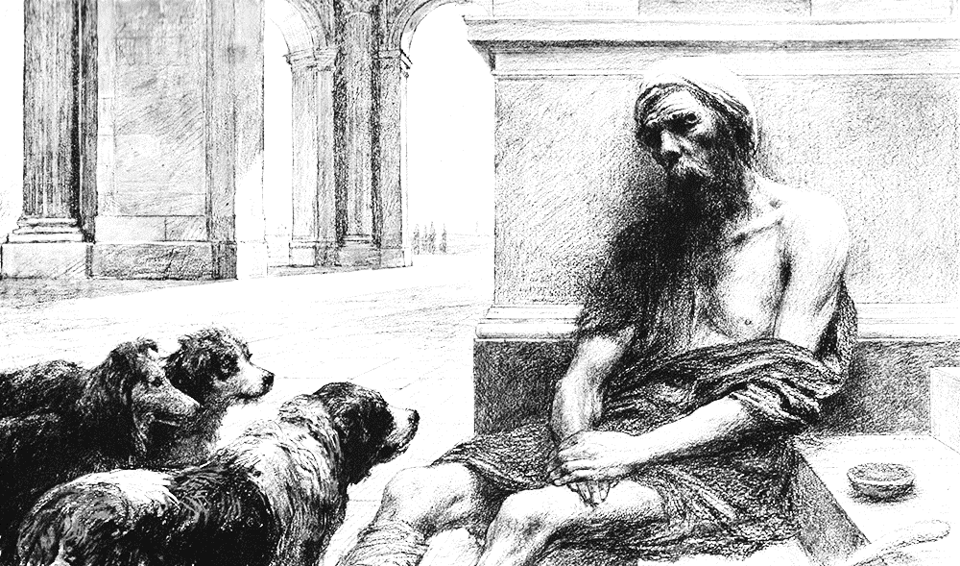
“Who shall separate us from the love of Christ?”
Q10
Shall NAKEDNESS?
GYMNOTES – “without clothes; nudity”
"in weariness and toil, in sleeplessness often, in hunger and thirst, in fastings often, in cold and nakedness” (2 Cor. 11:27)
Laodicea: "I counsel you to buy from Me gold refined in the fire, that you may be rich; and white garments, that you may be clothed, that the shame of your nakedness may not be revealed; and anoint your eyes with eye salve, that you may see.” (Rev. 3:18)

Slide 26
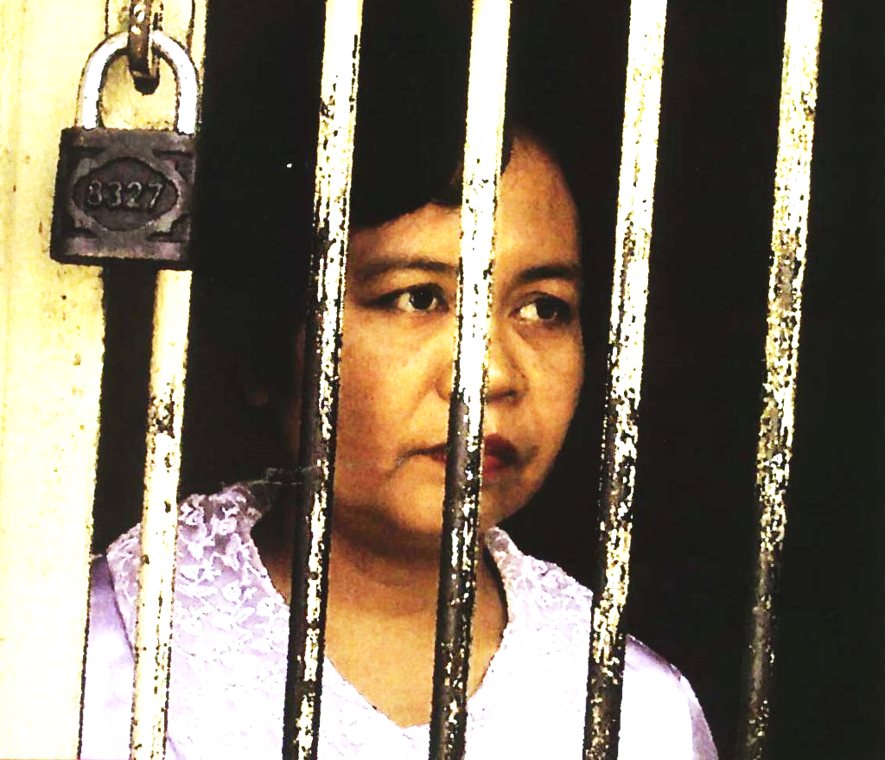
“Who shall separate us from the love of Christ?”
Q11
Shall PERILS?
KINDYNOS – “danger; peril”
"For we do not wrestle against flesh and blood, but against principalities, against powers, against the rulers of the darkness of this age, against spiritual hosts of wickedness in the heavenly places.” (Eph. 6:12)
“Having disarmed principalities and powers, He made a public spectacle of them, triumphing over them in it.” (Col. 2:15)

Slide 27

“Who shall separate us from the love of Christ?”
Shall PERILS?
"in perils of waters,
in perils of robbers,
in perils of my own countrymen,
in perils of the Gentiles,
in perils in the city,
in perils in the wilderness,
in perils in the sea,
in perils among false brethren”
(2 Cor. 11:26)
No Separation!

Slide 28
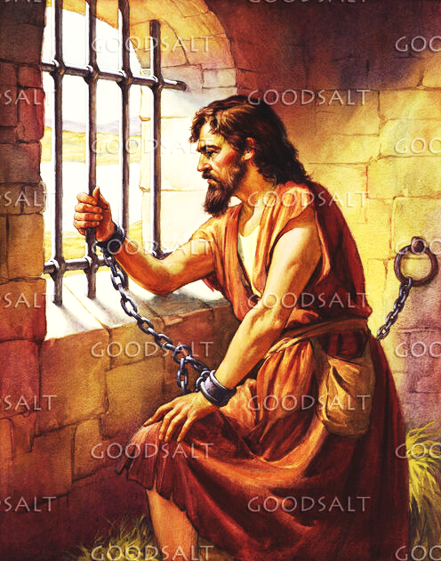
“Who shall separate us from the love of Christ?”
Q12
Shall SWORD?
“Immediately the king sent an executioner and commanded his head to be brought. And he went and beheaded him in prison” (Mark. 6:27)
“Then he killed James the brother of John with the sword”
(Acts 12:2)

Slide 29
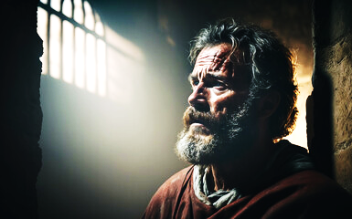
“Who shall separate us from the love of Christ?”
Shall SWORD?
“And I say to you, My friends, do not be afraid of those who kill the body, and after that have no more that they can do. But I will show you whom you should fear: Fear Him who, after He has killed, has power to cast into hell; yes, I say to you, fear Him!” (Luke 12:4-5)
“And what more shall I say? For the time would fail me to tell of …who quenched the violence of fire, escaped the edge of the sword, out of weakness were made strong, … They were stoned, they were sawn in two, were tempted, were slain with the sword.” (Hebrews 11:32-39)
No Separation!

Slide 30
Finale
8:36-39

Slide 31

I’m persuaded neither:
Death (Boom!)
Life (Boom!)
Angels (Boom!)
Principalities (Boom!)
Powers (Boom!)
Present (Boom!)
Future (Boom!)
Height (Boom!)
Depth (Boom!)
Any Created Thing (Boom!)
GOD

Slide 32

Super Overcomers
36 As it is written: "For Your sake we are killed all day long;
We are accounted as sheep for the slaughter.“
37 Yet in all these things we are more than conquerors
through Him who loved us.
HYPER-NIKAO “Super overcomer; gains the decisive victory”
The American Crisis:
“These are the times that try men's souls. The summer soldier and the sunshine patriot will, in this crisis, shrink from the service of their country; but he that stands by it now, deserves the love and thanks of man and woman. Tyranny, like hell, is not easily conquered; yet we have this consolation with us, that the harder the conflict, the more glorious the triumph. What we obtain too cheap, we esteem too lightly.”

Slide 33
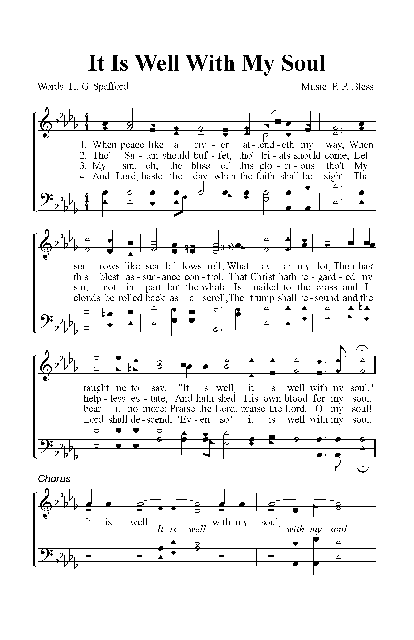
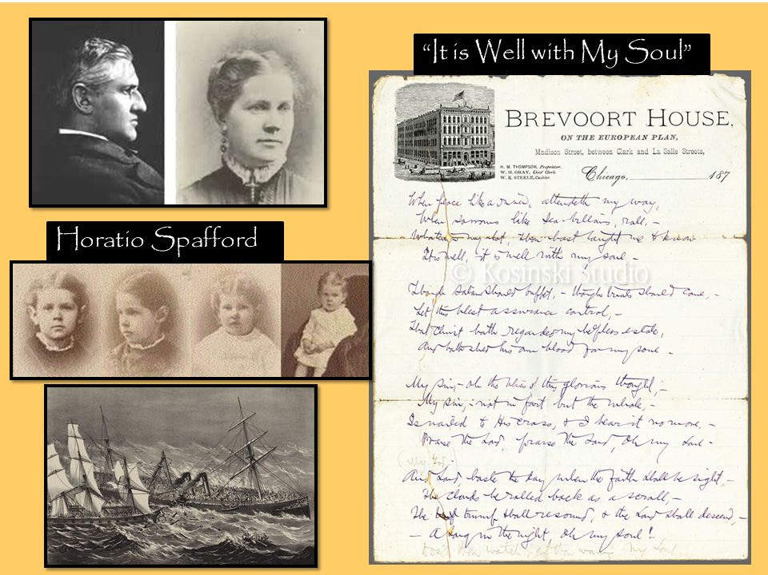
Horatio Spafford
It Is Well, With My Soul

