Slide 1
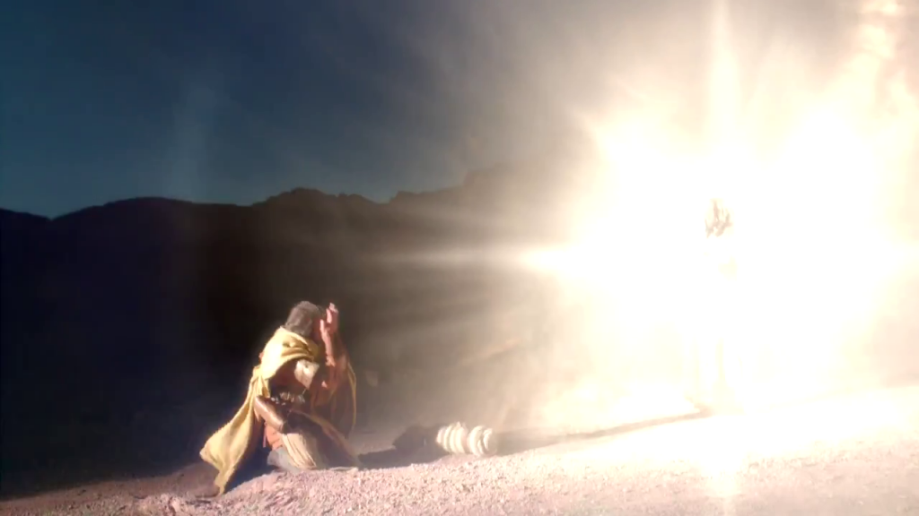
All Things To All Men
To Save Some
Paul’s S.O.S.

Slide 2
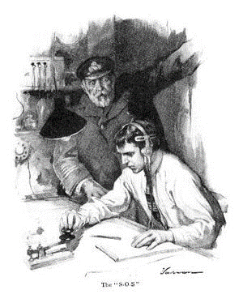
S. O. S.
Morse Code: … --- …
… = S
--- = O
… = S
Save Our Ship
Save Our Soul

Slide 3

Brethren, if anyone among you wanders from the truth, and someone turns him back, let him know that he who turns a sinner from the error of his way will save a soul from death and cover a multitude of sins. James 5:19-20

Slide 4
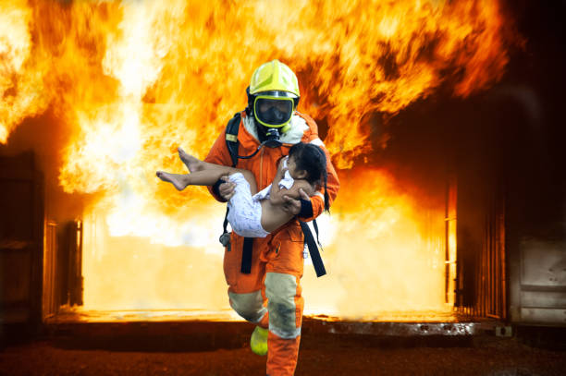
But you, beloved, building yourselves up on your most holy faith, praying in the Holy Spirit, keep yourselves in the love of God, looking for the mercy of our Lord Jesus Christ unto eternal life.
And on some have compassion, making a distinction; but others save with fear, pulling them out of the fire, hating even the garment defiled by the flesh.
Jude 23

Slide 5

THE OLD MAN
“I urge you, imitate me” (1 Cor. 4:16)
“Imitate me, just as I imitate Christ”
(1 Cor. 11:1)
To Corinthians

Slide 6
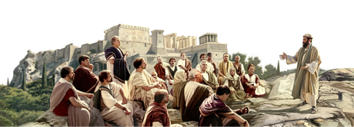
Paul’s SOS
Rom 9:1-3
10:1-3
​I tell the truth in Christ, I am not lying, my conscience also bearing me witness in the Holy Spirit, that I have great sorrow and continual grief in my heart. For I could wish that I myself were accursed from Christ for my brethren, my countrymen according to the flesh

Slide 7
Paul’s SOS
Rom 9:1-3
10:1-3
​Brethren, my heart’s desire and prayer to God for Israel is that they may be saved. For I bear them witness that they have a zeal for God, but not according to knowledge. For they being ignorant of God’s righteousness, and seeking to establish their own righteousness, have not submitted to the righteousness of God.

Slide 8
God’s Man for God’s Time
I Corinthians 9:19-22
For though I am free from all men, I have made myself a servant to all, that I might win the more:
1) and to the Jews I became as a Jew, that I might win Jews
(The Birth Jew)
2) to those who are under the law, as under the law, that I might win those who
are under the law (The Proselyte Jew)
3) to those who are without law, as without law (not being without law toward
God, but under law toward Christ), that I might win those who are without law
(The Gentile)
4) to the weak I became as weak, that I might win the weak. (The Outcast &
Forgotten)
5) I have become all things to all men, that I might by all means save some.
SAVE SOME

Slide 9
Is This For Apostles Only?
I Corinthians 10:31 – 11:1
³¹ Therefore, whether you eat or drink, or whatever you do, do all to
the glory of God.
³² Give no offense, either to the Jews or to the Greeks or to the
church of God,
³³ just as I also please all men in all things, not seeking my own
profit, but the profit of many, that they may be saved.
​¹ Imitate me, just as I also imitate Christ.
just as I also please all men in all things
that they may be saved

Slide 10
PAUL’S AIM:
Why surrender his freedom to become a slave to all?
WIN SOULS
I Corinthians 9:19-22
¹⁹ For though I am free from all men, I have made myself a servant to all, that I might win the more;
²⁰ and to the Jews I became as a Jew, that I might win Jews; to those who are under the law, as under the law, that I might win those who are under the law;
²¹ to those who are without law, as without law (not being without law toward God, but under law toward Christ), that I might win those who are without law;
²² to the weak I became as weak, that I might win the weak.
win
win
win
win
win

Slide 11
PAUL’S AIM:
Why surrender his freedom to become a slave to all?
PARTAKER WITH THEM
I Corinthians 9:23
²³ Now this I do for the gospel’s sake,
that I may be partaker of it with you.
partaker of it with you
¹⁶ Take heed to yourself and to the doctrine. Continue in them, for in doing this you will save both yourself and those who hear you.
1 Tim. 4:16

Slide 12
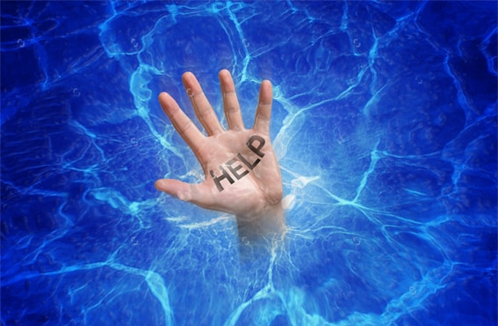
“SAVE SOME”
From What?
Save: Passive or Casual
Save: Active, Life-threatening
OR
“and to wait for His Son from heaven, whom He raised from the dead, even Jesus who delivers us from the wrath to come” (1 Thess. 1:10)

Slide 13
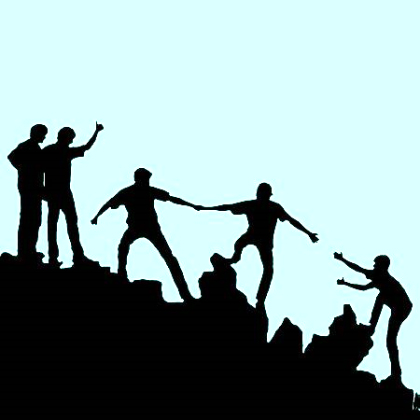
“PARTAKER”
Of What?
Fellowship:
in the gospel
in hope of salvation
in eternal life with God
“He who believes in the Son has everlasting life; and he who does not believe the Son shall not see life, but the wrath of God abides on him.”
(John 3:36)

Slide 14

The Strategy: LOVE
“For though I am free from all men,
I have made myself a servant to all” (vs. 19)
“I have become all things to all men” (vs. 23)
⁴ Love suffers long and is kind;
does not seek its own,
⁶ Love does not rejoice in iniquity,
but rejoices in the truth;
⁷ Love bears all things,
believes all things,
hopes all things,
endures all things.
1 Corinthians 13:4-7

Slide 15
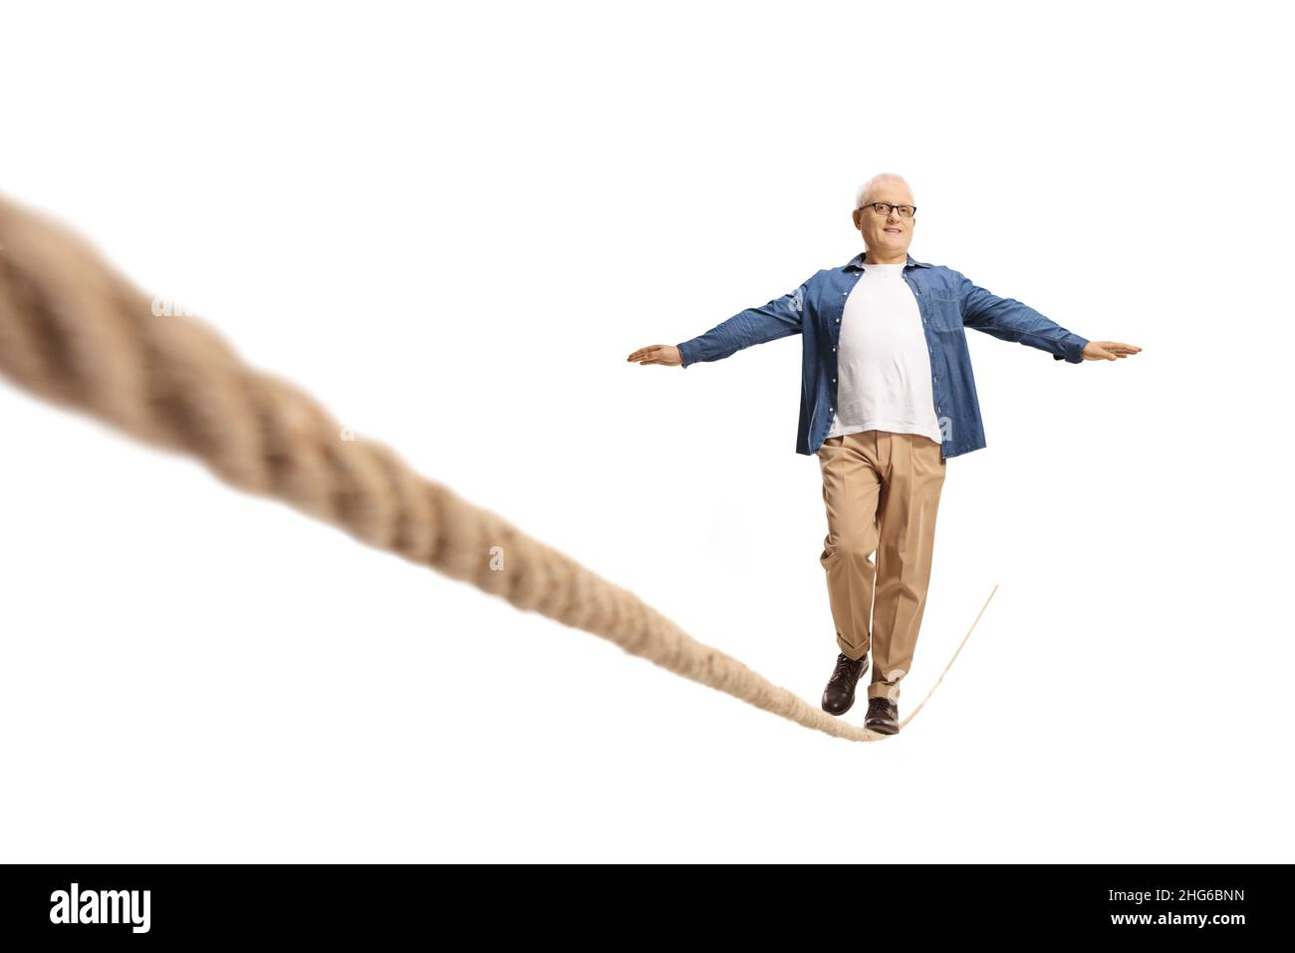
The Strategy: BALANCE
John 17:14-15 “not of the world”
Mk. 16:15 “go into all the world”
Compromise:
World
Compromise:
Hermit
“in the world, but not of the world”

Slide 16
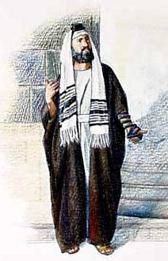
I became as a Jew
Elite Jewish Heritage
Philippians 3:3-5
though I also might have confidence in the flesh. If anyone else thinks he may have confidence in the flesh, I more so:
* circumcised the eighth day,
* of the stock of Israel,
* of the tribe of Benjamin,
* a Hebrew of the Hebrews; ...

Slide 17
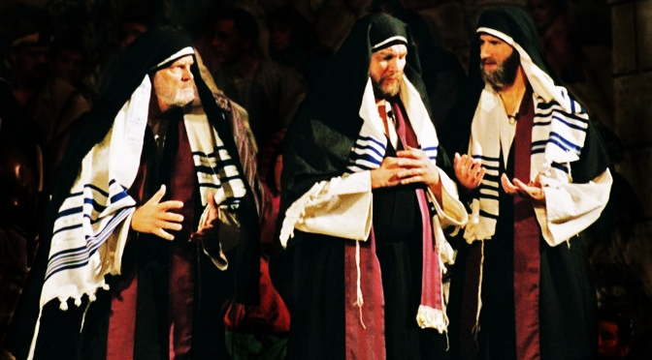
Valedictorian:
Graduated “Hebrew of Hebrews”
I became as a Jew
to those who are under the law, as under the law
Galatians 1:14
“And I advanced in Judaism beyond many of my contemporaries in my own nation, being more exceedingly zealous for the traditions of my fathers.

Slide 18
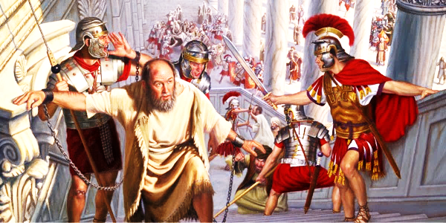
To The Gentile to those who are without law, as without law
Roman Citizenship:
Acts 22:25-28
“The commander answered, "With a large sum I obtained this citizenship." And Paul said, "But I was born a citizen.“

Slide 19
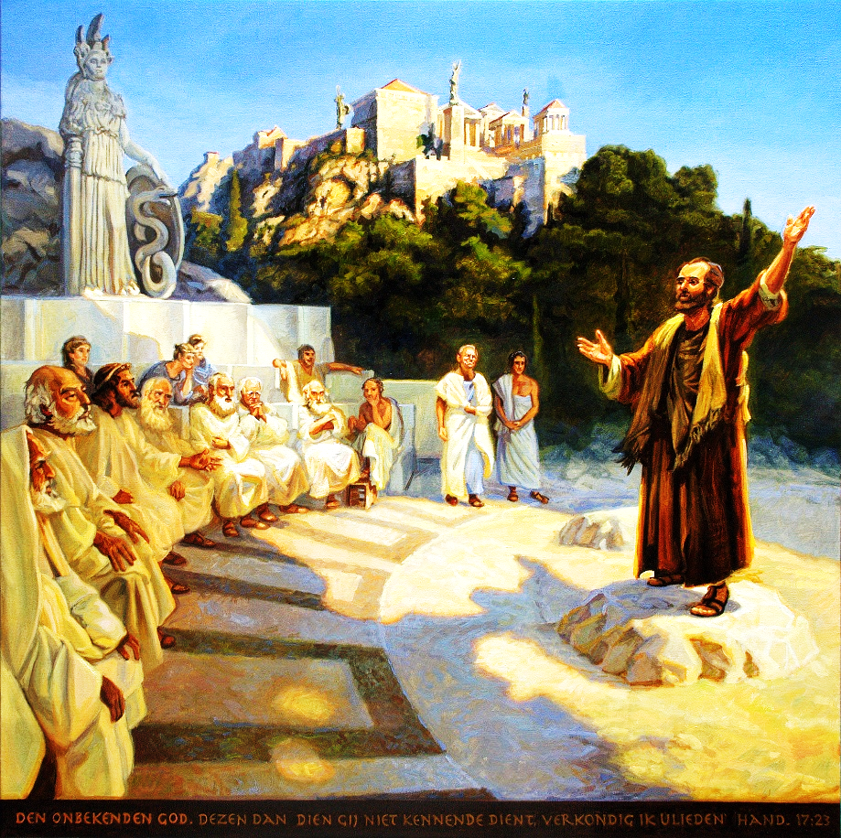
To The Gentile
to those who are without law,
as without law
Quotes Greek philosophers
Titus 1:12
Acts 17:28
I Cor. 15:33
Epimenides
“a prophet of their own, said, “Cretans are always liars, evil beasts, lazy gluttons”
Aratus
“as also some of your own poets have said, ‘For we are also His offspring.’
Menander
“Do not be deceived: “Evil company corrupts good habits.”

Slide 20
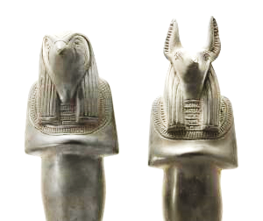
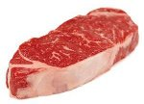
Jews & Greeks
(tender conscience)
Jews & Gentiles
to the weak I became as weak, that I might win the weak
​Receive one who is weak in the faith, but not to disputes over doubtful things. For one believes he may eat all things, but he who is weak eats only vegetables. Let not him who eats despise him who does not eat, and let not him who does not eat judge him who eats; for God has received him.
Romans 14:1-3

Slide 21
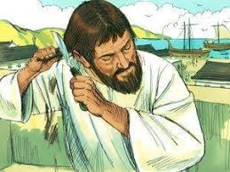
Jews & Greeks
(tender conscience)
Jews & Gentiles
to the weak I became as weak, that I might win the weak
​We have four men who have taken a vow. Take them and be purified with them, and pay their expenses so that they may shave their heads, and that all may know that those things of which they were informed concerning you are nothing, but that you yourself also walk orderly and keep the law.
Acts 21:23-24

Slide 22
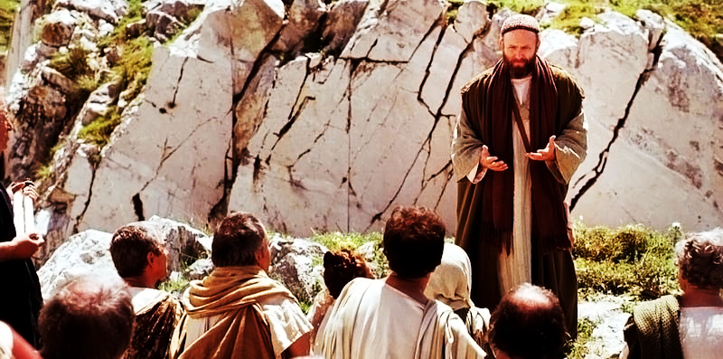
All Things to All Men
Romans 1:1-16
Jews & Greeks
⁵ Through Him we have received grace and apostleship for obedience to the faith among all nations for His name,
¹⁴ I am a DEBTOR both to Greeks and to barbarians, both to wise and to unwise. ¹⁵ So, as much as is in me, I am ready to preach the gospel to you who are in Rome also.
¹⁶ For I am not ashamed of the gospel of Christ, for it is the power of God to salvation for everyone who believes, for the Jew first and also for the Greek.

Slide 23

My S.O.S.
Live the Beatitudes
Blessed are the: poor in spirit
mourn
meek
hunger righteousness
merciful
pure in heart
peacemaker
persecuted
Let my salt flavor
my light shine

Slide 24
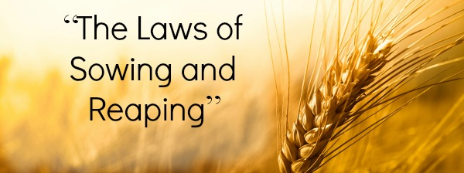
Galatians
6:6-10
¹⁰ Therefore, as we have opportunity, let us do good to all, especially to those who are of the household of faith.

Slide 25
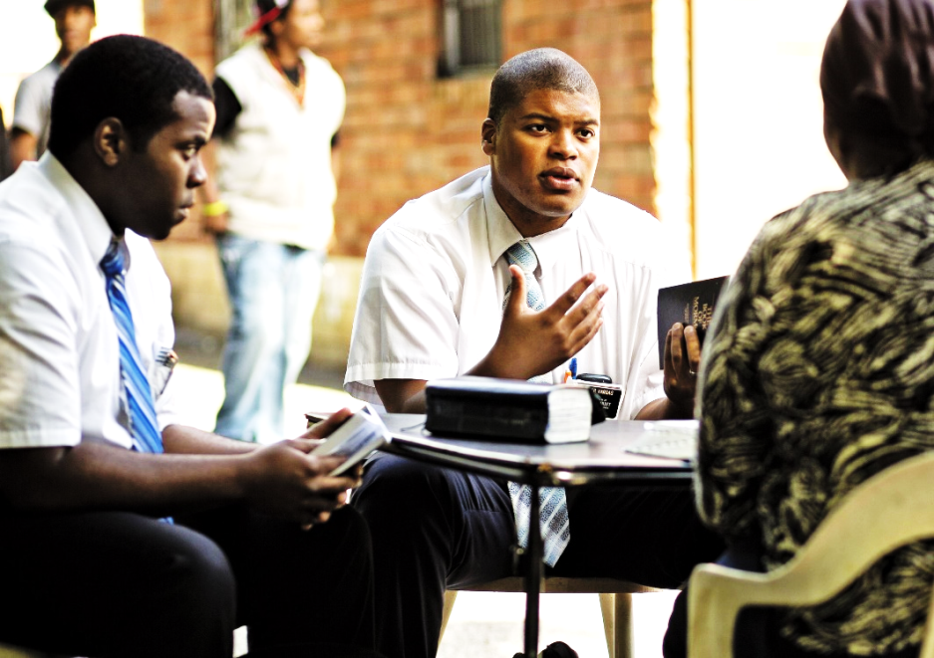
Go 2 x 2
(with prayer)
​¹ After these things the Lord appointed seventy others also, and sent them two by two before His face into every city and place where He Himself was about to go.
² Then He said to them, “The harvest truly is great, but the laborers are few; therefore pray the Lord of the harvest to send out laborers into His harvest.
Luke 10:1-2

Slide 26

Romans 12
&
You
​¹ I beseech you therefore, brethren, by the mercies of God, that you present your bodies a living sacrifice, holy, acceptable to God, which is your reasonable (rational, logical) service.
² And do not be conformed to this world, but be transformed by the renewing of your mind, that you may prove what is that good and acceptable and perfect will of God.

Slide 27
Brethren, if anyone among you wanders from the truth, and someone turns him back, let him know that he who turns a sinner from the error of his way will save a soul from death and cover a multitude of sins. James 5:19-20

