Slide 1
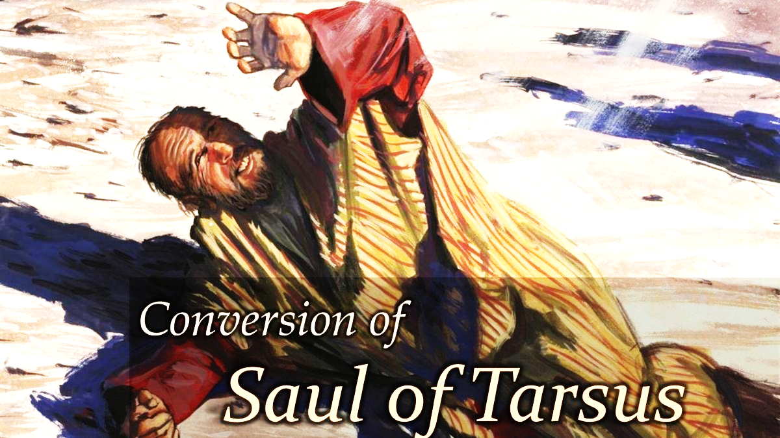
The Most Unlikely Conversion In History
The Salvation Of The
Chief of Sinners

Slide 2
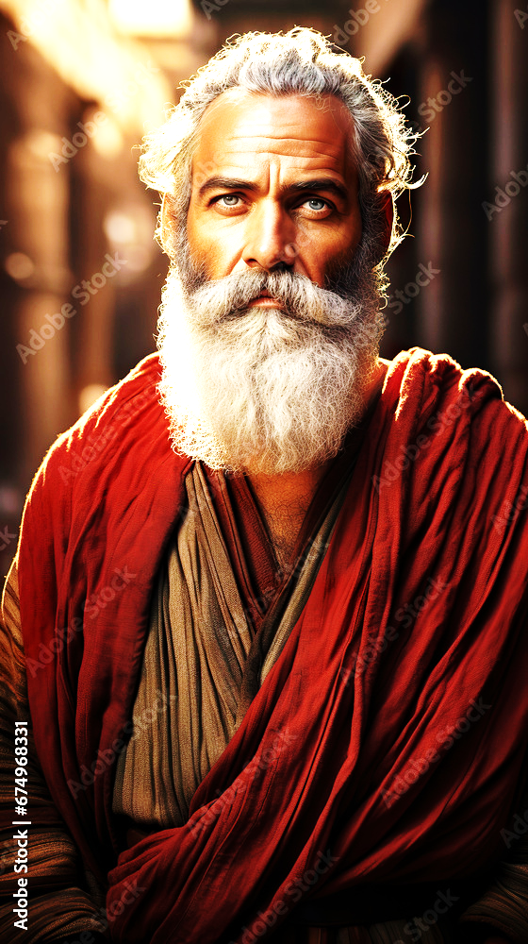
The Most Unlikely Conversion
In History
How Saul of Tarsus
Became Paul of Christ

Slide 3
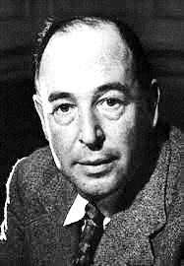
C. S. Lewis
The Most Reluctant Convert
“I gave in, and admitted that God was God, and knelt and prayed: perhaps, that night, the most dejected and reluctant convert in all England”

Slide 4
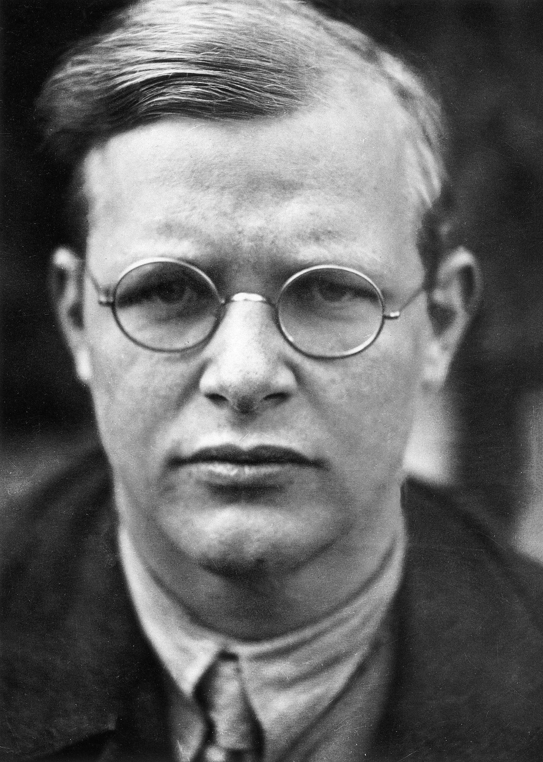
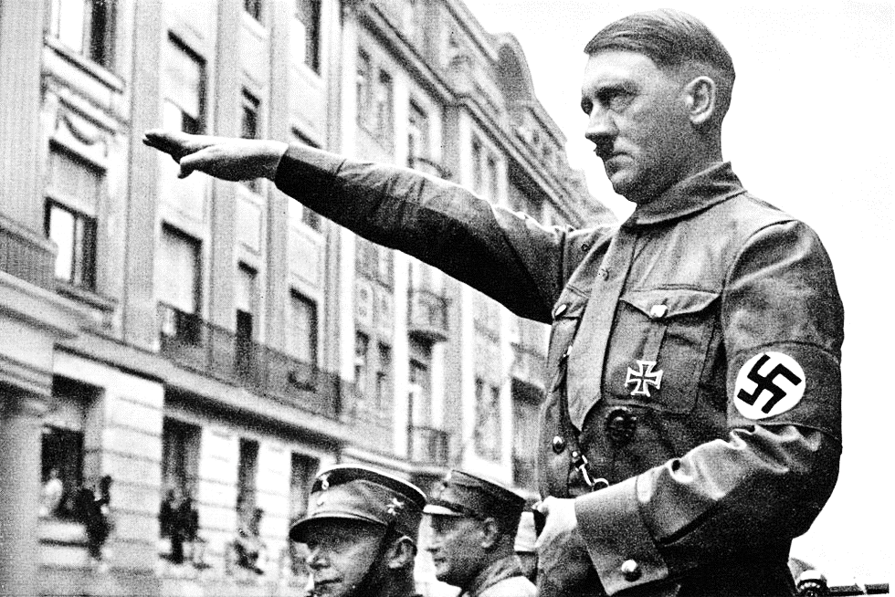
What If …
A young 39 year old imprisoned Bible teacher
who was arrested for religious and political
resistance against Nazism and the Third Reich, now sitting under sentence of death in a concentration camp in Flossenburg, Germany
Is suddenly summoned to appear before a 7-man court:
Albert Speer – Chief Architect of Nazism
Wilhelm Keitel – Field Marshal of the German Army
Joseph Goebbels – Minister for Propaganda
Martin Bormann – Chief of Staff of Nazi Party
Hermann Goring – Founder of Gestapo
Heinrich Himmler – Leader of SS
Adolf Hitler – The Fuhrer (“Leader”) of Nazi Party

Slide 5
What If …
Dietrich Bonhoeffer is sentenced:
“We find the defendant …
“Not guilty!”

Slide 6
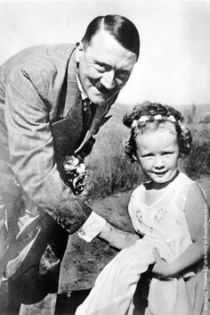
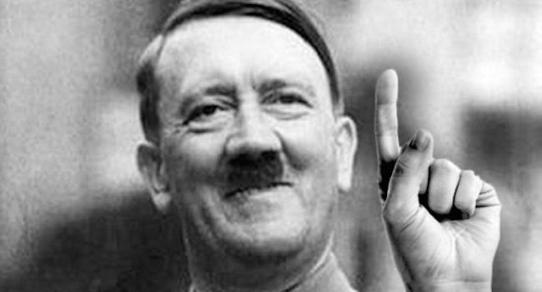
How ?
Adolf Hitler had converted to Judaism
“I see the light!”
“I love God and all Jews!”

Slide 7
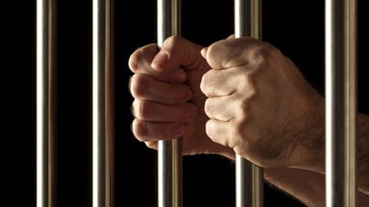
Saul The Avenger
Acts 8:1-3
-
“Now Saul was consenting to his death …
As for Saul, he made havoc of the church…”

Slide 8
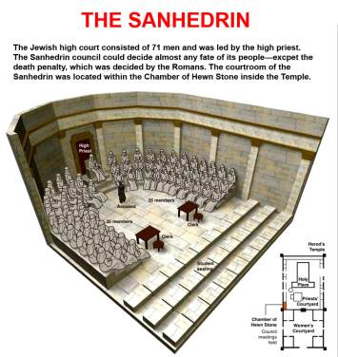
Saul The Murderer
Acts 9:1
“Then Saul, still breathing threats and murder against the disciples of the Lord…”
“I cast my vote
against them!”
Ac. 26:10

Slide 9
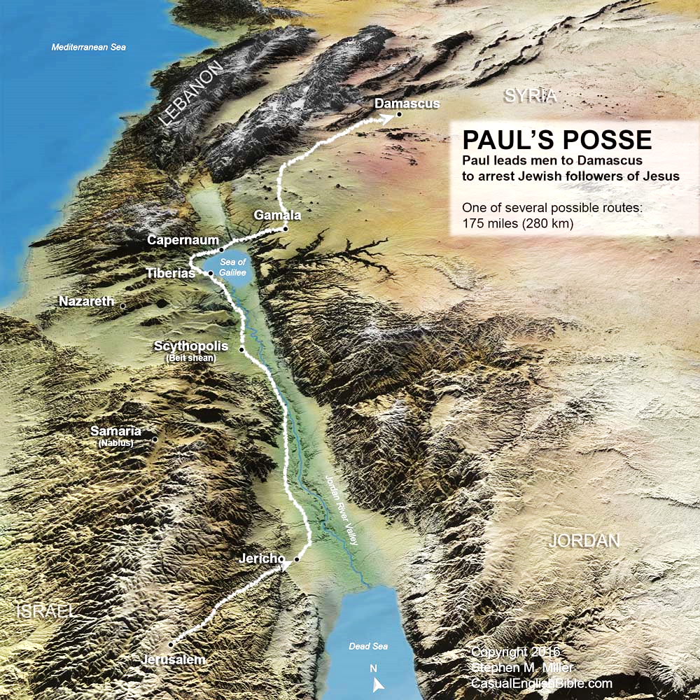
Saul The Hunter
Acts 9:2
“and asked letters from him to the synagogues of Damascus, so that if he found any who were of the Way, whether men or women, he might bring them bound to
Jerusalem.

Slide 10
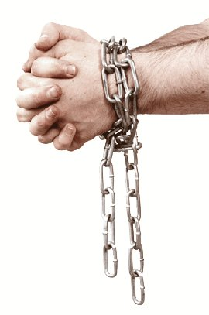
Saul The Terminator
Acts 22:4-5
I persecuted this Way to the death, binding and delivering into prisons both men and women, … and went to Damascus to bring in chains even those who were there to Jerusalem to be punished.

Slide 11
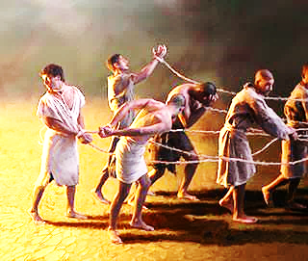
Saul’s Remembrance
Acts 22:19-20
Lord, they know that in every synagogue I imprisoned and beat those who believe on You. 'And when the blood of Your martyr Stephen was shed, I also was standing by consenting to his death, and guarding the clothes of those who were killing him”

Slide 12
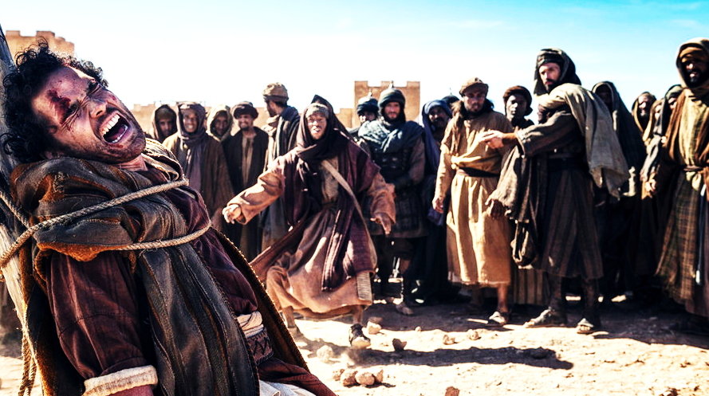
Saul Stones Stephen

Slide 13
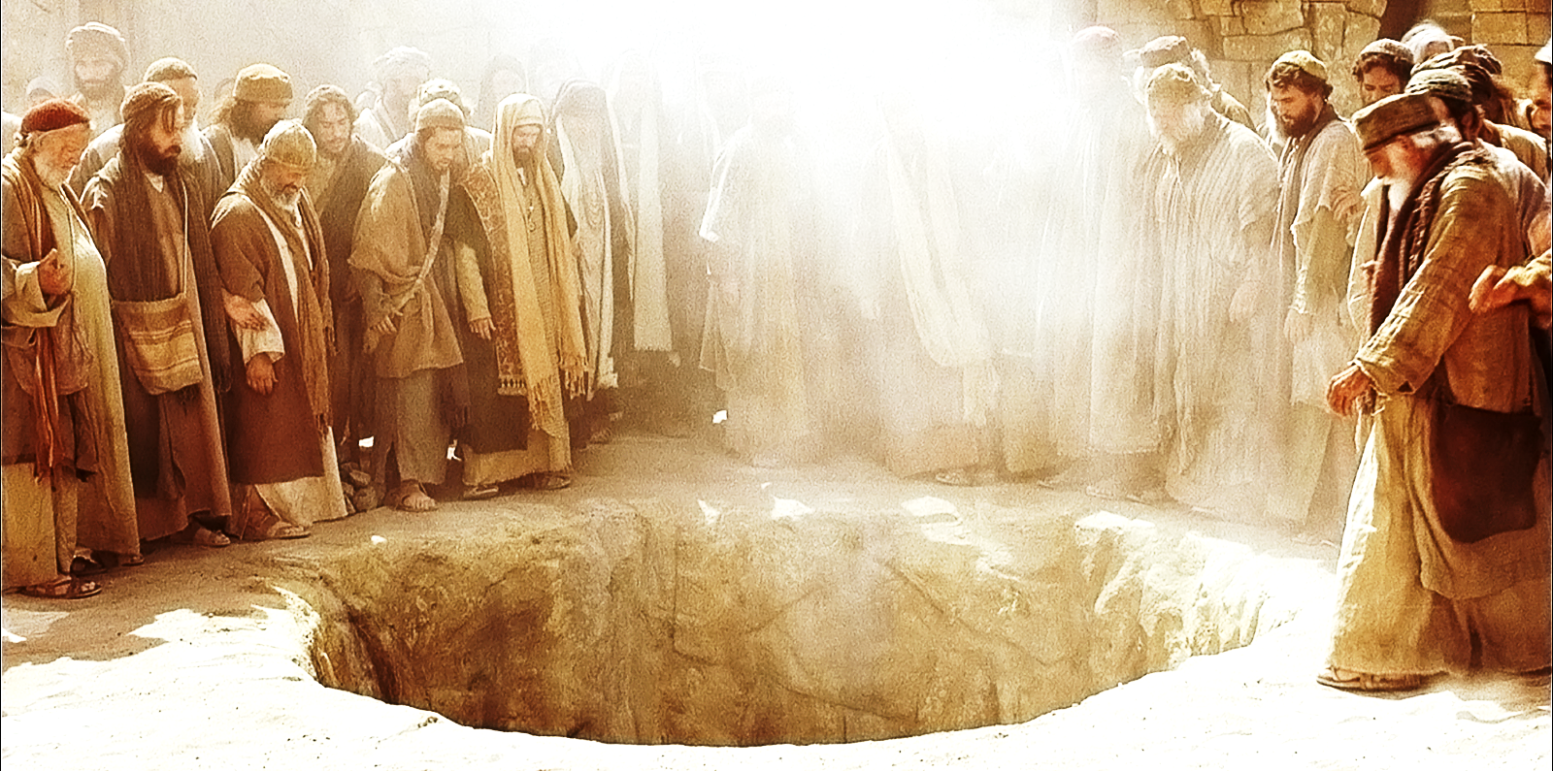
The Merciless Stoning

Slide 14
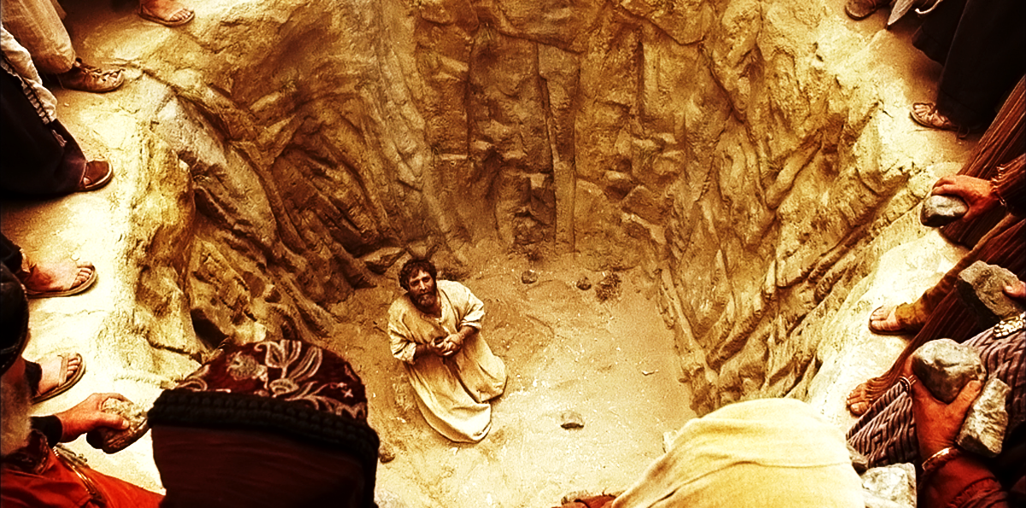
Merciless Stoning

Slide 15
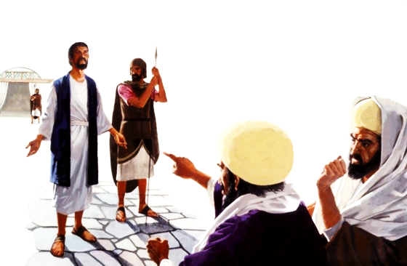
Saul’s Nightmares
Acts 26:11
I PUNISHED them often in every synagogue
I COMPELLED them to blaspheme…
and being exceedingly enraged against them,
I PERSECUTED them even to
foreign cities”

Slide 16
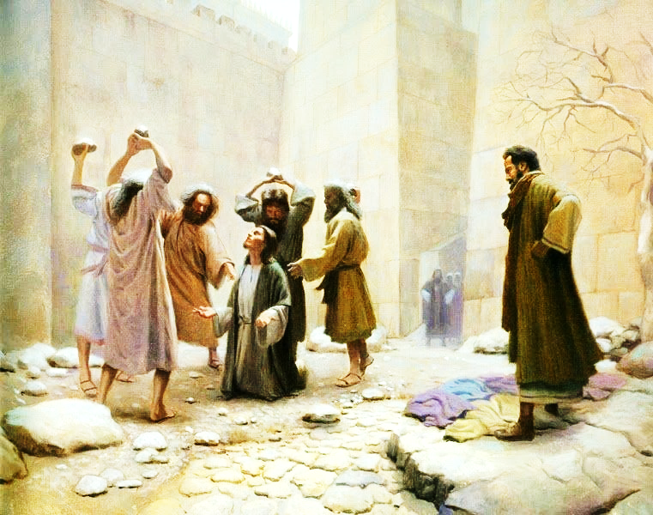
Saul’s Nightmares
Galatians 1:13
“You have heard of my former conduct in Judaism, how I persecuted the church of God beyond measure and tried to destroy it”

Slide 17
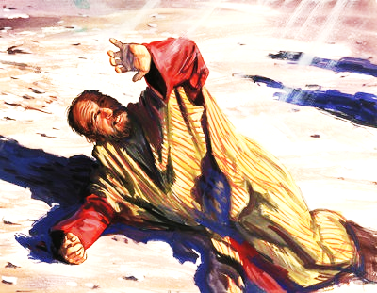
Heavenly Light
Acts 9:3
“As he journeyed he came near Damascus, and suddenly a light shone around him from heaven”
Acts 26:13
"at midday, O king, along the road I saw a light from heaven, brighter than the sun, shining around me and those who journeyed with me.

Slide 18
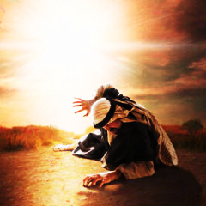
Heavenly Voice
Acts 9:4
“Then he fell to the ground, and heard a voice saying to him, ‘Saul, Saul, why are
you persecuting Me?’”

Slide 19
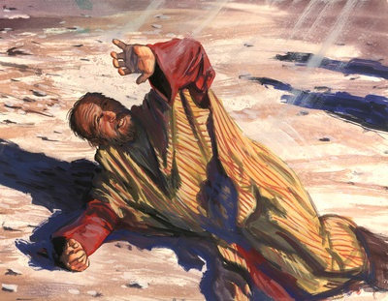
Ignorance
Acts 9:5
“And he said, ‘Who are you Lord?”
Lord (Greek – KYRIOS)
“a title of honor, expressive of
respect and reverence; with which servants greet their masters”

Slide 20
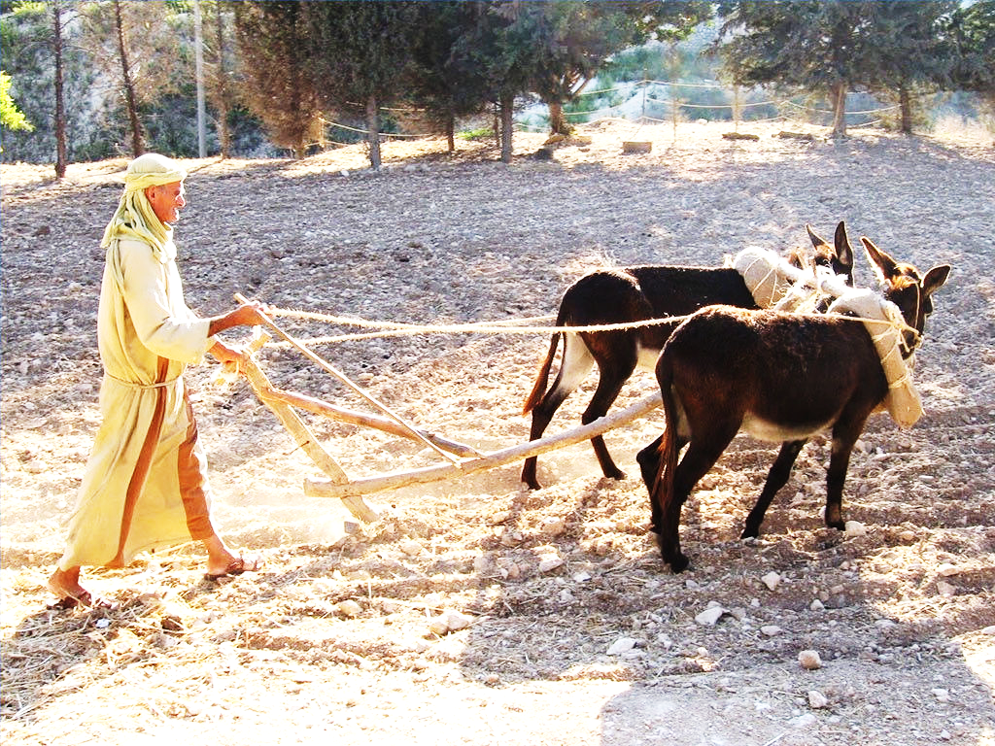
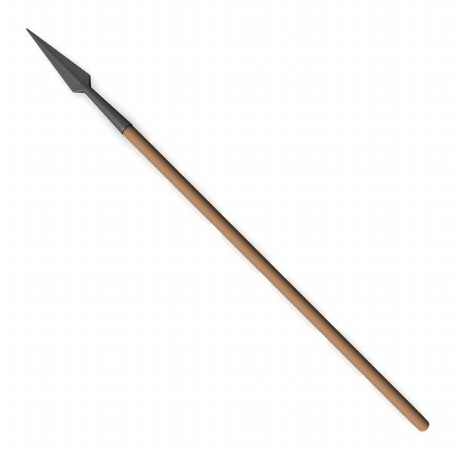
Identity & Insight
Acts 9:5
“Then the Lord said, ‘I am Jesus (“of Nazareth” – 22:8) whom you are persecuting. It is hard for you to kick against the goads.’”

Slide 21
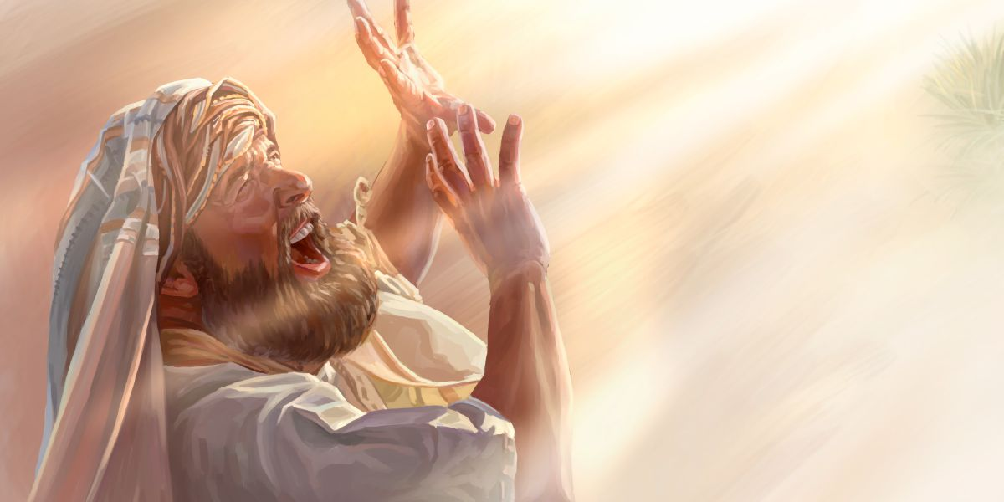
Reaction & Submission
Acts 9:6
“So he, trembling and astonished, said, ‘Lord, what do you want me to do?’”
Trembling (Greek – TEMO)
“to fear; to be very afraid”
Mark 5:33, Luke 8:47
Astonished (Greek – THAMBEO)
“to stupefy; astound; amaze”
Mark 1:27; 10:24,32

Slide 22
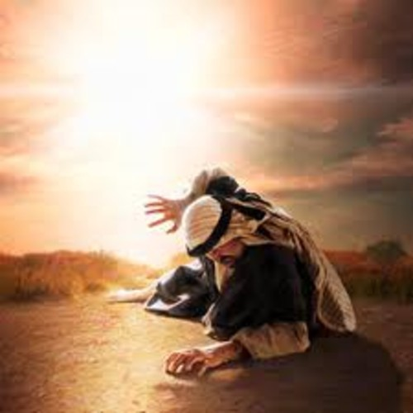
Jesus’ Answer
Acts 9:6
“Then the Lord said to him, ‘Arise and go into the city and you will be told what you must do.”

Slide 23
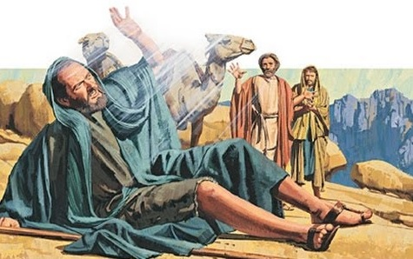
Witnesses
Acts 9:7
“And the men who journeyed with him stood speechless, hearing a voice but seeing no one”
Acts 22:9 "And those who were with me indeed saw the light and were afraid, but they did not hear the voice of Him who spoke to me.

Slide 24
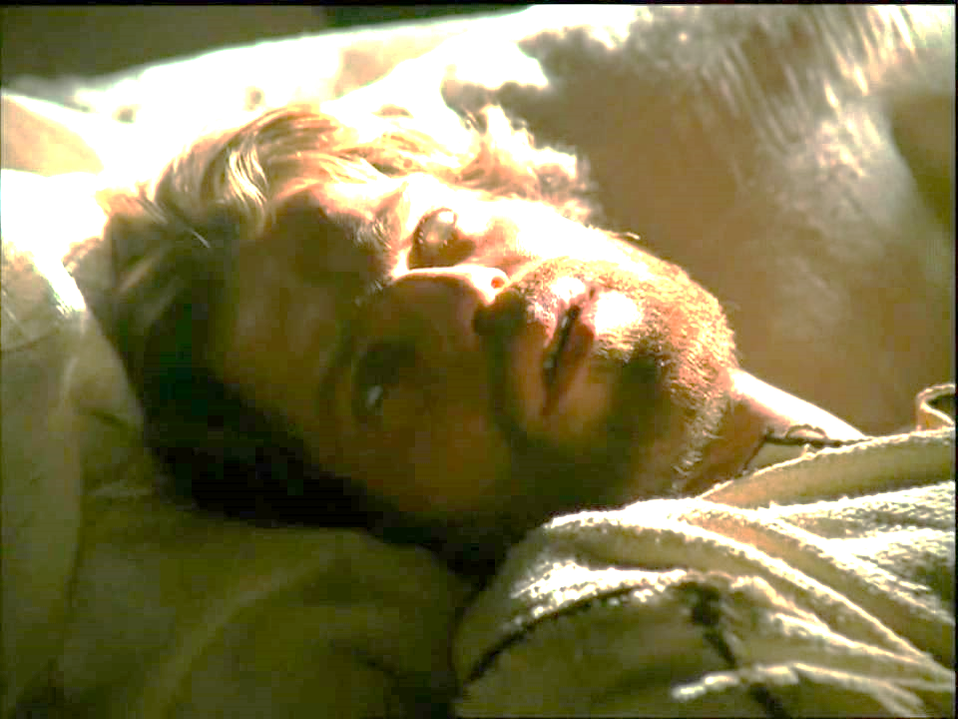
Blind
Acts 9:8
“Then Saul arose from the ground, and when his eyes were opened he saw no one.”

Slide 25
Sincere or Dishonest?
“If a man is honestly mistaken,
and presented with the truth,
he will either cease to be honest,
or cease to be mistaken”
Which One Are You?

Slide 26
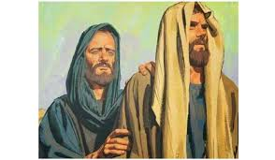
Troubled
Acts 9:9
“And he was three days without sight, and neither ate nor drank”
Was Saul Saved Yet?

Slide 27
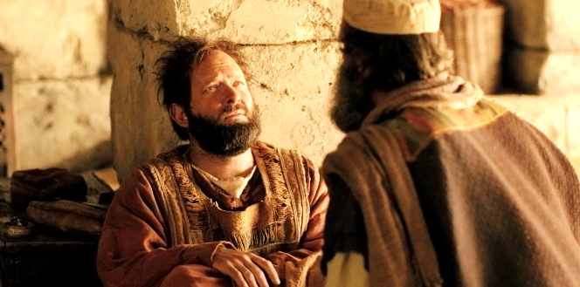
Ananias – God’s Messenger
Acts 9:10-16
“Now there was a certain disciple at Damascus named Ananias; and to him the Lord said in a vision, "Ananias." And he said, "Here I am, Lord."

Slide 28
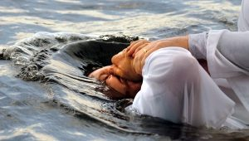
The Message From Jesus
Acts 9:17-18
"Brother Saul, the Lord Jesus, who appeared to you on the road as you came, has sent me that you may:
(1) receive your sight and
(2) be filled with the Holy Spirit.”
Immediately there fell from his eyes something like scales, and he
(1) received his sight at once; and
(2) he arose and was baptized.

Slide 29
Paul’s Salvation & Charge
Acts 22:13-16
"came to me; and he stood and said to me, 'Brother Saul, receive your sight.' And at that same hour I looked up at him.
"Then he said, 'The God of our fathers has chosen you that you should:
(1) know His will, and
(2) see the Just One, and
(3) hear the voice of His mouth.
'For you will be His witness to all men of what you have seen and heard.
When Was Saul Saved?

Slide 30
When Was Saul Saved?
Acts 22:13-16
'And now why are you waiting? Arise and be baptized, and wash away your sins, calling on the name of the Lord.'
For you are all sons of God through faith in Christ Jesus. For as many of you as were baptized into Christ have put on Christ. Gal. 3:26-27
But when the kindness and the love of God our Savior toward man appeared, not by works of righteousness which we have done, but according to His mercy He saved us, through the washing of regeneration and renewing of the Holy Spirit Titus 3:4-5

Slide 31
Paul’s 3-Fold Charge
# 1
Acts 26:16-18
'But rise and stand on your feet; for I have appeared to you for this purpose:
to make you a minister and a witness both of the things which you have seen and of the things which I will yet reveal to you.

Slide 32
Paul’s 3-Fold Charge
# 2
Acts 26:16-18
'I will deliver you from the Jewish people, as well as from the Gentiles, to whom I now send you,
'to open their eyes, in order to turn them
from darkness to light, and
from the power of Satan to God,

Slide 33
Paul’s 3-Fold Charge
# 3
Acts 26:16-18
that they may receive forgiveness of sins and an inheritance among those who are sanctified by faith in Me.'
knowing this, that our old man was crucified with Him, that the body of sin might be done away with, that we should no longer be slaves of sin. For he who has died has been freed from sin. Romans 6:6-7

Slide 34
From Chief of Sinners
To Christ’s Exhibit A
I Timothy 1:12-16
-
12 And I thank Christ Jesus our Lord who has enabled me, because He counted me faithful, putting me into the ministry,
13 although I was formerly a blasphemer, a persecutor, and an insolent man; but I obtained mercy because I did it ignorantly in unbelief.
14 And the grace of our Lord was exceedingly abundant, with faith and love which are in Christ Jesus.

Slide 35
From Chief of Sinners
To Christ’s Exhibit A
I Timothy 1:12-16
-
15 This is a faithful saying and worthy of all acceptance, that Christ Jesus came into the world to save sinners, of whom I am chief.
16 However, for this reason I obtained mercy, that in me first Jesus Christ might show all longsuffering, as a pattern to those who are going to believe on Him for everlasting life.

Slide 36
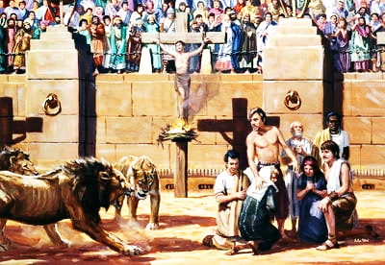
“Imitate Me” - My Life A.C.
Galatians 2:20
²⁰ I have been crucified with Christ;
It is no longer I who live, but Christ lives in me;
And the life which I now live in the flesh
I live by faith in the Son of God,
Who loved me and gave Himself for me.

