Slide 1
Assembling
Hebrews 10:24-25

Slide 2
“Assembling Ourselves Together”
This is NOT a sermon about attendance
For it has been reported to me by Chloe's people that there is quarreling among you, my brothers.
I Corinthians 1:11
For, in the first place, when you come together as a church, I hear that there are divisions among you. And I believe it in part, for there must be factions among you in order that those who are genuine among you may be recognized.
I Corinthians 11:18-19

Slide 3
“Assembling Ourselves Together”
This sermon IS about exploring why assembling together is important
Then the LORD God said, "It is not good that the man should be alone; I will make him a helper fit for him.“
Genesis 2:18
And let us consider how to stir up one another to love and good works, not neglecting to meet together, as is the habit of some, but encouraging one another, and all the more as you see the Day drawing near.
Hebrews 10:24-25

Slide 4
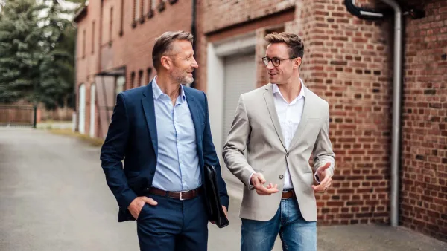
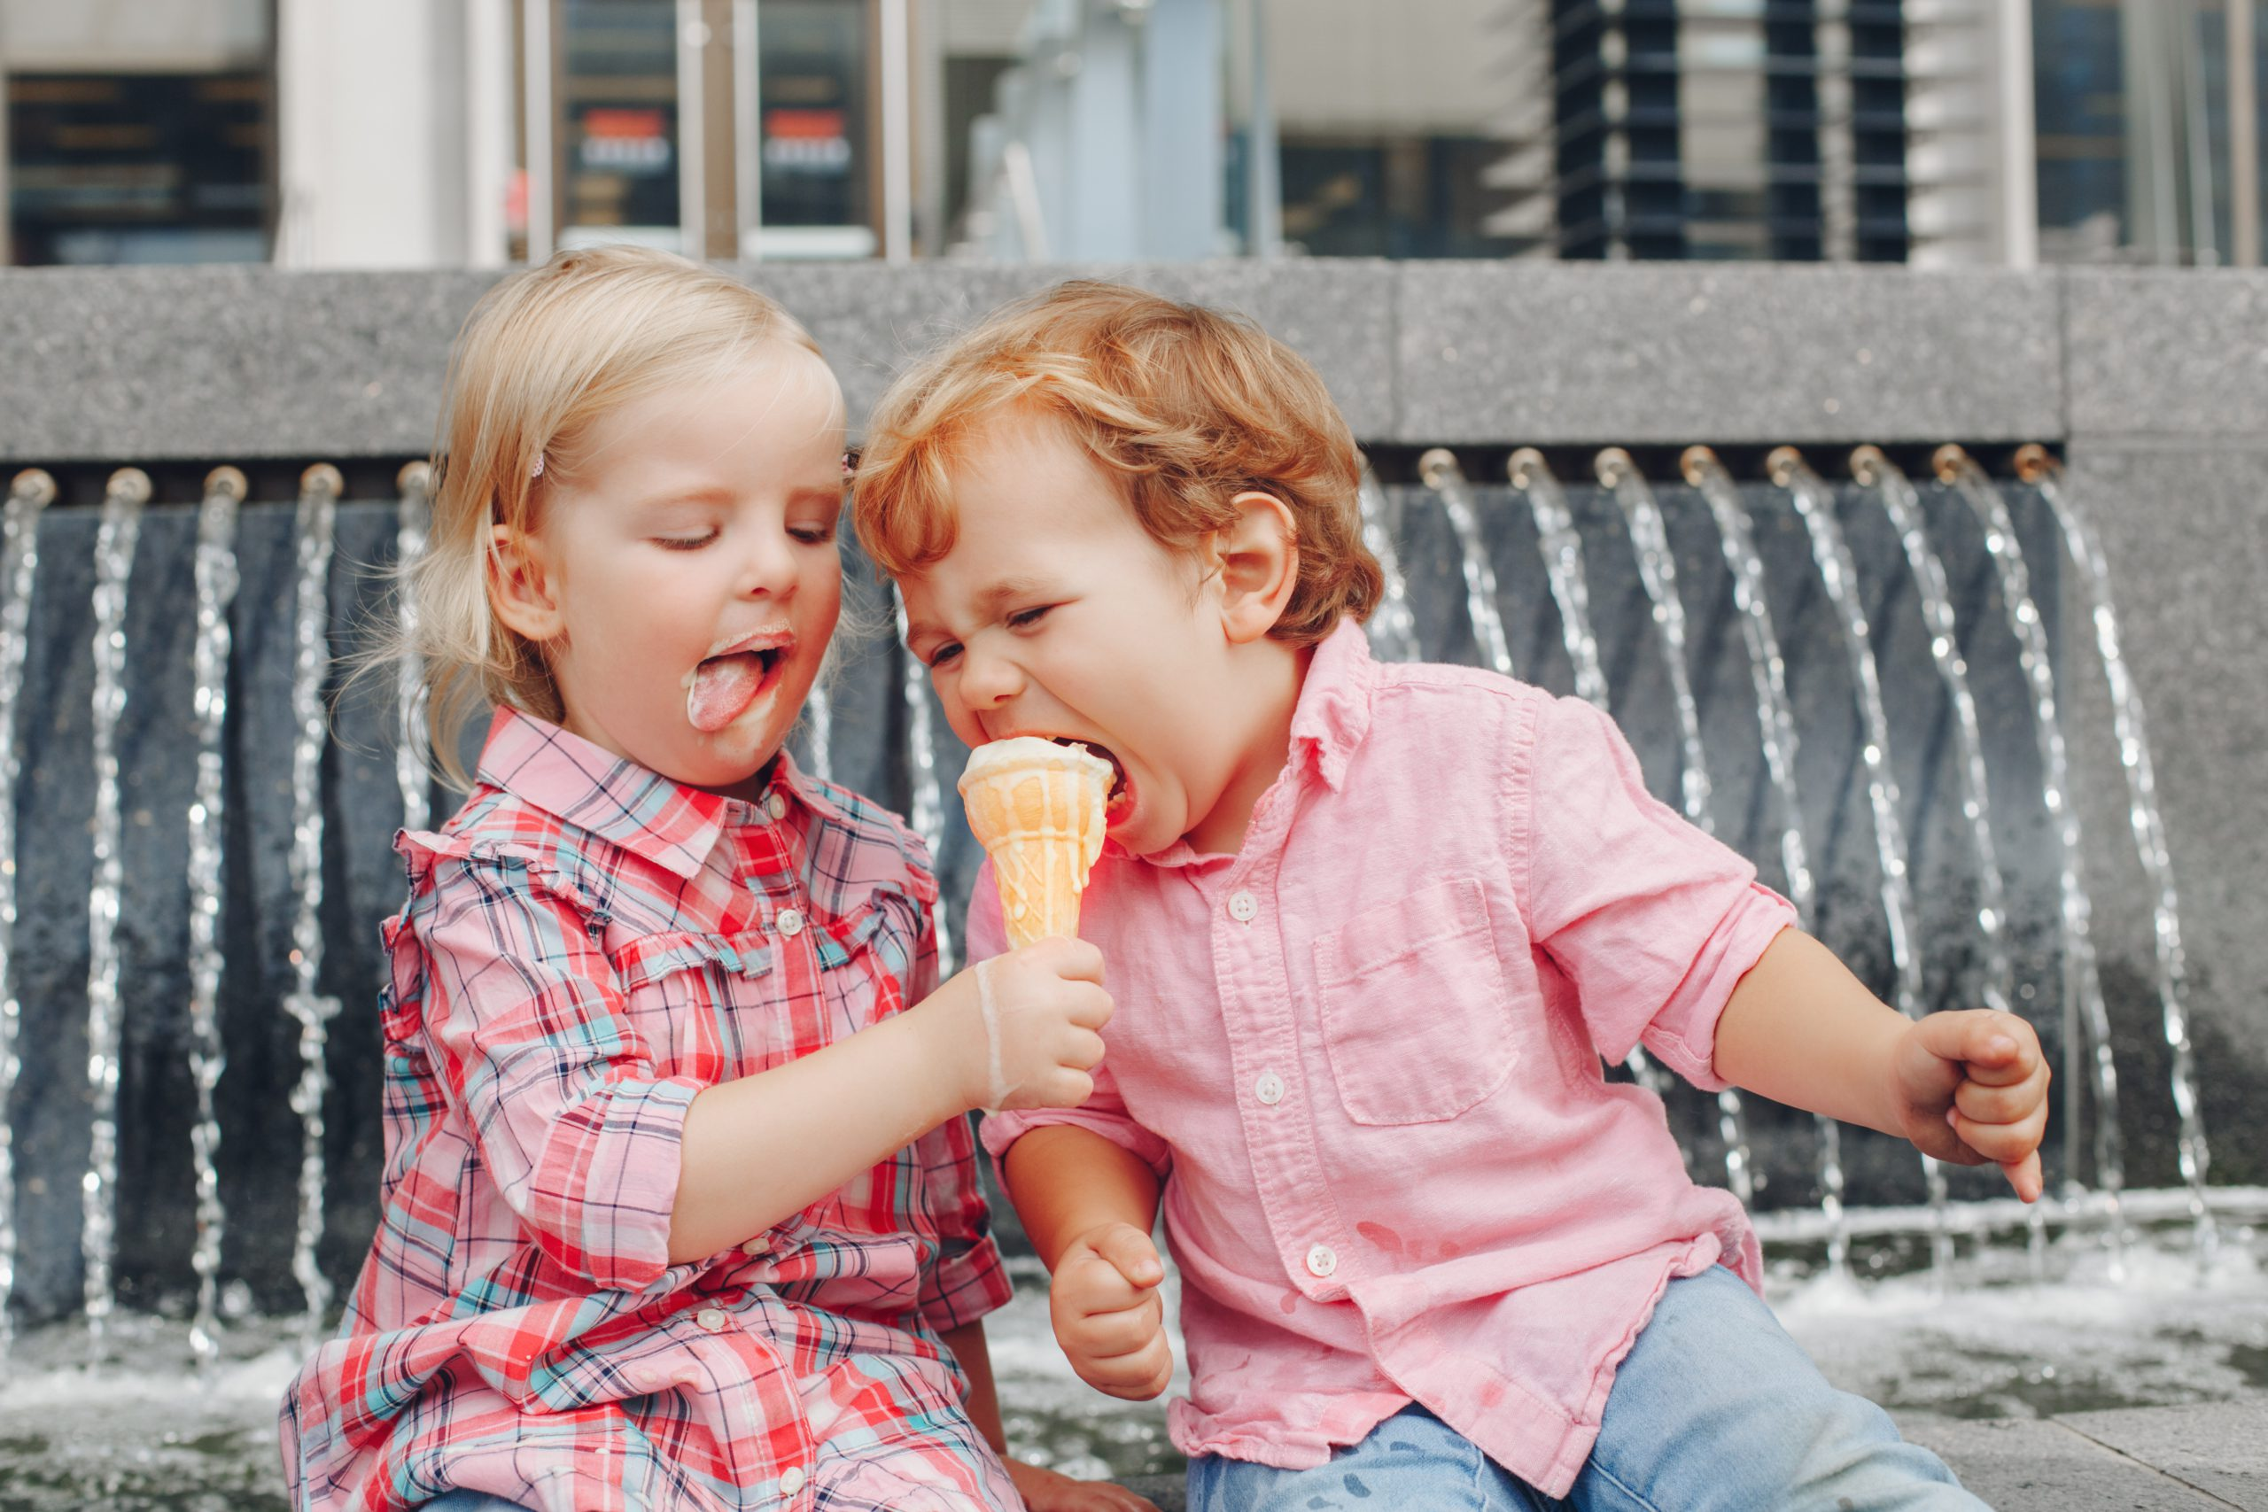
“Assembling Ourselves Together”
The Preacher recognized that being alone is not good for man – Ecclesiastes 4:8-12
Nobody to share things with (verse 8)
  Galatians 6:10 – It is good for us to look for opportunities to share what we have been blessed with
  Acts 2:44 – Early Christians shared what they had with each other
  I Timothy 6:17-19 – We need to be rich in good works, generous and ready to share

Slide 5
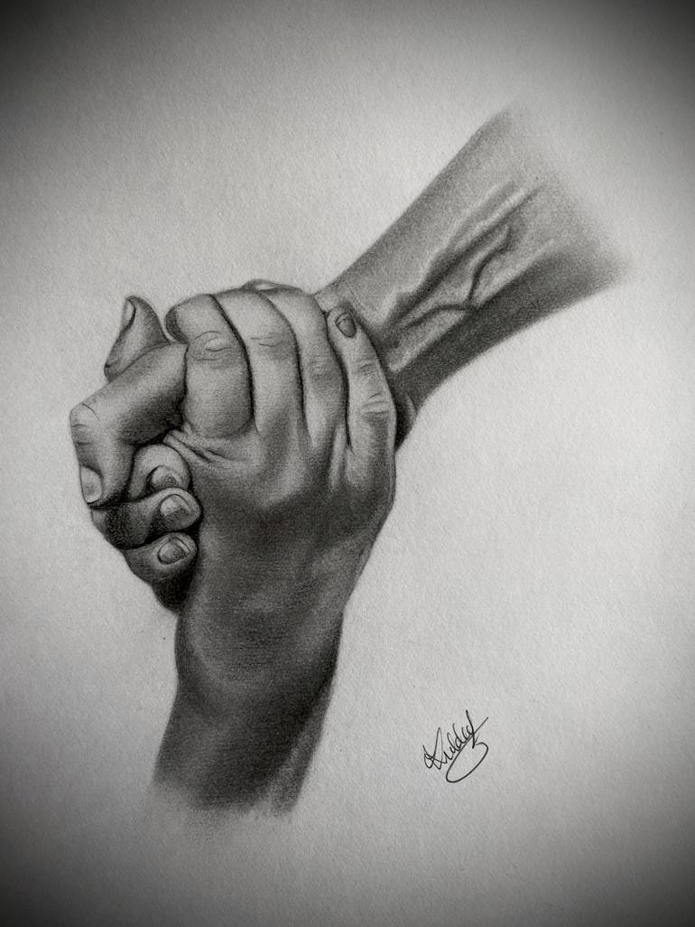

“Assembling Ourselves Together”
The Preacher recognized that being alone is not good for man – Ecclesiastes 4:8-12
Nobody to lift us up if we fall (verses 9-10)
  Hebrews 3:13 – We constantly need to exhort each other
  I Thessalonians 5:11 – We need to encourage each other
  Matthew 14:22-33 – We need to be watching each other, ready to help when our faith gets weak

Slide 6
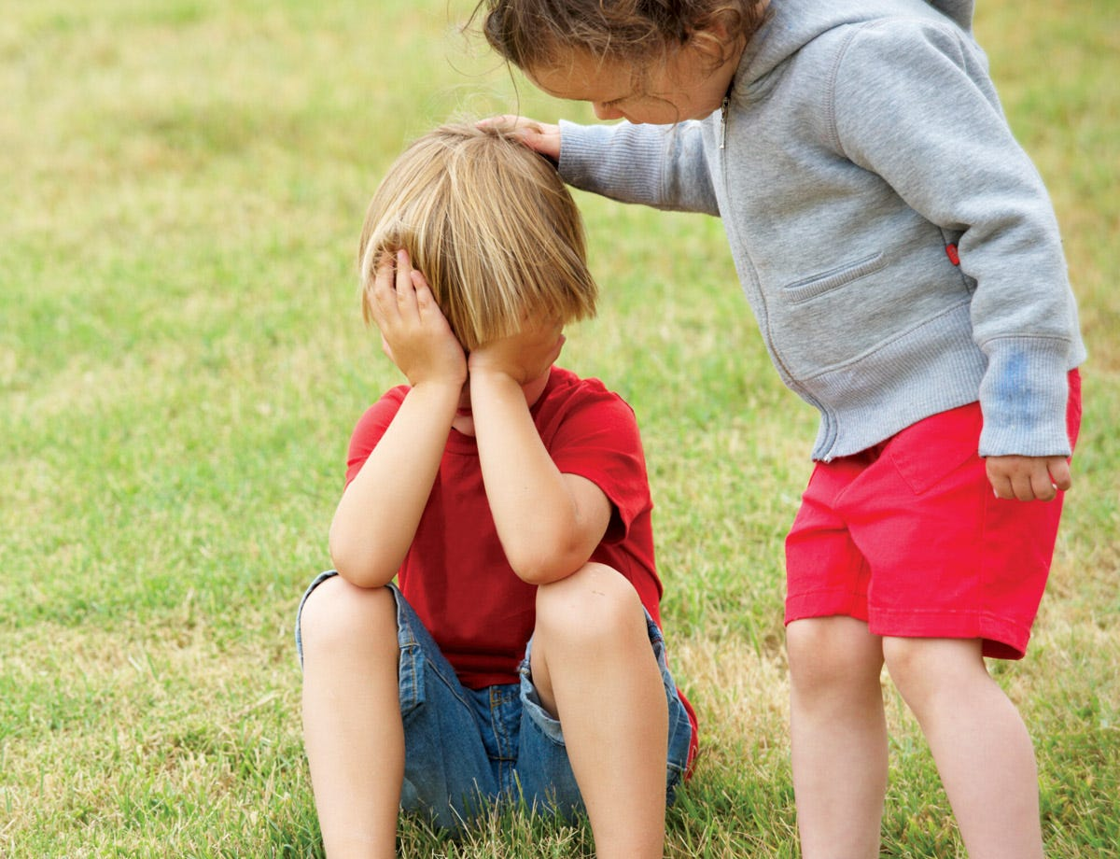
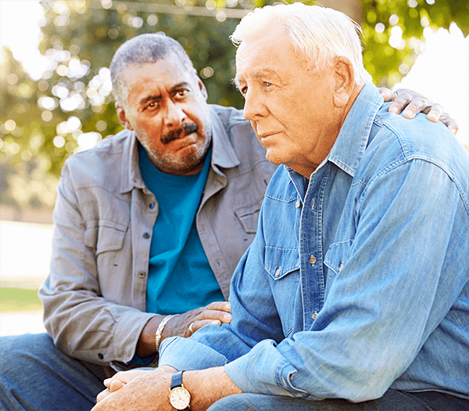
“Assembling Ourselves Together”
The Preacher recognized that being alone is not good for man – Ecclesiastes 4:8-12
Nobody to comfort or help us (verse 11)
  Philippians 2:4 – Need to look out for each other
  Matthew 7:12 – We need to do for others what we would want done for us
  Ephesians 4:32 – We need to care for each other

Slide 7
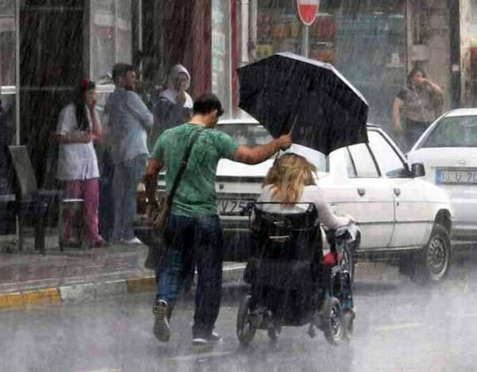
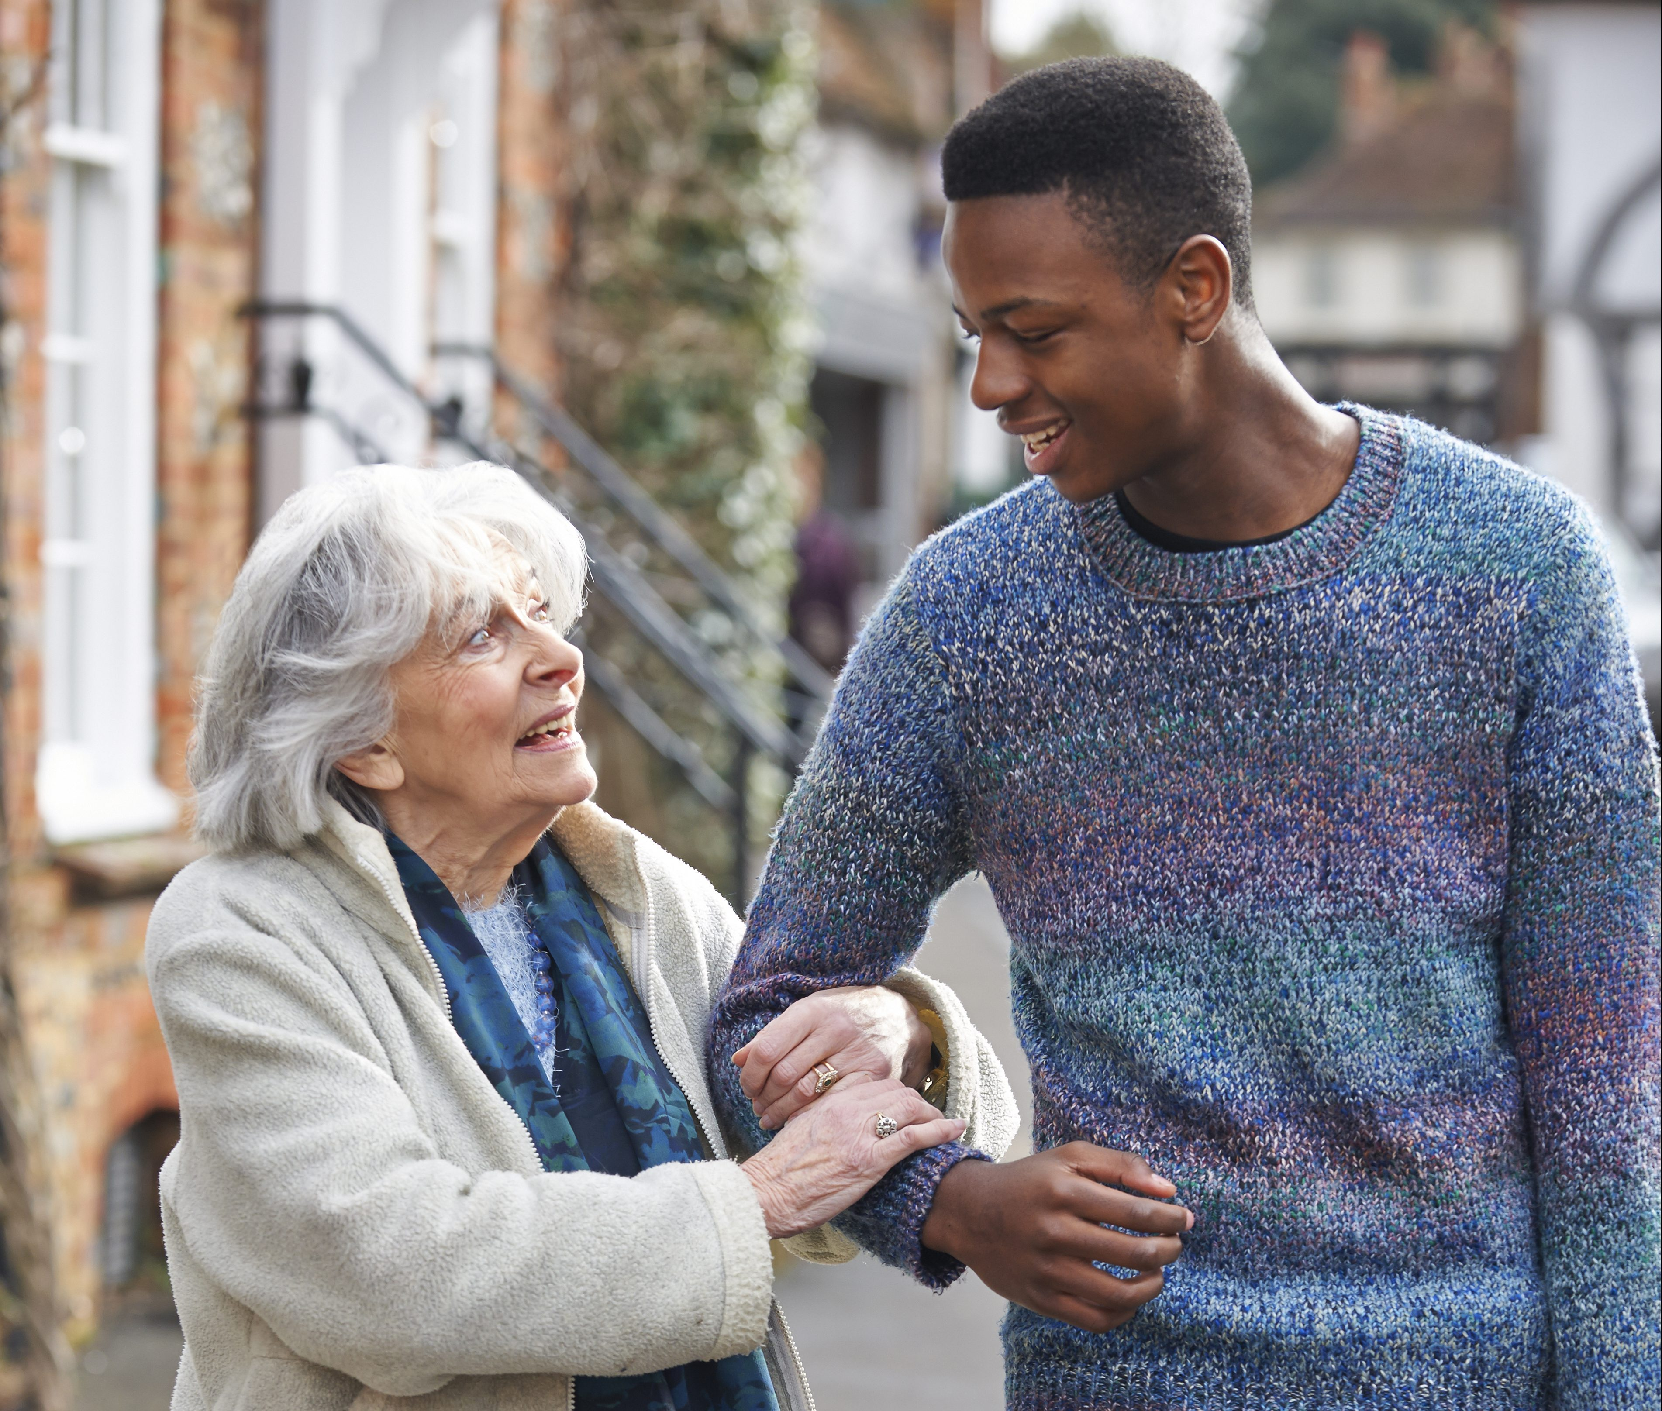
“Assembling Ourselves Together”
The Preacher recognized that being alone is not good for man – Ecclesiastes 4:8-12
Nobody to help us deal with difficulties (verse 12)
  Galatians 6:2 – Need to bear one another’s burderns
  Romans 15:1 – The strong need to help the weak
  Hebrews 6:10 – We need serve each others

Slide 8
“Assembling Ourselves Together”
As each has received a gift, use it to serve one another, as good stewards of God's varied grace:
I Peter 4:10
Love one another with brotherly affection. Outdo one another in showing honor.
Romans 12:10

Slide 9

“Assembling Ourselves Together”

