Slide 1
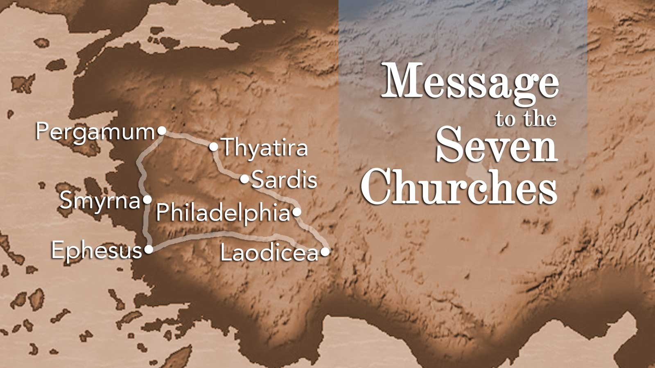

Slide 2
[
Is serving God our number 1 priority?
 | Ephesus 2:1-7 | Smyrna 2:8-11 | Pergamum 2:12-17 | Thyatira 2:18-29 | Sardis 3:1-6 | Philadelphia 3:7-13 | Laodicea 3:14-22
Condition and Praises | Good deeds Perseverance Won’t tolerate evil men | Slandered Afflicted In poverty Rich in Jesus | Remained faithful despite the evil around them | Growing Progressing | A few still faithful | Weak Tired Staying faithful | Lukewarm
Weaknesses | Forgot their first love | None | Allowed false teachers to remain | Tolerated a false prophetess Some had followed her teachings | Think they are a living church but they are not | None | On the fence, trying to serve God and the world
What did they need to do? | Repent Remember what their priorities were Return to first works | Continue to be faithful | Repent | Those who followed her must repent Those who didn’t follow her needed to hold fast to the truth | Repent Follow what they have been taught | Continue to be faithful | Turn their lives to Jesus
Consequence of Failing | Removal of their lampstand |  | Will be condemned by the Word | Will receive what their deeds deserve | They will be judged |  | Will not be with Christ for eternity
And one of them, a lawyer, asked him a question to test him. "Teacher, which is the great commandment in the Law?" And he said to him, "You shall love the Lord your God with all your heart and with all your soul and with all your mind. This is the great and first commandment. And a second is like it: You shall love your neighbor as yourself.
Matthew 22:36-39
Notes:
_______________________________________________________________________________________________________________________________________________________________________________________________________________________________________________________________________________________________________________________________________________________________________________________________________________________________________________________________________________________________________________________________________________________________________________________________________________________________________________________________________________________________________________________________________________________________________________________________________________________________________________________________________________________________________________________________________________________________________________________________________________

Slide 3
Are we letting trials drag us down?
 | Ephesus 2:1-7 | Smyrna 2:8-11 | Pergamum 2:12-17 | Thyatira 2:18-29 | Sardis 3:1-6 | Philadelphia 3:7-13 | Laodicea 3:14-22
Condition and Praises | Good deeds Perseverance Won’t tolerate evil men | Slandered Afflicted In poverty Rich in Jesus | Remained faithful despite the evil around them | Growing Progressing | A few still faithful | Weak Tired Staying faithful | Lukewarm
Weaknesses | Forgot their first love | None | Allowed false teachers to remain | Tolerated a false prophetess Some had followed her teachings | Think they are a living church but they are not | None | On the fence, trying to serve God and the world
What did they need to do? | Repent Remember what their priorities were Return to first works | Continue to be faithful | Repent | Those who followed her must repent Those who didn’t follow her needed to hold fast to the truth | Repent Follow what they have been taught | Continue to be faithful | Turn their lives to Jesus
Consequence of Failing | Removal of their lampstand |  | Will be condemned by the Word | Will receive what their deeds deserve | They will be judged |  | Will not be with Christ for eternity
Beloved, do not be surprised at the fiery trial when it comes upon you to test you, as though something strange were happening to you. But rejoice insofar as you share Christ's sufferings, that you may also rejoice and be glad when his glory is revealed.
I Peter 4:12-13
Notes:
___________________________________________________________________________________________________________________________________________________________________________________________________________________________________________________________________________________________________________________________________________________________________________________________________________________________________________________________________________________________________________________________________________________________________________________________________________________________________________________________________________________________________________________________________________________________________________________________________________________________________________________________________________________________________________________________________________________________________________________________________________________________________________________________________________________________________________________________________________________________________________________________________________________________________________________________________________________________________________________________

Slide 4
Do we make sure everything being taught is true?
 | Ephesus 2:1-7 | Smyrna 2:8-11 | Pergamum 2:12-17 | Thyatira 2:18-29 | Sardis 3:1-6 | Philadelphia 3:7-13 | Laodicea 3:14-22
Condition and Praises | Good deeds Perseverance Won’t tolerate evil men | Slandered Afflicted In poverty Rich in Jesus | Remained faithful despite the evil around them | Growing Progressing | A few still faithful | Weak Tired Staying faithful | Lukewarm
Weaknesses | Forgot their first love | None | Allowed false teachers to remain | Tolerated a false prophetess Some had followed her teachings | Think they are a living church but they are not | None | On the fence, trying to serve God and the world
What did they need to do? | Repent Remember what their priorities were Return to first works | Continue to be faithful | Repent | Those who followed her must repent Those who didn’t follow her needed to hold fast to the truth | Repent Follow what they have been taught | Continue to be faithful | Turn their lives to Jesus
Consequence of Failing | Removal of their lampstand |  | Will be condemned by the Word | Will receive what their deeds deserve | They will be judged |  | Will not be with Christ for eternity
Beloved, do not believe every spirit, but test the spirits to see whether they are from God, for many false prophets have gone out into the world..
I John 4:1
Now these Jews were more noble than those in Thessalonica; they received the word with all eagerness, examining the Scriptures daily to see if these things were so.
Acts 17:11
Notes:
___________________________________________________________________________________________________________________________________________________________________________________________________________________________________________________________________________________________________________________________________________________________________________________________________________________________________________________________________________________________________________________________________________________________________________________________________________________________________________________________________________________________________________________________________________________________________________________________________________________________________________________________________________________________________________________________________________________________________________________________________________________________________________________________________________________________________________________________________________________________________________________________________________________________________________________________________________________________________________________________

Slide 5
Do we focus on teachers who tell us what we want to hear or on teachers who tell us what we need to hear?
 | Ephesus 2:1-7 | Smyrna 2:8-11 | Pergamum 2:12-17 | Thyatira 2:18-29 | Sardis 3:1-6 | Philadelphia 3:7-13 | Laodicea 3:14-22
Condition and Praises | Good deeds Perseverance Won’t tolerate evil men | Slandered Afflicted In poverty Rich in Jesus | Remained faithful despite the evil around them | Growing Progressing | A few still faithful | Weak Tired Staying faithful | Lukewarm
Weaknesses | Forgot their first love | None | Allowed false teachers to remain | Tolerated a false prophetess Some had followed her teachings | Think they are a living church but they are not | None | On the fence, trying to serve God and the world
What did they need to do? | Repent Remember what their priorities were Return to first works | Continue to be faithful | Repent | Those who followed her must repent Those who didn’t follow her needed to hold fast to the truth | Repent Follow what they have been taught | Continue to be faithful | Turn their lives to Jesus
Consequence of Failing | Removal of their lampstand |  | Will be condemned by the Word | Will receive what their deeds deserve | They will be judged |  | Will not be with Christ for eternity
For the time is coming when people will not endure sound teaching, but having itching ears they will accumulate for themselves teachers to suit their own passions, and will turn away from listening to the truth and wander off into myths..
I Timothy 4:3-4
Notes:
___________________________________________________________________________________________________________________________________________________________________________________________________________________________________________________________________________________________________________________________________________________________________________________________________________________________________________________________________________________________________________________________________________________________________________________________________________________________________________________________________________________________________________________________________________________________________________________________________________________________________________________________________________________________________________________________________________________________________________________________________________________________________________________________________________________________________________________________________________________________________________________________________________________________________________________________________________________________________________________________

Slide 6
 | Ephesus 2:1-7 | Smyrna 2:8-11 | Pergamum 2:12-17 | Thyatira 2:18-29 | Sardis 3:1-6 | Philadelphia 3:7-13 | Laodicea 3:14-22
Condition and Praises | Good deeds Perseverance Won’t tolerate evil men | Slandered Afflicted In poverty Rich in Jesus | Remained faithful despite the evil around them | Growing Progressing | A few still faithful | Weak Tired Staying faithful | Lukewarm
Weaknesses | Forgot their first love | None | Allowed false teachers to remain | Tolerated a false prophetess Some had followed her teachings | Think they are a living church but they are not | None | On the fence, trying to serve God and the world
What did they need to do? | Repent Remember what their priorities were Return to first works | Continue to be faithful | Repent | Those who followed her must repent Those who didn’t follow her needed to hold fast to the truth | Repent Follow what they have been taught | Continue to be faithful | Turn their lives to Jesus
Consequence of Failing | Removal of their lampstand |  | Will be condemned by the Word | Will receive what their deeds deserve | They will be judged |  | Will not be with Christ for eternity
Have we honestly evaluated how we are doing as a congregation?
Examine yourselves, to see whether you are in the faith. Test yourselves. Or do you not realize this about yourselves, that Jesus Christ is in you?--unless indeed you fail to meet the test!
II Corinthians 13:5
Notes:
___________________________________________________________________________________________________________________________________________________________________________________________________________________________________________________________________________________________________________________________________________________________________________________________________________________________________________________________________________________________________________________________________________________________________________________________________________________________________________________________________________________________________________________________________________________________________________________________________________________________________________________________________________________________________________________________________________________________________________________________________________________________________________________________________________________________________________________________________________________________________________________________________________________________________________________________________________________________________________________________

Slide 7
 | Ephesus 2:1-7 | Smyrna 2:8-11 | Pergamum 2:12-17 | Thyatira 2:18-29 | Sardis 3:1-6 | Philadelphia 3:7-13 | Laodicea 3:14-22
Condition and Praises | Good deeds Perseverance Won’t tolerate evil men | Slandered Afflicted In poverty Rich in Jesus | Remained faithful despite the evil around them | Growing Progressing | A few still faithful | Weak Tired Staying faithful | Lukewarm
Weaknesses | Forgot their first love | None | Allowed false teachers to remain | Tolerated a false prophetess Some had followed her teachings | Think they are a living church but they are not | None | On the fence, trying to serve God and the world
What did they need to do? | Repent Remember what their priorities were Return to first works | Continue to be faithful | Repent | Those who followed her must repent Those who didn’t follow her needed to hold fast to the truth | Repent Follow what they have been taught | Continue to be faithful | Turn their lives to Jesus
Consequence of Failing | Removal of their lampstand |  | Will be condemned by the Word | Will receive what their deeds deserve | They will be judged |  | Will not be with Christ for eternity
Have we gotten tired and started to give up?
And let us not grow weary of doing good, for in due season we will reap, if we do not give up.
Galatians 6:9
Notes:
___________________________________________________________________________________________________________________________________________________________________________________________________________________________________________________________________________________________________________________________________________________________________________________________________________________________________________________________________________________________________________________________________________________________________________________________________________________________________________________________________________________________________________________________________________________________________________________________________________________________________________________________________________________________________________________________________________________________________________________________________________________________________________________________________________________________________________________________________________________________________________________________________________________________________________________________________________________________________________________________

Slide 8
 | Ephesus 2:1-7 | Smyrna 2:8-11 | Pergamum 2:12-17 | Thyatira 2:18-29 | Sardis 3:1-6 | Philadelphia 3:7-13 | Laodicea 3:14-22
Condition and Praises | Good deeds Perseverance Won’t tolerate evil men | Slandered Afflicted In poverty Rich in Jesus | Remained faithful despite the evil around them | Growing Progressing | A few still faithful | Weak Tired Staying faithful | Lukewarm
Weaknesses | Forgot their first love | None | Allowed false teachers to remain | Tolerated a false prophetess Some had followed her teachings | Think they are a living church but they are not | None | On the fence, trying to serve God and the world
What did they need to do? | Repent Remember what their priorities were Return to first works | Continue to be faithful | Repent | Those who followed her must repent Those who didn’t follow her needed to hold fast to the truth | Repent Follow what they have been taught | Continue to be faithful | Turn their lives to Jesus
Consequence of Failing | Removal of their lampstand |  | Will be condemned by the Word | Will receive what their deeds deserve | They will be judged |  | Will not be with Christ for eternity
Are we solely focused on serving God or have we become distracted?
"No one can serve two masters, for either he will hate the one and love the other, or he will be devoted to the one and despise the other.
Matthew 6:24a
Notes:
___________________________________________________________________________________________________________________________________________________________________________________________________________________________________________________________________________________________________________________________________________________________________________________________________________________________________________________________________________________________________________________________________________________________________________________________________________________________________________________________________________________________________________________________________________________________________________________________________________________________________________________________________________________________________________________________________________________________________________________________________________________________________________________________________________________________________________________________________________________________________________________________________________________________________________________________________________________________________________________________

