Slide 1
Selfless vs. Selfish
Matthew 22:36-40

Slide 2


Holiday Classics

Slide 3
Selfless vs. Selfish
Matthew 22:36-40
  A Pharisee attempted to “test” Jesus by asking what was the most important commandment in the law
  His response focuses on WHO should be important
    #1 is God
    #2 is other people
Notice that SELF is never mentioned!!

Slide 4
Selfless vs. Selfish
Matthew 26:36-44
  In the Garden of Gethsemane Jesus prayed to God regarding what was to befall him.
    Verse 39: “My Father, if it be possible, let this cup pass from me; nevertheless, not as I will, but as you will.”
    Verse 42: “My Father, if this cannot pass unless I drink it, your will be done.”
    Verse 44: So, leaving them again, he went away and prayed for the third time, saying the same words again.
Jesus set an example showing that we need to put God, and his will, above our own desires
Notes:
Matthew 6:9-13 – The Model Prayer includes the recognition that God’s will comes before our own.

Slide 5
Selfless vs. Selfish
Genesis 22
  God tested Abraham, telling him to take his ONLY son Issac and sacrifice him. At one point Issac asks him where the lamb was for the sacrifice
    Verse 8: “My son, God will provide himself a lamb for a burnt offering: so they went both of them together.”
Abraham’s love for God was greater than his love for anything else. He trusted that God could and would take care of things

Slide 6
Selfless vs. Selfish
John 13:12-17
  “When he had washed their feet and put on his outer garments and resumed his place, he said to them, "Do you understand what I have done to you? You call me Teacher and Lord, and you are right, for so I am. If I then, your Lord and Teacher, have washed your feet, you also ought to wash one another's feet. For I have given you an example, that you also should do just as I have done to you. Truly, truly, I say to you, a servant is not greater than his master, nor is a messenger greater than the one who sent him. If you know these things, blessed are you if you do them.”
Jesus also provided an example showing the importance of putting other people before self

Slide 7
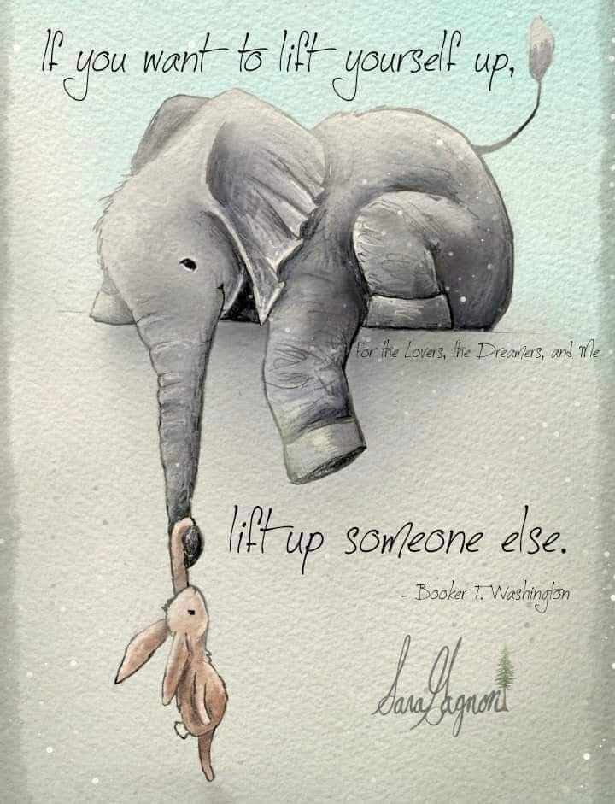
Selfless vs. Selfish

Slide 8
Selfless vs. Selfish
John 13:34
  In the upper room Jesus tells his disciples that he has a new commandment for them…”just as I have loved you, you also are to love one another”.
    What does it mean to “Love” others? – I Corinthians 13:4-7
      Being patient and kind
      Not being envious, boastful, arrogant or rude
      Not insisting on getting our own way
      Not being irritable or resentful
      Not rejoicing in the failures (spiritual and/or worldly) of others, but in the successes (spiritual and/or worldly)
      Not looking to expose the shortcomings of others
      Giving others the benefit of the doubt
      Having a positive view of others
      Being willing to forgive and forget
Love is Selfless!
Notes:
Song #79

Slide 9
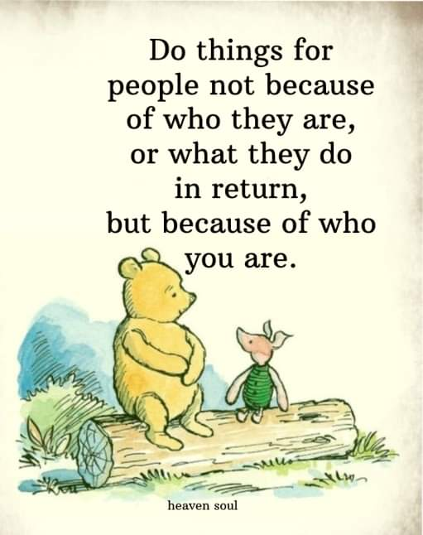
Selfless vs. Selfish

Slide 10
Selfless vs. Selfish
I Corinthians 10:23
  This passage discusses exercising “rights” versus doing what is best for others
    "All things are lawful," but not all things are helpful. "All things are lawful," but not all things build up.”
  There are many things that we have the “right” to say and do.
    We have the “right” to have opinions
    We have “freedom” of speech
    We have the “right” to worship as we desire
    We have the “freedom” to pursue life, liberty, and the pursuit of freedom
  Our “rights” don’t override our responsibilities to others

Slide 11
Selfless vs. Selfish
John 13:35
  He continues to tell his disciples that “By this all people will know that you are my disciples”.
They will know because most people are SELFISH, not SELFLESS!!
Notes:
Cain — an example of one who had no concern for others (Genesis 4). Most are familiar with the story of Cain — how God rejected his sacrifice while accepting that of Abel, his brother. Cain, jealous of his brother and having no regard for anyone but self, murdered his brother. When God afterward asks him where Abel was, Cain responds with the question, “Am I my brother’s keeper?” (Gen. 4:9). All of us must realize we are our “brother’s keepers.” We are to look out for the interests of others (Phil. 2:4) and to esteem others better than self (Phil. 2:3). We must love one another (1 John 4:7).
Ahab — an example of one whose selfishness led him to be concerned about things before he was concerned about people. King Ahab coveted Naboth’s vineyard and pouted when he could not get it (1 Kings 21). His wicked wife Jezebel killed Naboth and then gave his vineyard to her husband as a gift. He was ecstatic. He gave no thought to Naboth or his family. He had what he wanted. Too many people place undue emphasis on things of this world and too little on people. Jesus said one cannot serve God and things (Matt. 6:24).
David — an example of a selfish attitude which caused him to seek fulfillment of his own pleasures with no regard to the cost in getting them. His selfish pursuit of pleasure caused him to sin with Bathsheba. His selfishness then led to lies and murder (2 Samuel 11). Like David, far too many people today are selfishly pursuing pleasure with no regard for either consequences or the impact of their actions upon others.
The Older Brother of the prodigal (Luke 15) — an example of one who had no compassion or love for others. Jesus stated to His disciples, “A new commandment I give to you, that you love one another; as I have loved you, that you also love one another” (John 13:34). While the older brother seemed to love his father, his lack of love for his brother showed otherwise. The Christian may claim to love God but if, out of selfishness, he does not love his brother, he, in reality, does not love God (1 John 4:20-21).

Slide 12
Selfless vs. Selfish
How Did These Apply?

Slide 13
Selfless vs. Selfish
Philippians 2:5-8
  Jesus set the example of what it means to be selfless
    "Have this mind among yourselves, which is yours in Christ Jesus, 6 who, though he was in the form of God, did not count equality with God a thing to be grasped, but emptied himself, by taking the form of a servant, being born in the likeness of men. And being found in human form, he humbled himself by becoming obedient to the point of death, even death on a cross.”
He wasn’t selfish, he was selfless.
What about us?
Notes:
John 1:1 tells us the Jesus was God, yet he took on the form of a servant. Why?
Romans 5:6-10: To save us from OUR sins

