Slide 1
Jesus Seeks Solitude
Luk 5:12-16

Slide 2
Jesus Seeks Solitude
Lk 5:16, However, he continued his habit of retiring to deserted places and praying. ISV
  he would withdraw to desolate places and pray (ESV)
Introduction

Slide 3
Jesus Seeks Solitude
  Gen 16:6-7, Gen 21:17-21, Hagar
  Israel wandered for 40 years in the wilderness.
  Ps 63:1-8, David
  1 Kng 19:1-8, Elijah
  John the Baptizer
    Mt 3:1, John the baptizer ministered in the wilderness
    Isa 40:3-5, The voice of one crying in the wilderness.
    Mt 3:4, ...raiment of camel's hair, ... his meat was locusts and wild honey.
Highlighting Bible Characters & The Wilderness

Slide 4
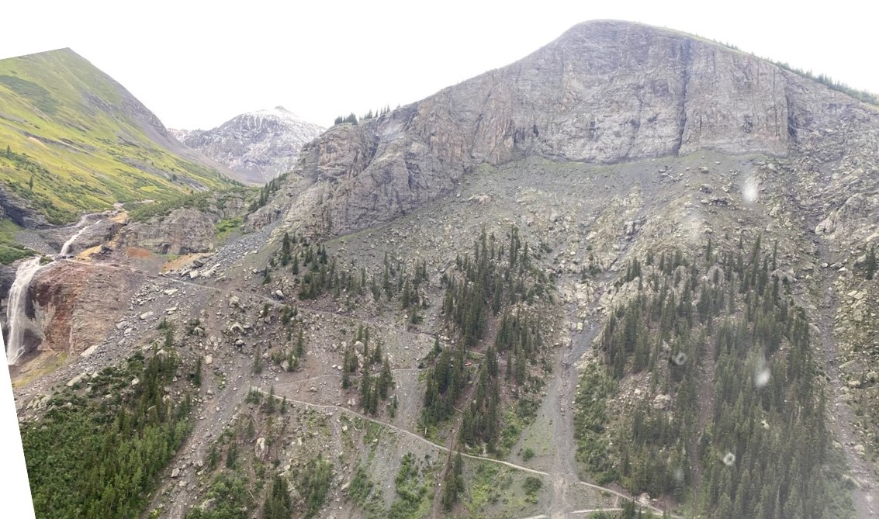
Mountains

Slide 5
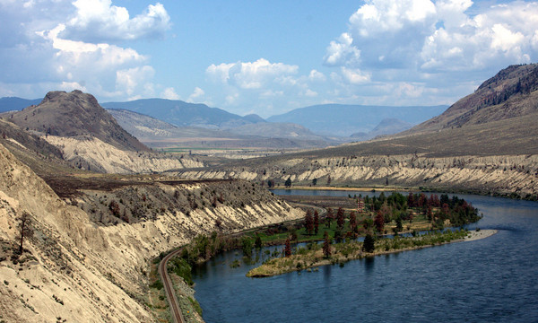
Desert

Slide 6
Jesus Seeks Solitude
Nature Of The Wilderness
  Ps 63:1-8, Lack Of Water
  Mt 3:4, Lack Of Food
  Isa 43:19, Ezk 34:25, Lack Of Safety
  Isa 43:19, Rugged Terrain
  1 Kng 19:1-8, 1 Kng 18:4, Lack Of Shelter
Wilderness Habitats

Slide 7
Jesus Seeks Solitude
  Mt 4:1-3, After His Baptism
  Mt 14:10-21, After John The Baptizers’ Death
    Mk 6:31-32, When Jesus heard of it, he departed by ship into a desert place
  Mt 14:22-29,Lk 5:12-16, After Intense Work
  Lk 6:12-16, Before Selecting Apostles
  Lk 22:39-46, Before A Great trial

Slide 8
Jesus Seeks Solitude
Jesus Put Himself Into Difficult, Hard, & Challenging Situations
  Often
  With Intent
  Purpose:
    Prayer, Fasting, Meditation, Rest, & Recovery
    In some instances we can only presume why
Summary

Slide 9
Jesus Seeks Solitude
Solitude... With God
  The Believer Is Never Truly Alone
  Solitude From
    Isolation From Work
    Isolation From Influences
    Isolation From Noise Of Life
Lessons

Slide 10
Jesus Seeks Solitude
Trials Produce
  Results/Solutions/Resilience
  Control Of Our Thoughts And Emotions
    Fear
    The Unknown
    Faith In God And His Works
  We Have Capabilities Far Beyond Our Experiences
Lessons

Slide 11
Jesus Seeks Solitude
The Trivial
  Prioritization Of Needs vs. Wants
Life Here Is Our Wilderness
  We Are Wanderers & Pilgrims In This World
Lessons

