Slide 1
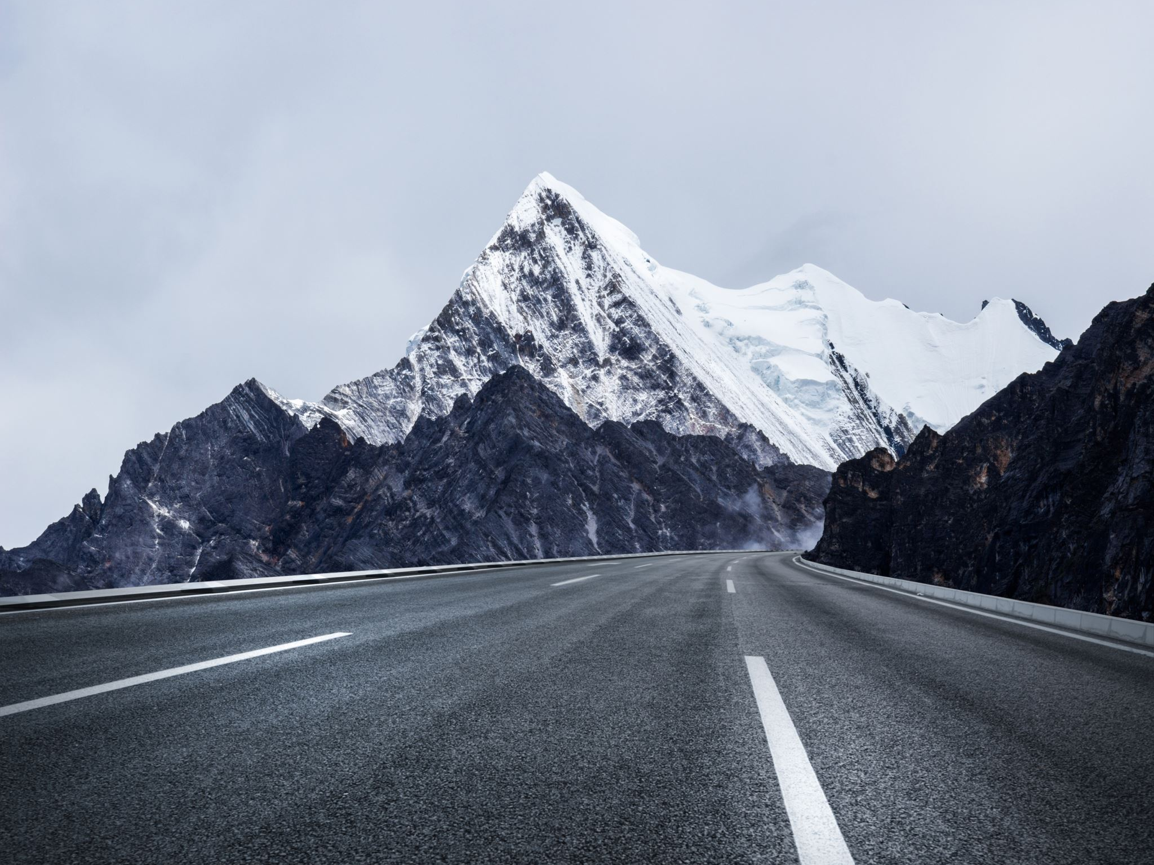
Our Pilgrimage
Heb 11:13-16

Slide 2
Our Pilgrimage
In Foreign Land
  Ex 6:4, The Land Of Their Pilgrimage
    400 Years Between Joseph To The Exodus
  Gen 17:8, Abraham
  Gen 36:7, Jacob & Esau
  Gen 50:23-26, Joseph
Allegory to Israel In Egypt
Notes:
We have been promised a new home flowing with milk and honey
We are blessed by God and prosper here; but there is better.

Slide 3
Our Pilgrimage
Prospered
  Ex 1:7, they were fruitful, increased abundantly, multiplied, exceedingly mighty; so that the land was full of them
  Ex 1:12, the more they were afflicted the more they multiplied
Allegory to Israel In Egypt
Notes:
We have been promised a new home flowing with milk and honey
We are blessed by God and prosper here; but there is better.

Slide 4
Our Pilgrimage
Enslaved
  Ex 1:8-14, Pharoah burdened them due to fear
  Ex 6:4-9, God speaks of their burdens and bondage
Allegory to Israel in Egypt

Slide 5
Our Pilgrimage
Promises of God
  A Better Home
    Gen 17:8, To Abraham
    Gen 50:23-26, Joseph
      Lived To The 3rd Generation Of Ephraim
      Surly Family Stories Spoke Of This Promise
    Ex 6:8, God To Fulfill The Promise
  A Glorious Land
    Ex 3:8, Num 13:27, good and large land, unto a land flowing with milk and honey
Allegory to Israel in Egypt

Slide 6
Our Pilgrimage
Weak In Faith
  Faith To Endure
    Ex 5, Murmuring Over Problems Pharoah Creates
  Faith To Act
    Cross Over Jordan
      Ex 14:8-13, Murmuring About Egypt Army Coming
    Enter The Land
      Num 13:26-33, Report Of The Spies
  Murmured Much!
    16 Verses On Murmuring
Allegory to Israel in Egypt

Slide 7
Our Pilgrimage
Allegory Of Israel And The Exodus
  In Foreign Land
  Prosper
  Enslaved
  Promises Of God
    A Better Home
    A Glorious Land
  Weak In Faith
    Faith To Endure
    Faith Act
Summary

Slide 8
Our Pilgrimage
Current Conditions Are Not Ideal
  We Prosper In A Since
  Bad – Sin
  Maybe Normal For Us But Not Normal For Eternity
    Sickness, Death, Temptation, Fear, Sadness, Etc.
Lessons

Slide 9
Our Pilgrimage
Faith For The Journey
  To Endure Hardship
    Absent Of Complaining
      Not A Factor Of How Unfair Or Difficult
      A Factor Of Our Attitude Toward It & More Importantly Toward God
  Trust God
    That It Is Our Purpose
    The Way Works For Our Benefit
  Heb 3:7-19, Analogy Made With Christian Lives And The Exodus
Lessons

Slide 10
Our Pilgrimage
There Is An Infinitely Better Place
  Pilgrims To Our Nation
    Not Many Generations Ago
    Passion For Change – Something Better
    Today – We Have Already Forgotten Who They Are
  Heb 11:13-16, Faith, Hope, Desire, & Passion For Better
Lessons

Slide 11
Our Promised Land
Rev 22:1-5:
1 And he shewed me a pure river of water of life, clear as crystal, proceeding out of the throne of God and of the Lamb.
2 In the midst of the street of it, and on either side of the river, was there the tree of life, which bare twelve manner of fruits, and yielded her fruit every month: and the leaves of the tree were for the healing of the nations.
3 And there shall be no more curse: but the throne of God and of the Lamb shall be in it; and his servants shall serve him:
4 And they shall see his face; and his name shall be in their foreheads.
5 And there shall be no night there; and they need no candle, neither light of the sun; for the Lord God giveth them light: and they shall reign for ever and ever.

