Slide 1
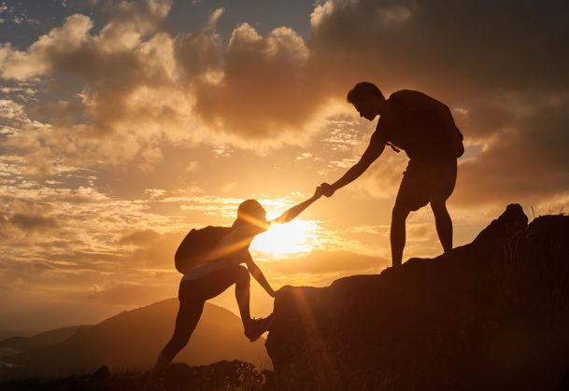
Helping Others
Philippians 2:1-4

Slide 2
Helping Others
    Ruth 1:20-21 And she said unto them, Call me not Naomi, call me Mara: for the Almighty hath dealt very bitterly with me. I went out full, and the LORD hath brought me home again empty: why then call ye me Naomi, seeing the LORD hath testified against me, and the Almighty hath afflicted me?
Naomi was struggling, she felt defeated
    Had to leave her home and go to a foreign country due to a famine
    Her husband died
    Her 2 sons died

Slide 3
Helping Others
Then something changed
    Ruth 4: 14-15 And the women said unto Naomi, Blessed be the LORD, which hath not left thee this day without a kinsman, that his name may be famous in Israel. And he shall be unto thee a restorer of thy life, and a nourisher of thine old age: for thy daughter in law, which loveth thee, which is better to thee than seven sons, hath born him.

Slide 4
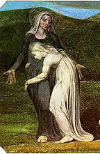
Helping Others
What Changed?
  She wouldn’t leave Naomi to fend for herself – Ruth 1:16-19
    We need to help others when they are dealing with difficulties
      It isn’t good for us to be alone – Genesis 2:18
      We need to be there to provide support when it is needed – Ecclesiastes 4:9-12
      Helping others will help us – Proverbs 11:25
Ruth refused to leave Naomi
Notes:
Ruth 1:16-18 ¹⁶ But Ruth said, "Do not urge me to leave you or to return from following you. For where you go I will go, and where you lodge I will lodge. Your people shall be my people, and your God my God. ¹⁷ Where you die I will die, and there will I be buried. May the LORD do so to me and more also if anything but death parts me from you." ¹⁸ And when Naomi saw that she was determined to go with her, she said no more.
Genesis 2:18 Then the LORD God said, "It is not good that the man should be alone; I will make him a helper fit for him.“
Ecclesiastes 4:9-12 ⁹ Two are better than one, because they have a good reward for their toil. ¹⁰ For if they fall, one will lift up his fellow. But woe to him who is alone when he falls and has not another to lift him up! ¹¹ Again, if two lie together, they keep warm, but how can one keep warm alone? ¹² And though a man might prevail against one who is alone, two will withstand him--a threefold cord is not quickly broken.
Proverbs 11:25 Whoever brings blessing will be enriched, and one who waters will himself be watered.

Slide 5
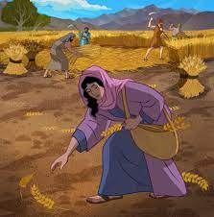
Helping Others
What Changed?
  She worked hard to help Naomi – Ruth 2:3-8
    We need to be active in our efforts to help others
      Actions speak louder than words – James 2:14-17
      We need to do good works and acts of charity – Acts 9:36, 39
      We need to use what we have been given to help others – I Peter 4:10
Ruth put effort into helping
Notes:
Ruth 2:3-8 ³ So she set out and went and gleaned in the field after the reapers, and she happened to come to the part of the field belonging to Boaz, who was of the clan of Elimelech. ⁴ And behold, Boaz came from Bethlehem. And he said to the reapers, "The LORD be with you!" And they answered, "The LORD bless you." ⁵ Then Boaz said to his young man who was in charge of the reapers, "Whose young woman is this?" ⁶ And the servant who was in charge of the reapers answered, "She is the young Moabite woman, who came back with Naomi from the country of Moab. ⁷ She said, 'Please let me glean and gather among the sheaves after the reapers.' So she came, and she has continued from early morning until now, except for a short rest." ⁸ Then Boaz said to Ruth, "Now, listen, my daughter, do not go to glean in another field or leave this one, but keep close to my young women.
James 2:14-17 ¹⁴ What good is it, my brothers, if someone says he has faith but does not have works? Can that faith save him? ¹⁵ If a brother or sister is poorly clothed and lacking in daily food, ¹⁶ and one of you says to them, "Go in peace, be warmed and filled," without giving them the things needed for the body, what good is that? ¹⁷ So also faith by itself, if it does not have works, is dead.
Acts 9:36 Now there was in Joppa a disciple named Tabitha, which, translated, means Dorcas. She was full of good works and acts of charity.
Acts 9:39 So Peter rose and went with them. And when he arrived, they took him to the upper room. All the widows stood beside him weeping and showing tunics and other garments that Dorcas made while she was with them.
I Peter 4:10 As each has received a gift, use it to serve one another, as good stewards of God's varied grace:

Slide 6
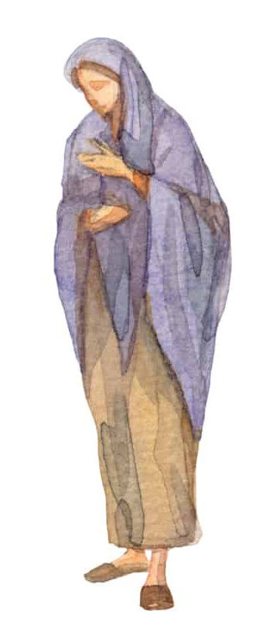
Helping Others
What Changed?
  She was willing to make sacrifices for the benefit of Naomi – Ruth 2:11
    We need to remember everything isn’t about us
      We need to look after the needs of others, not just our own – Philippians 2:4
      Helping others is not always convenient – Luke 10:30-35
    Making sacrifices isn’t about making ourselves look good
      We don’t need to let others know about sacrifices we have made – Colossians 3:23
      Our efforts shouldn’t be based on ambition, getting gain from someone’s troubles – Philippians 2:3
Ruth was willing to inconvenience herself
Notes:
Ruth 2:11 But Boaz answered her, "All that you have done for your mother-in-law since the death of your husband has been fully told to me, and how you left your father and mother and your native land and came to a people that you did not know before.
Philippians 2:4 Let each of you look not only to his own interests, but also to the interests of others.
Luke 10:30-35 ³⁰ Jesus replied, "A man was going down from Jerusalem to Jericho, and he fell among robbers, who stripped him and beat him and departed, leaving him half dead. ³¹ Now by chance a priest was going down that road, and when he saw him he passed by on the other side. ³² So likewise a Levite, when he came to the place and saw him, passed by on the other side. ³³ But a Samaritan, as he journeyed, came to where he was, and when he saw him, he had compassion. ³⁴ He went to him and bound up his wounds, pouring on oil and wine. Then he set him on his own animal and brought him to an inn and took care of him. ³⁵ And the next day he took out two denarii and gave them to the innkeeper, saying, 'Take care of him, and whatever more you spend, I will repay you when I come back.’
Colossians 3:23 Whatever you do, work heartily, as for the Lord and not for men,
Philippians 2:3 ³ Do nothing from selfish ambition or conceit, but in humility count others more significant than yourselves.

Slide 7
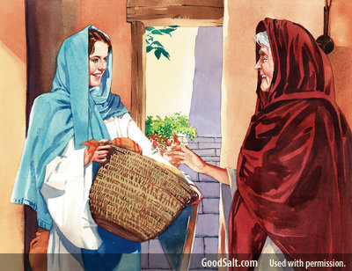
Helping Others
What Changed?
  She made sure Naomi was taken care of – Ruth 2:2, 17-18
    We need to look out for the physical needs of others
      Instructed to use the blessings we are given to care for others – I John 3:17
      Sharing what we have with others is pleasing to God – Hebrews 13:16
    We need to look out for spiritual needs of others
      Instructed to be there when others struggle spiritually – Galatians 6:1-2
      We can pray for each other – Luke 22:31-32
Ruth made sure Naomi had what she needed
Notes:
Ruth 2:2 And Ruth the Moabite said to Naomi, "Let me go to the field and glean among the ears of grain after him in whose sight I shall find favor." And she said to her, "Go, my daughter.“
Ruth 2:17-18 ¹⁷ So she gleaned in the field until evening. Then she beat out what she had gleaned, and it was about an ephah of barley. ¹⁸ And she took it up and went into the city. Her mother-in-law saw what she had gleaned. She also brought out and gave her what food she had left over after being satisfied.
I John 3:17 But if anyone has the world's goods and sees his brother in need, yet closes his heart against him, how does God's love abide in him?
Hebrews 13:16 Do not neglect to do good and to share what you have, for such sacrifices are pleasing to God.
Galatians 6:1-2 ¹ Brothers, if anyone is caught in any transgression, you who are spiritual should restore him in a spirit of gentleness. Keep watch on yourself, lest you too be tempted. ² Bear one another's burdens, and so fulfill the law of Christ.
Luke 22:31-32 ³¹ "Simon, Simon, behold, Satan demanded to have you, that he might sift you like wheat, ³² but I have prayed for you that your faith may not fail. And when you have turned again, strengthen your brothers."

Slide 8
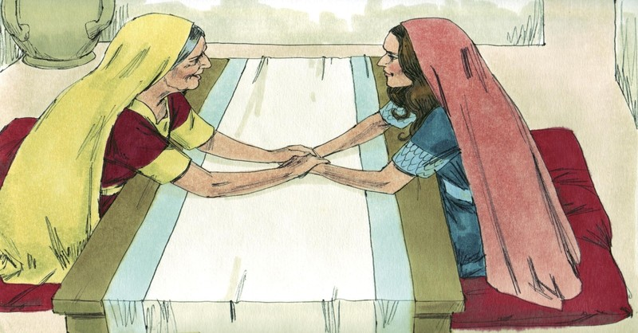
Helping Others
What Changed?
  She was willing to let Naomi help her – Ruth 3:1
    Helping others is good for us
      It is more blessed to give than receive – Acts 20:35
      We need to give others the opportunity to help us – Philippians 4:10
Ruth was willing to let Naomi help her
Notes:
Ruth 3:1 Then Naomi her mother-in-law said to her, "My daughter, should I not seek rest for you, that it may be well with you?
Acts 20:35 In all things I have shown you that by working hard in this way we must help the weak and remember the words of the Lord Jesus, how he himself said, 'It is more blessed to give than to receive.’”
Philippians 4:10 I rejoiced in the Lord greatly that now at length you have revived your concern for me. You were indeed concerned for me, but you had no opportunity.
“It’s a Wonderful Life”
“The Grinch”

Slide 9
Helping Others
Summary
  We need to be there for others
  We need to be active in our efforts to help others
  We need to remember everything isn’t about us
  Helping others isn’t about making ourselves look good
  We need to look out for the physical and spiritual needs of others
  Helping others is good for us

Slide 10
