Slide 1
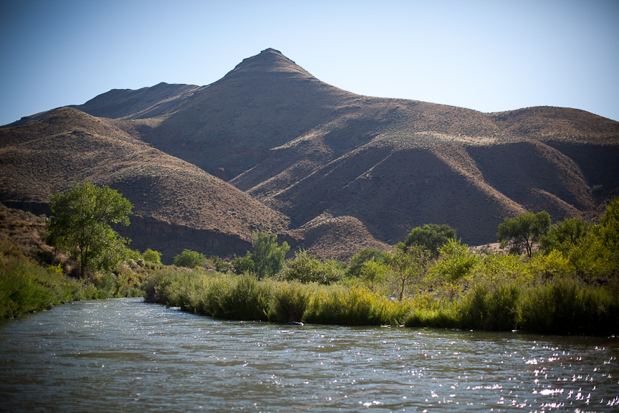
HIGHWAY of HOLINESS
Isa 35:3-10

Slide 2
Highway of Holiness
Introduction
  Pioneer Travel
    Found Good Routes
    Cleared And Developed
    Improved
    Navigated Obstacles
      Rivers
      Mississippi Delta
      Woodlands
      Mountains

Slide 3
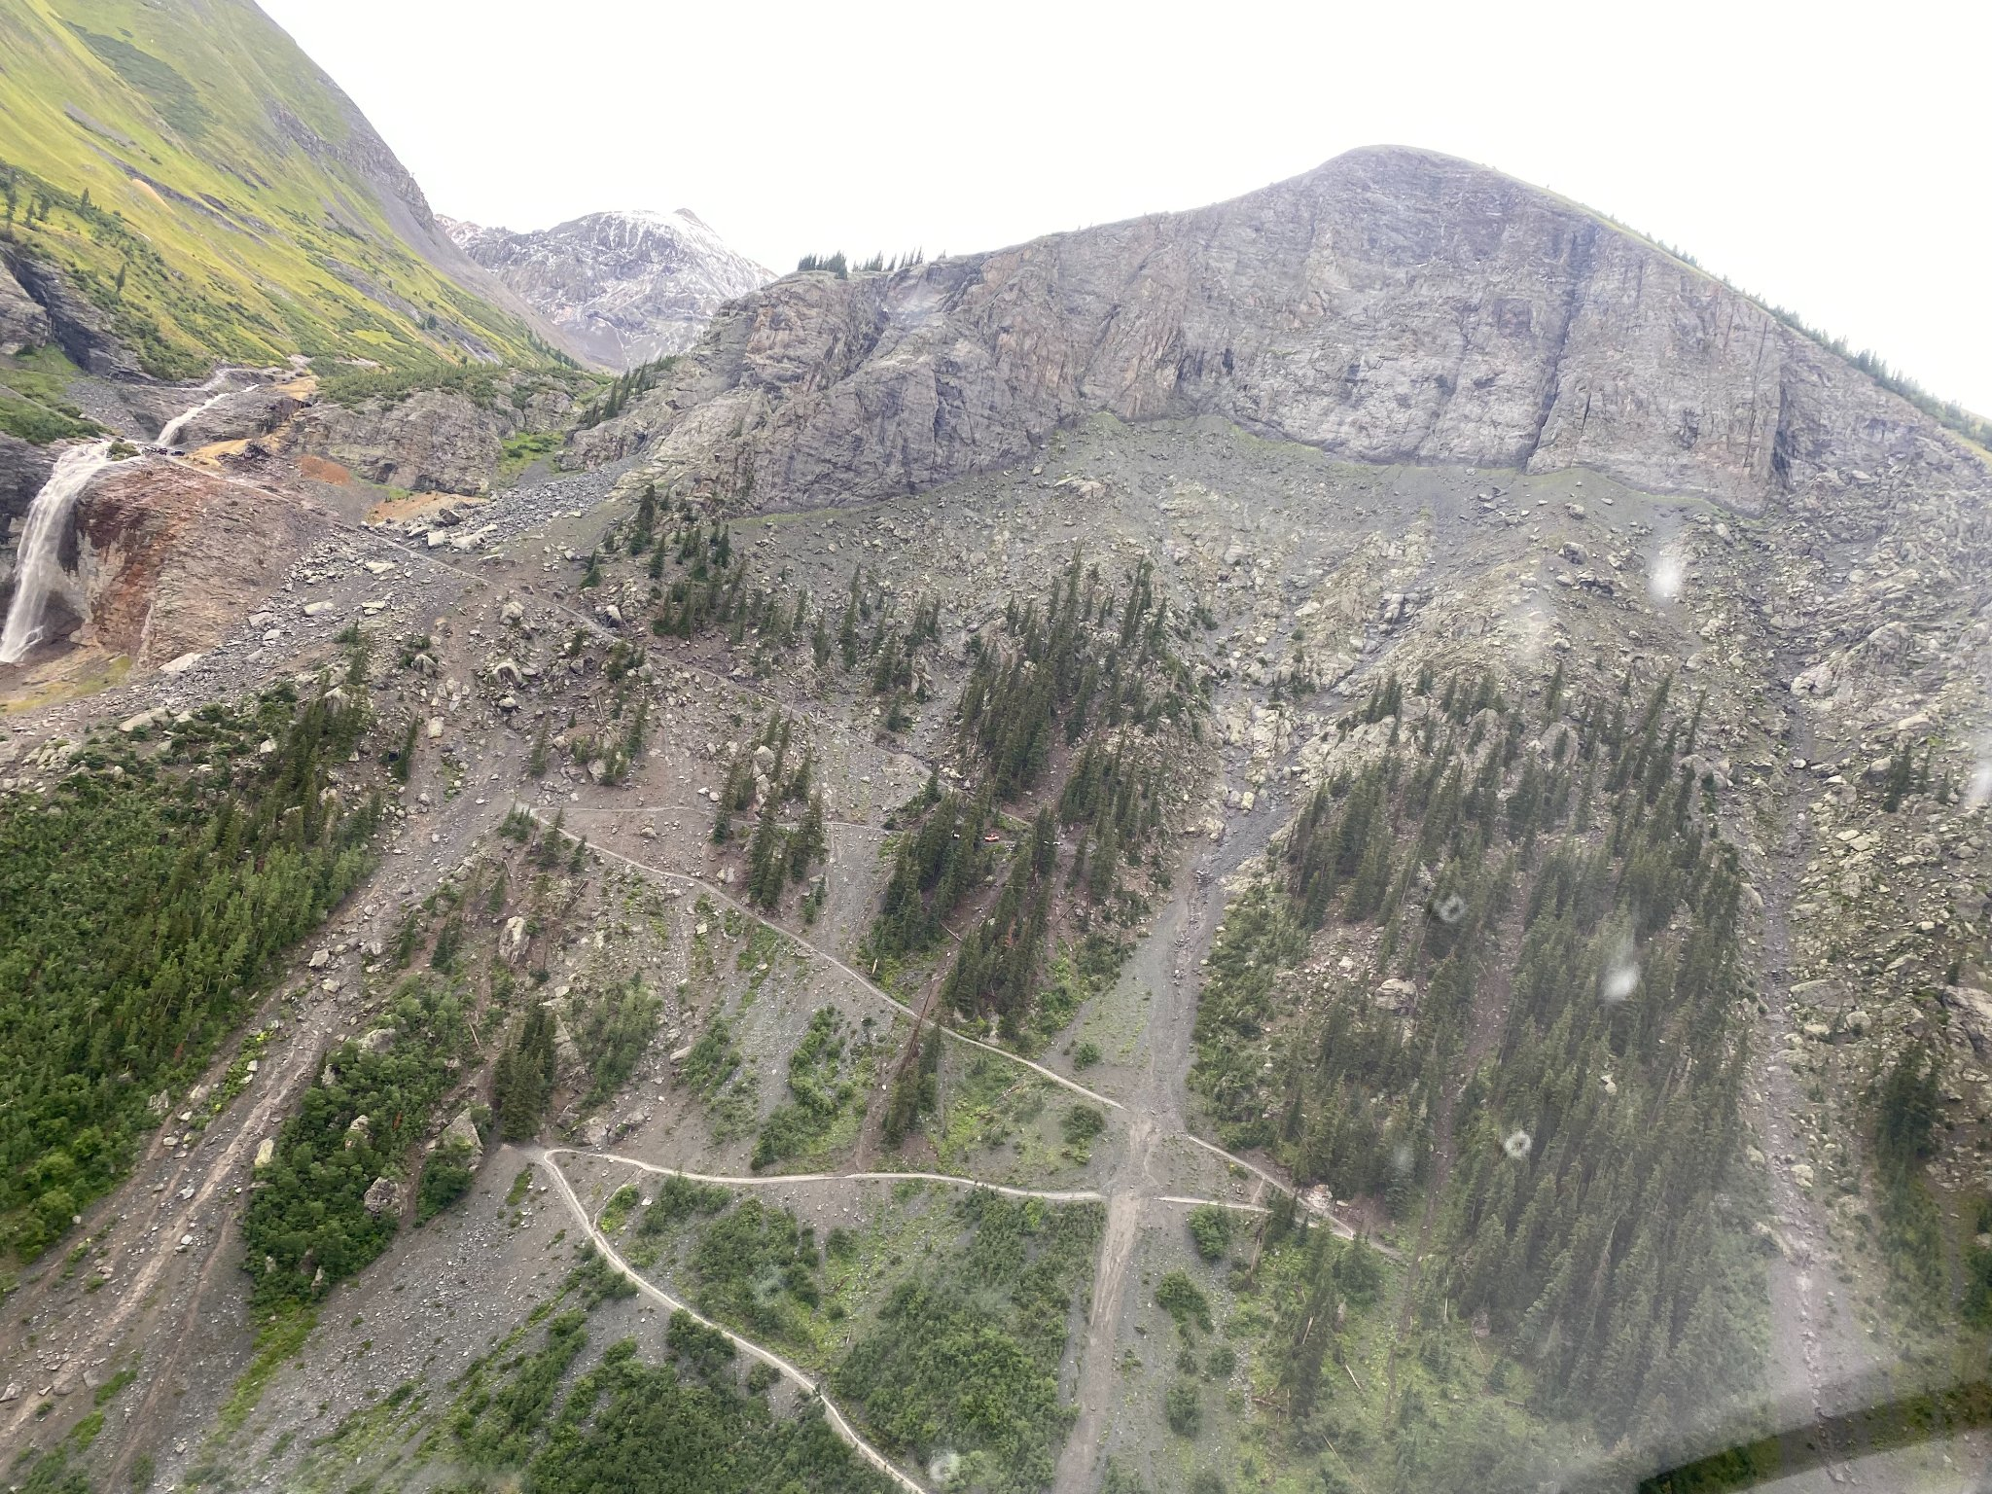

Slide 4
Highway of Holiness
A Highway
  Isa 35:8 “And an highway shall be there,”
    Lk 3:4-6, They knew how to build highways
    Analogy: Early Settlers and Wilderness Travel

Slide 5
Highway of Holiness
Safe
  Isa 35:9, “No lion shall be there, nor any ravenous beast shall go up thereon, it shall not be found there.”
    Vs. 4-7, for in the wilderness shall waters break out...
    Mt 11:28-30; Jesus will provide rest
    1 Cor 10:15; Dealing with Temptations
    Rom 8:31-39, More than Conquers

Slide 6
Highway of Holiness
Holy
  Isa 35:8, 9, “the unclean shall not pass over it…but the redeemed shall walk their.”
    2 Cor 4:3-4, god of this world blinds
    Mt 11:25-26, Gospel hid from the wise and prudent
    Mt 13:14-16, Hearts hard and ears closed
  Gal 5:22-25; Fruit of the Spirit

Slide 7
Highway of Holiness
Accessible
  Isa 35:8, “Redeemed shall walk there”
    “It shall belong to those who walk on the way; even if they are fools” (ESV)
    2 Tim 2:4-6; God desires that all men be saved
    Typically The Common Man Received

Slide 8
Highway of Holiness
Rejoicing & Hope
  Isa 35:10, “come to Zion with songs & everlasting joy upon their heads: they shall obtain joy & gladness, & sorrow & sighing shall flee away.”
    Jas 5:13, Song & Prayer Among Christians
    Gal 5:22, Joy, Peace, ...
    Heb 4:14-16, God Is Approachable

Slide 9
Highway of Holiness
Leaving the Highway
  Highways Designed With Purpose
    Highways Are Cleared
    Highways Are Safe
  Hard Going
    Impossible To Go
  People Love The Desert
    Jn 3:19, Men Love Darkness
    Mirage

Slide 10
Highway of Holiness
Summary
  God Has Prepared A Superhighway For Man To Travel On
  Condition Of The Highway
    Hills Brought Low
    Valleys Raised Up
    Cleared Of Predators
    He Made It EASY
  A Way Of Holiness
  Accessible To The Simple
  Offer Of Joy And Hope

Slide 11
Highway of Holiness
Lessons
  The Way is prepared but we must still travel on it
  Mt 7:13-14, Straight And Narrow
    There Are Challenges Along The Way
    Have To Stay On The Highway
  God Designed It, Jesus Paved It, Holy Spirit Revealed The Plans

Slide 12
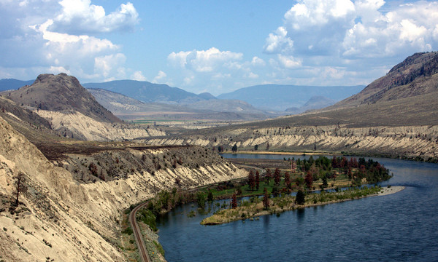
Who Will Follow Jesus
Along the Highway of Holiness?

