Slide 1
Isa 53:1-12

Slide 2
Prophecies of Jesus
Isa 53:1-3, Rejected By His Own People
  Who Believed, Who Saw His Power?
    Lk 19:10, Jesus came to seek and save that which was lost.
    Lk 9:56, For the Son of man is not come to destroy men's lives, but to save them.
      Disciples wanted to call fire down from Heaven on the unbelievers

Slide 3
Prophecies of Jesus
Isa 53:1-3, Rejected By His Own People
  Who Believed, Who Recgonized His Power?
    Kingdom Citizens, Lk 13:22-19:28
      Lk 14:1-6, heals the man with dropsy
      Lk 14:7-14, Humility when going to a wedding
      Lk 14:15-24, Parable of the Great Supper, poor, maimed…
      Lk 14:25-35, Loyalty to Jesus over family
      Lk 15, Parable of the Lost Sheep, Coin, Son
      Lk 16:16-31, Parable of the Rich man and Lazarus
      Lk 17:3-4, forgiving a brother
      Lk 17:12-19, Heals 10 leper, Samaritan returns
      Lk 18:1-8, Widow is heard
      Lk 18:9-14, Prayer of a Tax Collector
      Lk 18:15-17, Accepts Children
      Lk 18:35-43, Heals Blind Men
      Lk 19:1-10, Eats with Zacchaeus, Tax Collector

Slide 4
Prophecies of Jesus
Isa 53:1-3, Rejected By His Own People
  Rejected:
    Mt 13:54-58, Appearance of a Common Man
    Mk 6:3, Is not this the carpenter...

Slide 5
Prophecies of Jesus
Isa 53:1-3, Rejected By His Own People
  Despised
    Mt 27:11-14, he was accused of the chief priests and elders
    Jn 19:14-15, Away with him, away with him, crucify him.

Slide 6
Prophecies of Jesus
Isa 53:1-3, Rejected By His Own People
  His Disciples Turned Away in Shame
    Mt 26:31-35, Then saith Jesus unto them, ... I will smite the shepherd, and the sheep of the flock shall be scattered abroad.
    Mt 26:55-56, Then all the disciples forsook him and fled.

Slide 7
Prophecies of Jesus
Isa 53:1-3, Rejected By His Own People
  A Common Man
    Heb 2:14-18, Jesus was Flesh and Blood
    Heb 4:14-16, Jesus was afflicted by Infirmities
    Contrast: Royalty and Privilege of the Elite

Slide 8
Prophecies of Jesus
Isa 53:4-6, Thought To Be Cursed by God
  Stricken, Smitten, And Afflicted By God
    Jn 9:2-5, who sinned, this man or his parents.
    Lk 13:1-5, Suppose ye that these Galileans were sinners above all the Galileans, because they suffered such things?3 I tell you, Nay...
    Acts 28:4, Paul was bitten by a snake and the Barbarians said he must have been a murder

Slide 9
Prophecies of Jesus
Isa 53:7-8, Gave No Defense
  As a Lamb
    Mt 27:11-14, he answered him to never a word; insomuch that the governor marveled greatly
    Jn 18:31-40, Jesus responds to Pilate but never makes a defense

Slide 10
Prophecies of Jesus
Isa 53:9, Buried In Rich Man's Tomb
  Mt 27:57-60, rich man of Arimathea, named Joseph

Slide 11
Prophecies of Jesus
Isa 53:10-12, A Sin Sacrifice
  A Sin Offering
    Heb 9:11-15, by his own blood he entered in once into the holy place,...for the redemption of the transgressions that were under the first testament
    Heb 9:22-28, ...without shedding of blood is no remission... Christ was once offered to bear the sins of many

Slide 12
Prophecies of Jesus
Isa 53:10-12, A Sin Sacrifice
  Crucified With Thieves
    Mt 27:38, Then were there two thieves crucified with him

Slide 13
Prophecies of Jesus
Isa 53:10-12, A Sin Sacrifice
  Forgave Sins
    Lk 23:34, Then said Jesus, Father, forgive them; for they know not what they do.
    Mt 9:1-8, Son... thy sins be forgiven thee... For whether is easier, to say, Thy sins be forgiven thee; or to say, Arise, and walk?6 But that ye may know that the Son of man hath power on earth to forgive sins...multitudes saw it, they marveled, and glorified God

Slide 14
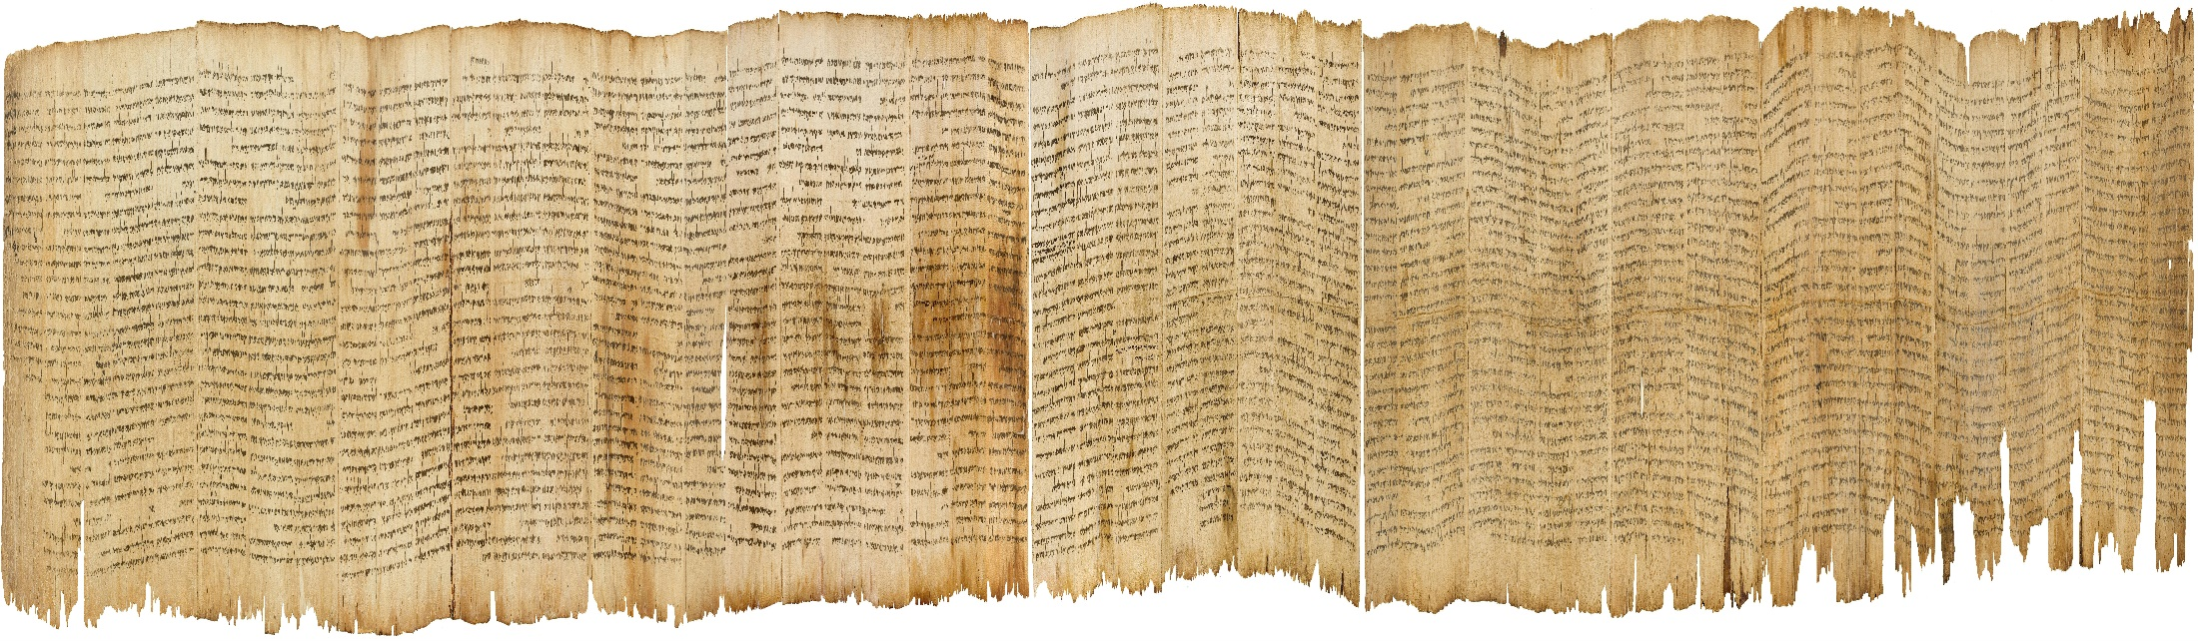
Prophecies of Jesus
Isaiah Dead Sea Scroll
Dated: 150BC-68AD
  Entire Book (Scroll) of Isaiah

Slide 15
Prophecies of Jesus
Lessons
The End of an Era:
  Nation of Israel, God’s Chosen People
    Jew’s nation undermined and crumbling before their eyes
    Mt 27:50-54, the veil of the temple was rent in twain from the top to the bottom; and the earth did quake, and the rocks rent;52 And the graves were opened; and many bodies of the saints which slept arose,53 And came out of the graves after his resurrection, and went into the holy city, and appeared unto many.

Slide 16
Prophecies of Jesus
Lessons
End of an Era:
  Forgiveness of Sins
    Heb 9, The Bondage of Sin is released

Slide 17
Prophecies of Jesus
Lessons
Power of the Prophecy:
  God put much effort into men coming to believe and following Jesus
    God gives ample proof Jesus was the Messiah
    It was not God’s desire that men reject the Messiah
    This is counter to the fulfilling of these prophecies.
    In essence God put great effort into undermining fulfillment of these prophecies, not leading them to be fulfilled.

Slide 18
Prophecies of Jesus
Lessons
Gospel of Jesus
  1 Cor 15:1-8, Moreover, brethren, I declare unto you the gospel .... how
    Christ died for our sins according to the scriptures;
    he was buried
    he rose again the third day according to the scriptures:
    he was seen...

