Slide 1
Jesus’ Last Hours
His Crucifixion
Psalm 22:7-18

Slide 2
Jesus’ Last Hours
Sleep Deprived
  Thursday after Dark
    Partaking of the Passover & Institution of the Lord’s Supper, Lk 22:7-20
    Teachings to Disciples, Jn 13-16
  Late Thursday Night
    Prayer in Gethsemane, Mt 26:36-46
  Early Friday before Sun Rise
    Betrayal and Arrest of Jesus, Jn 18:1-11
Suffering Prior to Crucifixion

Slide 3
Jesus’ Last Hours
Abuses During Trial
  Mt 26:57-68, Jesus Before Caiaphas – The High Priest
    Spit In His Face
    Buffeted Him
    Smote Him With The Palms Of Their Hands
  Mt 27:26-30, Jesus Before Pilate
    Scourged
    Crown Of Thorns
      Took A Reed, And Hit Him On The Head.
Suffering Prior to Crucifixion

Slide 4
Jesus’ Last Hours
Jn 19:16-17, Jesus Carries the Cross
  Mt 27:32-33, Simon Commissioned To Help
    Jesus Unable To Carry Cross Alone
Crucifixion

Slide 5
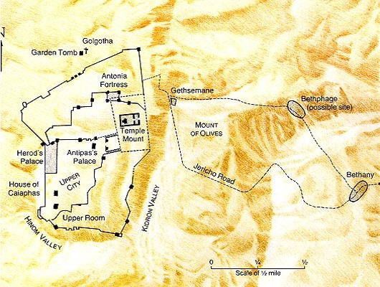
Jesus’ Last Hours

Slide 6
Jesus’ Last Hours
Jn 19:18-27, Jesus Crucified
  Mk 15:25, 3rd Hour Friday
  Gospel Writers Omit The Details Of The Process
  Treatment Was Horrendous
    Scourged
    Struck Thorn Crown On His Head With A Rod
    Driving Nails In Hands And Feet
    Cross Lifted Up To Post
  It Was A Spectacle
    Not Just To Execute
    Torture, Inflict Pain, Embarrassment
  It Fulfilled Prophecy
Crucifixion

Slide 7
Jesus’ Last Hours
Sayings On The Cross
  Lk 23:34, Forgive Them…
  Lk 23:39-43, With Thief
  Mt 27:46, My God, My God, Why Hast Thou Forsaken Me
    Ps 22
  Jn 19:28, I Thirst
Crucifixion

Slide 8
Jesus’ Last Hours
Jn 19:28-30, Death of Jesus
  Mk 15:33-37, 9th Hour
  Mt 27:50-54, God’s Power On Display
    Veil Torn In Temple Between Holy & Most Holy
    Earthquake & Rock’s Torn
    Graves Open
      After Resurrection Of Jesus
  Prophecy(s)Would Have Been Apparent
    Isa 53, PS 22
  Mt 27:54, ...when they saw ...feared exceedingly, saying, Truly this was the Son of God.
Crucifixion

Slide 9
Jesus’ Last Hours
Jn 19:31-37, Jesus Side Was Pierced
  In Accordance With Prophecy
Crucifixion

Slide 10
Jesus’ Last Hours
Ps 22:1-21, Prophecies Of Crucifixion
  His Forsaken Cry, Ps 22:1 – Mt 27:46
  Mocked, Ps 22:6-8 – Mt 27:27-31
  People Wag Their Heads, Ps 22:7 – Mt 27:39
  Heartbroken, Ps 22:14 – Jn 19:34
  Became Very Thirsty, Ps 22:15 – Jn 19:28
  Hands And Feet Pierced, Ps 22:16 – Jn 20:24-28
  People Stared At Him, Ps 22:17 – Lk 23:35
  Clothes Divided And Gambled For, Ps 22:18 – Jn 19:23-24
Notes:
Abundance of trivial details which could apply to many situations in life, all come together at Jesus’ crucifixion

Slide 11
Jesus’ Last Hours
Summary
  Jn 19:16-17, Jesus Carries the Cross
  Jn 19:18-27, Jesus Crucified
  Jn 19:28-30, Death of Jesus
  Jn 19:31-37, Jesus Side was Pierced
  Ps 22, Fulfilled Prophecies
Crucifixion

Slide 12
Jesus’ Last Hours
Lessons
  Emphasis’ The Cost Of Our Salvation
  Reveals The Humanity Of Jesus
  Reveals The Mercy Of Jesus
  Reveals The Forbearance Of Jesus
  Reveals The True Victory
    Over Death & Satan
    1 Cor 15:54-57
  What A Friend We Have In Jesus
Crucifixion

