Slide 1
Jesus’ Last Week
Teachings on Mt Olive
Tuesday
Prophesies and parables
Mt 24-25

Slide 2
Jesus Last Week
Luke 13-19
  Details Of His Journey To Jerusalem
Matthew 21-25
  Public Teachings
    Interrogation & Woe’s
      To Disciples
      To/About Scribes & Pharisees
  Private Teachings
    Prophecies & Warnings
      To Select Disciples
John 12-17
  Private Teachings
    Select Disciples
Focus of The Gospels
Notes:
Big Picture of the Gospels
They tell a story
Using the Gospels in this order keeps the event together
Some pieces are available in other writers, but the main is covered in detail.
When we look at these as a whole, we see a picture of Jesus
His last-ditch efforts to convert the Scribes & Pharisees
His Protection and encouragement for the “Lost”
His love and passion for his chosen ones, Apostles

Slide 3
Teachings On Mt Olive
  Parable of the Wicked Husbandman, Mt 21:28-45
    Vs. 37-39, kill him, and seize his inheritance
    Vs. 41-45, He will miserably destroy…
  Parable of the Wedding Feast, Mt 22:1-14
    Mt 22:5-9, he sent forth his armies, and destroyed those murderers, and burned up their city
Pre-text:
Pending Judgment

Slide 4
Teachings On Mt Olive
Prophecies
  Mt 23:34-36, All these things shall come upon this generation
  Mt 23:38, your house is left unto you desolate
  Mt 23:39, Ye shall not see me henceforth, till …
Pre-text:
Pending Judgment

Slide 5
Teachings On Mt Olive
Mt 24:1-3, Leaving Temple
  Vs. 1, The Buildings Of The Temple (Under Construction)
    Lk 21:1-4, rich men’s gifts, poor widow’s two mites
  Vs. 2, Not One Stone On Another
Beginning of Private Teachings to Apostles
Pre-Text:
Pending Judgment
Notes:
Remember, Disciples were still expecting a Physical Jewish Nation

Slide 6
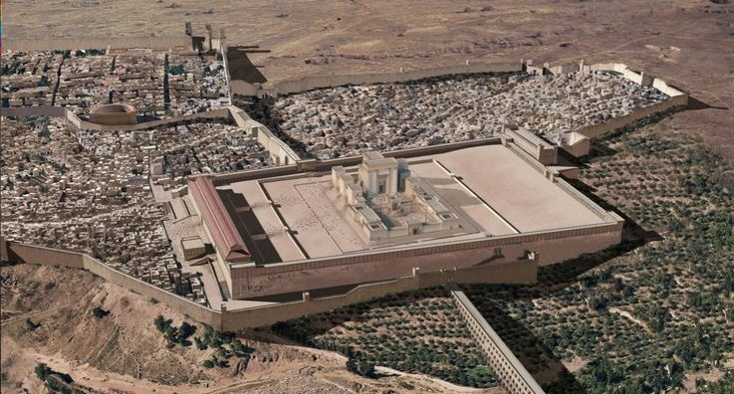
Temple Structure
Mt 24-25
Their View
Notes:
View from Mt Olives would have been at a higher elevation than the Temple
Also other places along the road(s) going to Jerusalem from the West.

Slide 7
Teachings On Mt Olive
Mt 24:1-3, Jesus discusses the Temple with Disciples
  Disciples Questions:
    When will Temple be Destroyed
    What are the signs of your coming
    What are the signs of the end of the age
  Mt 24&25 are His answers
Pre-Text:
Pending Judgment
Notes:
Note that the disciples still had man misconception about the nature of the kingdom. See Acts 1:6. in their mind, all 3 of these probably coincided with the same event, but Jesus teaches 2 distinct events.

Slide 8
Teachings On Mt Olive
Mt 24:4-35, Destruction of Jerusalem
  Mt 24:4-14, Watch For “These” Signs
  Mt 24:15-22, Flee…
  Mt 24:23-28, Warning Of False Prophets
  Mt 24:29-35, Signs It Is Near
  Bookended:
    Mt 23:36 & Mt 24:34

Slide 9
Teachings On Mt Olive
Mt 24:36-25:46, Final Judgment
Mt 24:36-41, Comparison: The Flood
  “But of THAT Day”
  Vs. 36, No man or angel knows the day or hour
  Vs. 38-39, day will come WITHOUT warning
  Emphasis
    Preparation in advance
    No Sign Given
    A Completely Different Approach to the Calamity
Notes:
A very distinct change in instructions here
Before: When you see…. Flee
Now: be prepared because there will be NO signs…

Slide 10
Teachings On Mt Olive
Mt 24:36-25:46, Final Judgment
Mt 24:42-44, Parable Of A Thief
  Nobody knows when a thief comes, else we would be standing guard
  No sign or indication of this event!
    Be prepared because there will not be notice

Slide 11
Teachings On Mt Olive
Mt 24:36-25:46, Final Judgment
Mt 24:45-51, Parable Of The Householder
  Vs. 45-47, Good Householder
    Found To Be Working
    Blessed
  Vs. 48-51, The Evil Householder
    Idle
    Will Receive The Wrath Of God
  Be Prepared Because There Will Not Be Notice
    “My Lord Is Delayed”
    Analogous To Noah And The Flood
Notes:
When the cat’s away the mice will play
When the boss is away, the inmates run the asylum

Slide 12
Teachings On Mt Olive
Mt 24:36-25:46, Final Judgment
Mt 25:1-13, Parable of the 10 Virgins
  All 10 were prepared
    5 not prepared enough
  Watch, You do not know the day or hour
    Be prepared because there will not be notice
    When event happens there will not be time to prepare

Slide 13
Teachings On Mt Olive
Mt 24:36-25:46, Final Judgment
Mt 25:14-30, Parable of the Talents
  5, 2, & 1 Talent Men
  Vs. 19, They Labored For A “Long Time”
  Warning From 1 Talent Man
    did not put forth any effort
    Punishment – cast into outer darkness, weeping and gnashing of teeth
  Work According To Abilities

Slide 14
Teachings On Mt Olive
Mt 24:36-25:46, Final Judgment
Mt 25:31-46, Parable Of The Sheep And Goats
  Jesus Comes With His Angels
    Sits On Throne
    Gathers All Nations
  Sheep
    Inherit Kingdom
  Goats
    Everlasting Fire With Devil And His Angels

Slide 15
Teachings on Mt. Olive
Summary
Begin of Private Teachings to Apostles
  Mt 24:1-35, Destruction of Jerusalem-Temple Prophecy
    Watch For These Signs & Be Ready – To Flee
  Transformation of a Nation
    End of an Era

Slide 16
Teachings On Mt Olive
Summary
Begin of Private Teachings to Apostles
  Be Prepared – There Will Be No 2nd Chance
    Mt 24:36-41, Comparing Judgment With The Flood
    Mt 24:42-44, Parable Of A Thief
    Mt 24:45-51, Parable Of The Householder
    Mt 25:1-13, Parable Of The 10 Virgins
    Mt 25:14-30, Parable Of The Talents
    Mt 25:31-46, Parable Of The Sheep And Goats
Notes:
Time will be long
Example of Noah and Flood
Evil Servant said in his heart…, parable of the householder
After a long time… parable of the talents
Be ready for the final judgment for time will be no more

Slide 17
Teachings on Mt. Olive
Lessons
Be Ready
  It Will Be A Long Time
  “Mostly” Ready Will Not Be Enough
  Being Idle Is Not Enough
  Generosity Of The Faithful

