Slide 1
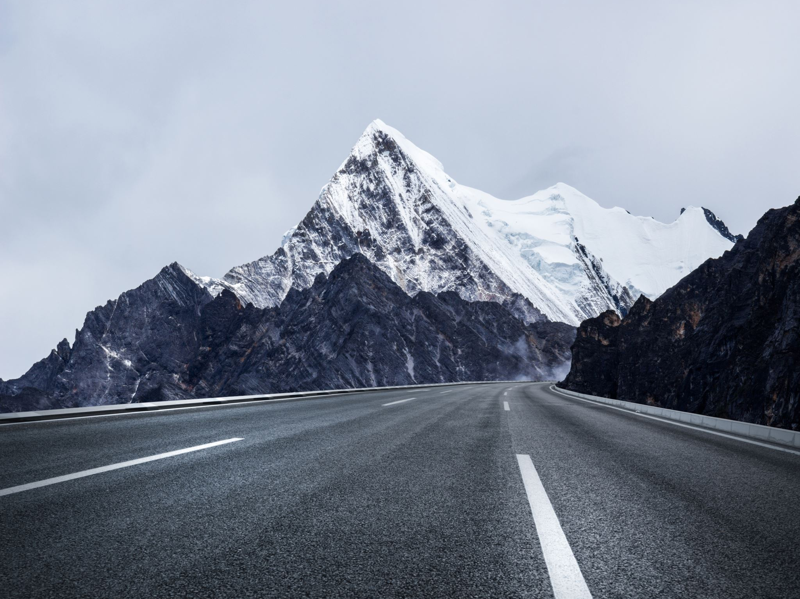
Our Pilgrimage
Ex 6:1-8

Slide 2
Our Pilgrimage
In Foreign Land
  Ex 6:4, the land of their pilgrimage
  400 years between Joseph to leaving
Prospered
  Ex 1:7, they were fruitful, increased abundantly, multiplied, exceedingly mighty; so that the land was full of them
  Ex 1:12, the more they were afflicted the more they multiplied
Allegory to Israel in Egypt
Notes:
We have been promised a new home flowing with milk and honey
We are blessed by God and prosper here; but there is better.

Slide 3
Our Pilgrimage
Enslaved
  Ex 1:8-14, Pharoah burdened them due to fear
  Ex 6:4-9, God speaks of their burdens and bondage
Allegory to Israel in Egypt

Slide 4
Our Pilgrimage
Promises of God
  A Better Home
    Gen 17:8, Abraham
      Gen 50:23, Joseph lived to the 3rd generation of Ephraim
      Surly family stories spoke of this promise
    Ex 6:8, God to fulfill the promise
  A Glorious Land
    Ex 3:8, Num 13:27, good and large land, unto a land flowing with milk and honey
Allegory to Israel in Egypt

Slide 5
Our Pilgrimage
Promises of God
  Provided an Advocate and Messiah
  Ex 3:6-10, God Speaking to Moses
  Ex 2:11-15, Act 7:23-29, Moses advocating for Israelite being abused
  Ex 32:9-14, advocating for the Nation of Israel
  Num 12:6-8, spoke face to face with God
Allegory to Israel in Egypt

Slide 6
Our Pilgrimage
Faith In The Journey
  Faith to Endure
    Staying Focused
    Ex 5, murmuring over problems Pharoah creates
  Faith to Act
    Cross Over Jordan
      Ex 14:8-13, murmuring about Egypt Arming coming
    Enter the Land
      Num 13:26-33, report of the Spies
  Murmured Much!
    16 verses on murmuring
Allegory to Israel in Egypt

Slide 7
Our Pilgrimage
In Foreign Land
Prosper
Enslaved
Promises of God
  A Better Home
  A Glorious Land
  An Advocate & Messiah
Faith In The Journey
  Faith to Endure
  Faith Act
  Murmuring?
Played out in our Lives
Application

Slide 8
Our Pilgrimage
Pilgrims to our Nation
  Not Many Generations ago
  Passion for Change, Something Better
Application

Slide 9
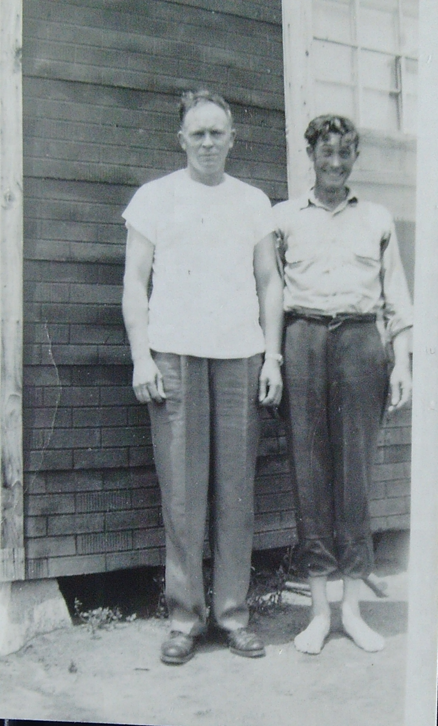
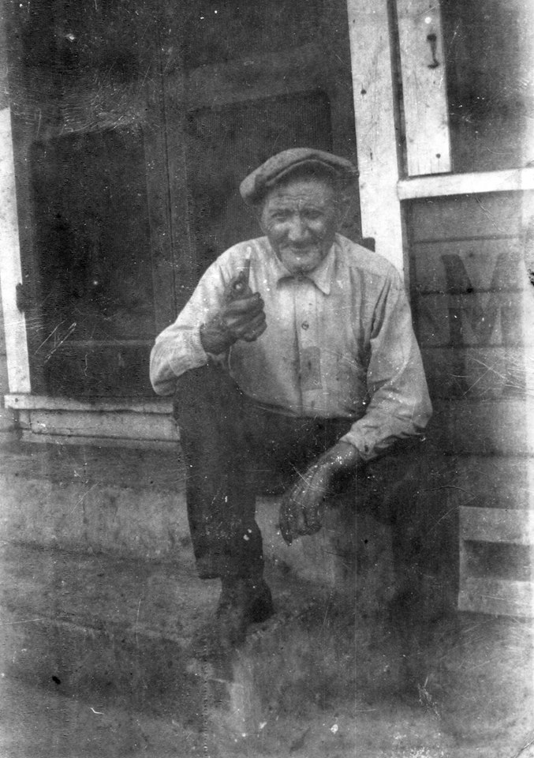

Slide 10
Our Pilgrimage
Rev 22:1-5:
1 And he shewed me a pure river of water of life, clear as crystal, proceeding out of the throne of God and of the Lamb.
2 In the midst of the street of it, and on either side of the river, was there the tree of life, which bare twelve manner of fruits, and yielded her fruit every month: and the leaves of the tree were for the healing of the nations.
3 And there shall be no more curse: but the throne of God and of the Lamb shall be in it; and his servants shall serve him:
4 And they shall see his face; and his name shall be in their foreheads.
5 And there shall be no night there; and they need no candle, neither light of the sun; for the Lord God giveth them light: and they shall reign for ever and ever.

