Slide 1
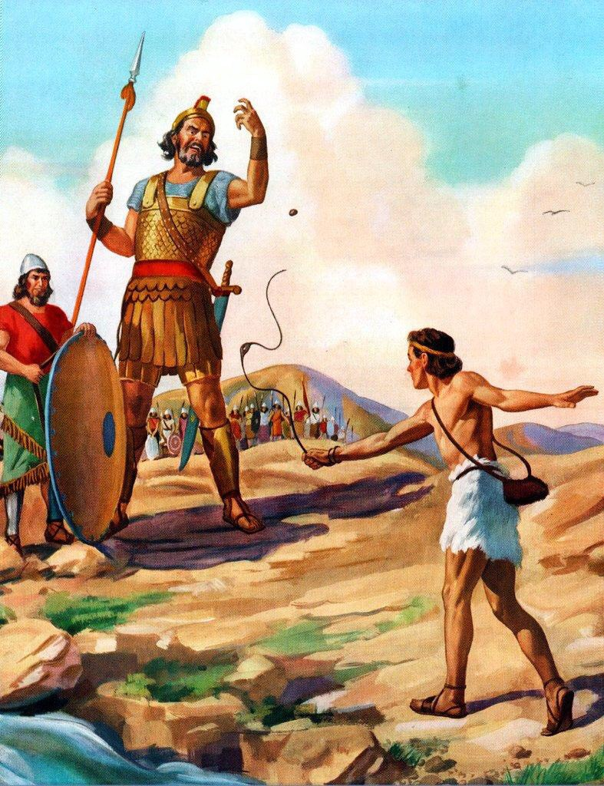
Trusting In God
I Samuel 17:37

Slide 2
Trusting In God
King Saul’s Problem: What to do about Goliath?
  What to do about Goliath
    Led to dismay and fear - I Samuel 17:11
    Didn’t just go away – I Samuel 17:16
    The dismay and fear did not make the fear go away – I Samuel 17:24
  David knew how to deal with the problem
    Didn’t become dismayed or afraid – I Samuel 17:37
    Put his trust in God – I Samuel 17:45-46
Dealing With Problems

Slide 3
Trusting In God
Recognize trials are a part of life
  Shouldn’t be surprised by them
    I Peter 4:12
    John 16:33
  Jesus experienced them just like us
    Luke 22:28
Dealing with our problems

Slide 4
Trusting In God
Turn to God
  He has promised to help us
    Isaiah 41:10,13
    Isaiah 40:29-31
    Romans 8:31
  He won’t forget us
    Hebrews 13:5
    Joshua 1:9
  We need to put our trust in him
    Philippians 4:6
    I Peter 5:7
    Proverbs 3:5-6
Dealing with our problems

Slide 5
Trusting In God
Look at troubles differently
  They can strengthen us
    Romans 5:3-5
    James 1:2-4
    I Peter 1:6-7
  They can remind us to put our trust in God
    II Corinthians 12:9
    Proverbs 3:5-7
Problems can be a blessing

Slide 6
Trusting In God
  Stay faithful
  Remember the gift that awaits us
    Galatians 6:9
Dealing with our problems

Slide 7
Trusting In God
Examples
  Adam
    The garden provided what Adam and Eve needed
    Sinned and became separated from God – Isaiah 59:2
    Had to work hard and deal with problems and discouragement
  Sampson
    Incredibly strong and able to do great things
    Sinned and became separated from God
    Became weak and unable to do those great things
God is only with us when we obey him
Notes:
Genesis 2:8-9 – Garden provided what was needed
Genesis 2:15 – Adam cared for the garden but his efforts were easy and fruitful
Sinned which separated him from God – Isaiah 59:2
Genesis 3:17-19 – Had to work hard and deal with problems

Slide 8
Trusting In God
What we have to offer
  Kind words
    Proverbs 12:25
  Help with burdens
    Galatians 6:2
    Romans 15:1
  Comfort/Encourage
    II Corinthians 1:3-4
    I Thessalonians 5:11
  Love
    John 15:12
  A good example
    Matthew 5:13-16
We can help each other
Notes:
I Thessalonians 5:11

Slide 9
Summary
Problems are going to come
When they come, we need to turn to God
Need to embrace problems
    Can be strengthened by them
    A reminder that we need God
Need to remember that God will only be with us if we are obedient to him
We have opportunities to help each other

