Slide 1
Greatest Command balanced Living
Gen 1:26-28

Slide 2
Introduction
Greatest (Foremost) Command
  LOVE for God
  LOVE for Neighbor

Slide 3
Balanced Living
God’s Purpose for Mankind
Who We Are
  Gen 1:27, made in the image of God
  Acts 17:26-29, Children
  Behavior
    Mind, Morals, Behavior, Attitude

Slide 4
Balanced Living
God’s Purpose for Mankind
What We Do
  Family Relationships
    Gen 1:28, Instructions for Adam & Eve
    Eph 5:22-6:4, Relationship of the Husband, Wife, & Children

Slide 5
Balanced Living
God’s Purpose for Mankind
What We Do
  Work
    Gen 2:15, in the Garden
    Gen 3:17-19, Beyond the Garden
    Eph 6:5-8, serve our masters as unto the Lord
    Eph 4:28, work to help others
    Eccl 9:7-10, Whatsoever thy hand finds to do, do it with thy might

Slide 6
Balanced Living
God’s Purpose for Mankind
What We Do
  Seek God
    Acts 17:26-29, Paul teaching in Athens
    Respect God as creator
    Respect our purpose under the sun
    Directly in Service to Him
      Assemblies of Christians
      Personal Life

Slide 7
Balanced Living
God’s Purpose for Mankind
What We Do
  Rest from Labors
    All work and no play…
    God and Rest
      Gen 2:1-3, Worked 6 days and ceased from work on 7th
    Sabbath is Old Covenant
      Insightful concepts taught about Man and Work

Slide 8
Balanced Living
God’s Purpose for Mankind
What We Do
  Rest from Labors
    Jesus and Rest
      Mk 1:35, departed into a solitary place
      Mk 6:31, Come ye … and rest a while … they had no leisure
      Re-Creation
        Mk 2:23-28, Sabbath made for man

Slide 9
Balanced Living
God’s Purpose for Mankind
What We Do
  Rest from Labors
    Health
      Mk 2:23-28, Nourishment
      1 Tim 5:23, Medicine for Timothy
      1 Tim 4:8, Exercise profits a little

Slide 10
Balanced Living
God’s Purpose for Mankind
What We Do
  Joy in Labors
    Fruit of our Labor
      Eccl 3:9-13, 5:18-19, Gift of God
      Eccl 9:7-10, of one approved by God
    Effects of Physical Activity
      Boost immune system
      Promotes & Suppresses our brain chemicals

Slide 11
Balanced Living
Pitfalls in our Culture
Idleness
  Proverbs on Slothfulness
    Sleep: Prov 6:6-11, 9:15, 26:14-15
    Excuses: Prov 20:4, 22:13, 26:13
    Waste & Want: Prov 13:4, 18:9, 24:30-33, Eccl 10:18
  2 Thes 3:6-15, Idle are often busy about others
    Too much time to think

Slide 12
Balanced Living
Pitfalls in our Culture
Busy
  Tyranny of Busy
    Monopolizing our Time
  Expend 110% Resources
    Time
    Strength/Energy
    Finances
    Mental
Notes:
McKee Foods, “Owner” Quote, Little Debbie

Slide 13
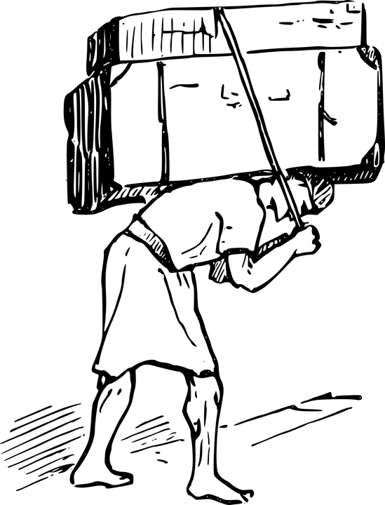

Slide 14
Balanced Living
Pitfalls in our Culture
Busy
  No time For
    Physical
    Spiritual
    Think-Meditate

Slide 15
Balanced Living
Pitfalls in our Culture
Amassing
  Mt 6:19-24, Treasures & Masters
  Lk 12:13-21, great harvest, build bigger barns, take ease
  Work – Work – Work

Slide 16
Jesus walked EVERYWHERE

Slide 17

Fulfilling God’s Purpose
  Godly Principles:
    Time for Work
    Time for Rest
    Time for Family
    Time for Health
    Time to Devote to Serving Him
    God in it all, through it all, and above it all
      “As Unto the Lord”
Notes:
The good we do gets us into heaven? No
First, it is the mercy and grace of God
Second, it is the bad that we do keeps us out of heaven
Fulfill God’s will; not minimize our work; don’t be a minimalist

Slide 18
Results of our Love for God:
Attitude
Behavior
Purpose
Transforms Every Part of Our Life

Slide 19


