Slide 1
Shine as Lights
Phil 2:14-16

Slide 2
Shine as Lights
Luminaires
  Need for Illumination
  Sources of Illumination
    Sun & Moon
    Light Houses
    Flashlights

Slide 3
Shine as Lights
Shine Ye as Lights
  Be Seen
    Be a Luminary
  As Son’s of God
    Blameless in action
    Sincere in heart
    Without blemish
  Word of life
    Beacon of hope
    Encouragement
    Good life
    Absent evils
Our Lights

Slide 4
Shine as Lights
Dark World
  Crooked
    Curved
  Perverse
    Twisted
World of Darkness

Slide 5
Shine as Lights
Succumbing to Darkness
  Grumbling
    An Onomatopoeia
  Murmurings
  Complaining
  Disputing
  These pull the life out of us
    Uninspiring
    Demoralizing
    Deflating
    Draw the Oxygen out of the Room
World of Darkness

Slide 6
Shine as Lights
Succumbing to Darkness
  Related Sins of Speech
    1 Cor 5:11, 6:10, Railer (a man of coarse, harsh, and bitter words)
    Rom 1:29-32, debate, deceit, malignity; whisperers,30 Backbiters, haters of God, despiteful, proud, boasters
    Eph 4:29-32, Let no corrupt communication
      bitterness, and wrath, and anger, and clamor, and evil speaking, be put away from you, with all malice
World of Darkness

Slide 7
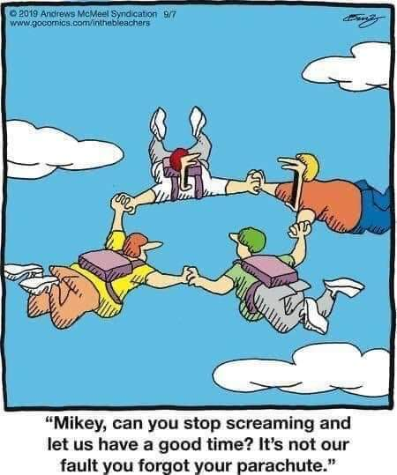

Slide 8
Shine as Lights
Do ALL Things Without
  Murmurings and Disputing’s
    Darkness
    Disease
    Death
    Carnal
Application

Slide 9
Shine as Lights
Do ALL Things Without
  Behaviors we Exhibit
    Speech
  Optimist, Happy Camper
  Be A Light
    Show the World
      The Word of Life
      As Sons of God
    Heb 10:23-25, Inspire & Encourage Love & Good works
Application

Slide 10
Shine as Lights
Do ALL Things Without
  Managing Disappointment
    Change what we can.
    Manage what we cannot.
    Wisdom to know the difference.
  Developing Mental Strength
  Inspire & Encourage!
  “This Little Light of Mine”
Application

