Slide 1
Rest for the Weary
Mt 11:28-30
Notes:
Mt 11:28-30, Come unto me, all ye that labor and are heavy laden, and I will give you rest.²⁹ Take my yoke upon you, and learn of me; for I am meek and lowly in heart: and ye shall find rest unto your souls.³⁰ For my yoke is easy, and my burden is light.

Slide 2
Rest for the Weary
We Need Jesus
  Labor And Are Heavy Laden
    Labored – fatigued, weary
    Heavy Laden – loaded up with weight
  Offer of Rest
    A Relief
    Jesus ends the weariness and heavy burdens
Notes:
Man is burdened. Fatigued & Loaded up
We need Jesus to lift our burdens
Jesus offers a Relief;
a better burden a good burden

Slide 3
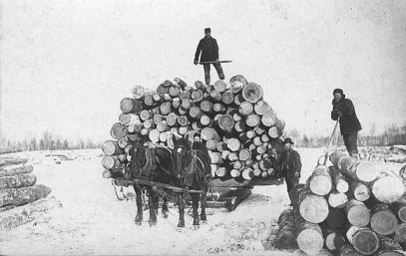
Burden
Jesus Uses A Cultivating Analogy:
Fatigued
Overburdened
Notes:
Burden of a team of horses, or oxen,
Easily overloaded
Fatigued from working long time

Slide 4
Rest for the Weary
Jesus Lifts Burdens
  Burden of the Pharisees “Religion”
    Mt 23:4-7, Pharisees placed heavy and grievous burdens
  Burden of the Law of Moses
    Gal 5:1-6, Stand in the Freedom of Jesus
Notes:
Pharisees false religion, additional burden of traditions that God did not command
Washing of pots, hands, etc
Sabbath day’s journey
do not pluck food to eat
Law of Moses was burdensome; Acts 15:10, “more than they could bear”

Slide 5
Rest for the Weary
Jesus Lifts Burdens
  Burden of Sin
    Gal 2:15-21, justified by Jesus Christ
  Burden of Life Under the Sun
    2 Cor 5:1-10, …For in this we groan, earnestly desiring to be clothed upon with our house which is from heaven… For we that are in this tabernacle do groan, being burdened…
Notes:
Only Jesus can carry the burden of our sin
Consequences, relief from it,
Eternal life and a new body only though Jesus

Slide 6
Rest for the Weary
Jesus Offers – Easy Yoke
  Jesus’ Yoke
    A Burden
    A Coupling Together
  Yoke – Easy
    Useful, wholesome, profitable
Notes:
Jesus Yoke
We have a yoke to bear
Jesus works together with us
In that he lived as a man; Heb 2 & 4
His yoke is easy,
Useful, profitable

Slide 7
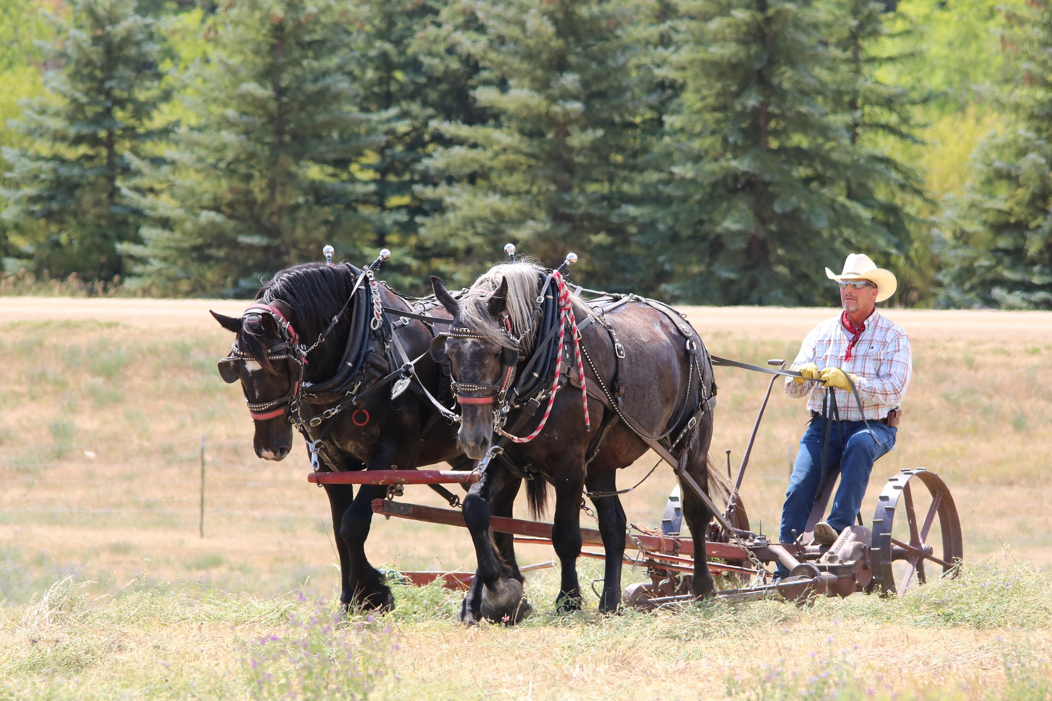
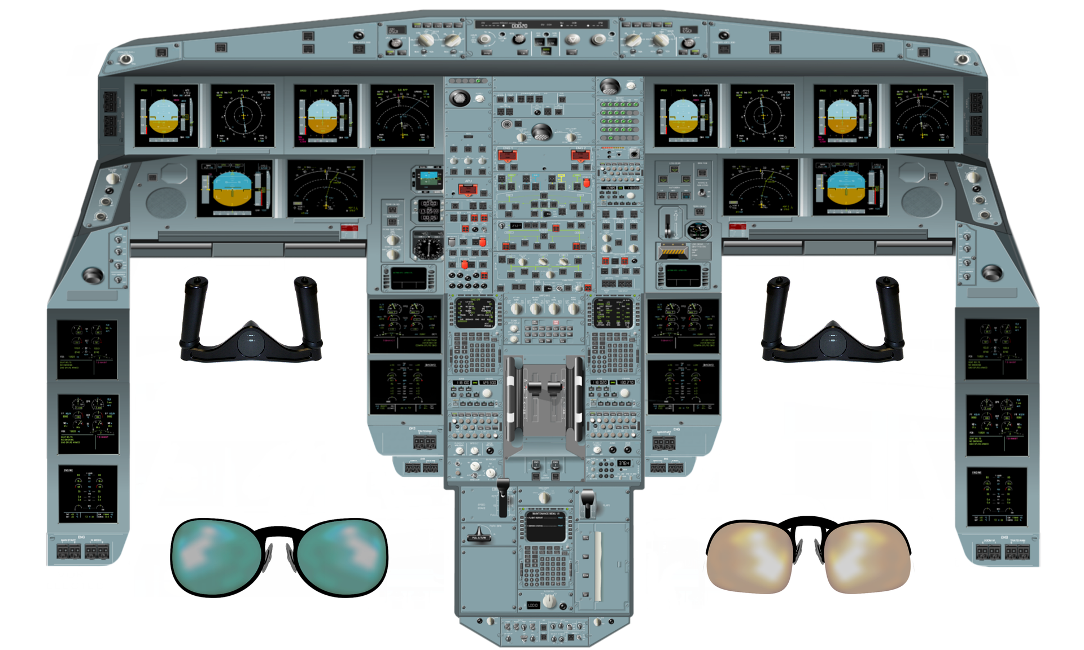
A Yoke
Notes:
A team of horses
Working
Pulling together

Slide 8
Rest for the Weary
Jesus Offers – Useful Burdens
  Jesus Burden
    Load, Freight, Pack
  Burden – Light
    Light, Bearable, Not Overloaded
Notes:
Jesus offers burdens
We are not free of burdens
But he offers a light burden

Slide 9
Rest for the Weary
We Need Jesus
  A Relief
    Not the ending of labor
    Lighter and useful labor
  Like Feathers on a Bird
  Not like Working a Rented Mule
  Easy Yoke
  Useful Burdens

Slide 10
Rest for the Weary
Useful Burdens & Yokes
  A Purse/Wallet
  Eye Glasses
  Steel Toe Work Boots
  Lawn Mower
Notes:
Things we have that can be a burden or yoke in our lives
Eyeglasses fall off, fall down, get wet, smudged,

Slide 11
Rest for the Weary
Useful Burdens & Yokes
  Fruit of the Spirit
    Gal 5:22-23, Love, Joy, Peace, Longsuffering, Gentleness, Goodness, Faithfulness, Meekness, Temperance
  Trials
    Jas 1:2-5, trying of our faith produces endurance
Notes:
Fruit of the Spirit – Life at its best
The Spirit of God showing from our heart though our actions
Even Difficulties are good for us
Produce endurance, build faith

Slide 12
Rest for the Weary
Heavy Burdens & Damaging Yokes
  Works of Flesh, Gal 5:19-21
    Activities: Sensuality, Idolatry, & Reveling
    Relationships: Animosity, Rivalry, Quarrelling, Envy, Wrath, Division, Strife, Politics, Spite
  Anxiety
    Phil 4:4-7, be anxious for nothing…
      Rejoice, Peace, Prayerful, Faith, Gentle, Forbearing
Notes:
These are bad for us
Damage us and our relationships with God and fellow man
Anxiety steals joy
We worry, even leads us to become sick

Slide 13
Rest for the Weary
Jesus Beseeches: Come Unto Me
  Beseech – encouraging & even pleading
  Approachable
    Heb 2:14-18, Took on nature of man, merciful and faithful high priest
    Heb 4:14-16, Sympathetic high priest
      “Come Boldly”
      Obtain Mercy & Find Grace

Slide 14
Rest for the Weary
Summary
  We Need Jesus
    The fatigued and overly weighed realize it best
  Jesus Will Relieve Heavy Burdens
    Offers Easy Yoke/Useful Burdens
    Farming – place the heavy burden on the team of Oxen
    Jesus carries our heaviest burden

Slide 15
Rest for the Weary
Summary
  Jesus Shares In Burdens
  Jesus Will Give You Relief
  Come One Come All!
    Jesus Is Approachable
    Jesus Is Sympathetic

Slide 16

Jesus Offers: Rest
Relief from the Burden of Sin

