Slide 1
Jesus’ Last Week
A King’s Rejection
Monday
Mk 11:12-14
Mk 11:20-26

Slide 2
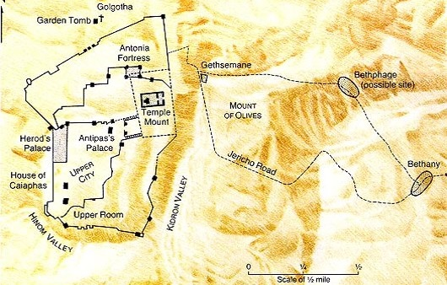
Jesus Travels – Monday
Jesus
Spends Night
Mt 21:17

Slide 3
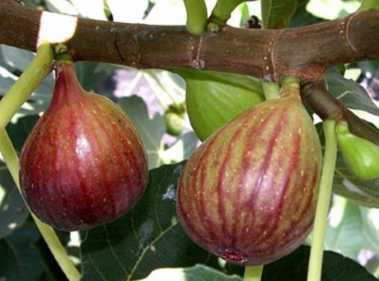
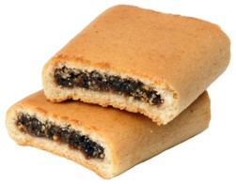
Barren Fig Tree
Notes:
Have you seen a fig? Not a fig newton

Slide 4
Monday
A Day of Rejection
Mk 11:12-13, Jesus Desired Fruit
  Hoped For Fruit
  Wanted Fruit
  Expected Fruit
  At a Time Not Expected
    Opportunity Had Been Given
The Barren Fig Tree
Rejected by the King

Slide 5
Monday
A Day of Rejection
Mk 11:14, Jesus “Curses” the Tree
    Mt 21:19, Fig tree immediately withers
The Barren Fig Tree
Rejected by the King

Slide 6
Monday
A Day of Rejection
Lesson to be Learned
  Time to “Harvest” “Fruit”
    Time for “Judgment”
    No More Opportunity
    Un-expected and it was not “Prepared” with Fruit
    Mt 23:34-39, Judgment: your house is left to you desolate
    Mt 24:42-25:13, Parables
The Barren Fig Tree
Rejected by the King

Slide 7
Monday
A Day of Rejection
Application
  God Has A Purpose For Us
  What Fruit Are We Bearing?
    Gal 5:19-26, Put off works of flesh, Bear Fruit of Spirit
  Lk 13:6-9, Parable of the Barren Fig Tree
    Patience and Effort
    Vs. 1-5, repent or perish
  The Day Will Come
The Barren Fig Tree
Rejected by the King

Slide 8
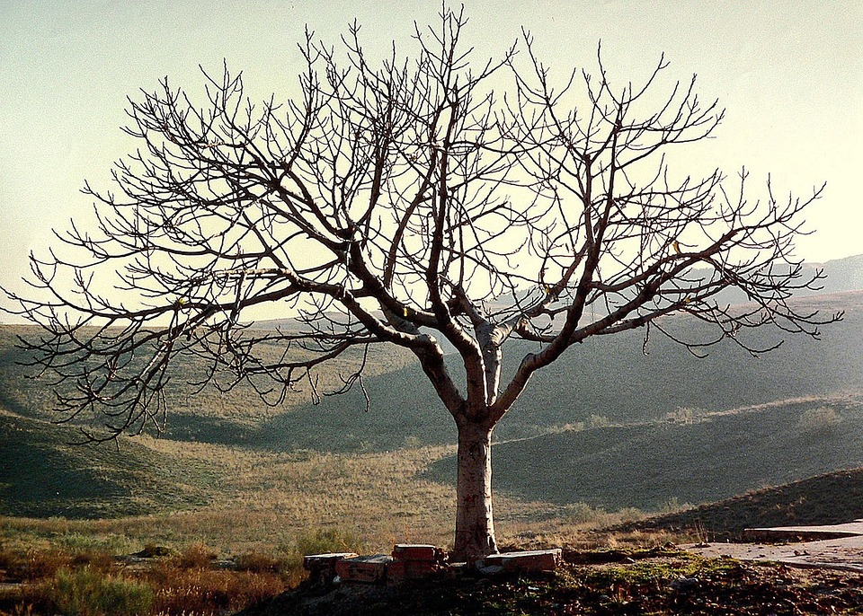
Tuesday – Dead Fig Tree

Slide 9
Tuesday
A Day of Rejection
Mk 11:20-24
  The Next Day (Tuesday)
  Vs. 20, The fig tree is Dried up
Dead Fig Tree
Notes:
We have skipped the cleaning of the temple, next weeks lesson.

Slide 10
Tuesday
A Day of Rejection
Lessons
  Mk 11:20-24, Have Faith in God
    Faith To Move Mountains
    Disciples had a weak faith
      Mt 17:14-21, healing of the son who had a devil
      Mt 16:21-23, Peter rebukes Jesus
      Mt 26:31, you shall all stumble tonight
Dead Fig Tree
Notes:
We have skipped the cleaning of the temple, next weeks lesson.

Slide 11
Tuesday
A Day of Rejection
Lessons
  Mk 11:25-26, Forgive Others
    God forgives those who forgive
Dead Fig Tree

Slide 12
Tuesday
A Day of Rejection
Applications
  Faith in Action
    Live after the gospel
    Put confidence in God
      Especially during trials
  Faith in Prayer
    Jas 1:5-8, ask for wisdom in faith
    Jas 5:13-18, example of Elijah
  Forgive Others
    Mt 18:21-35, Parable of the Unforgiving Servant
Dead Fig Tree

Slide 13
Monday
A King’s Rejection
Barren Fig Tree
  Event that “Bookends” the events in the Temple (Next lesson)
  Opportunity had Past – A Time of Judgment (For Some)
  Fulfill God’s Purpose
    Bear Fruit – Or be Rejected
    Have Faith
    Forgive – Or be Rejected
  Lk 19:41-46, Jesus wept aloud over Jerusalem

Slide 14
Monday
A King’s Rejection
Lk 13:31-35, Jesus' care for the Jews, Like a Hen to her chicks
Lk 19:41-46, Jesus wept aloud over Jerusalem
Lk 23:34, Forgive them…

