Slide 1
Lessons from Balaam
Num 22-24

Slide 2
Balaam – The Narrative
Num 22:2-4, Balak Is Threatened
Num 22:5-6, Balak Knows Of A Prophet Whose Word Stands True
Num 22:7-20, 1st Group Of Princes Sent To Balaam
Num 22:15-18, Even Greater Princes
Num 22:21-35, God Is Angry With Balaam
Num 23, Balak’s Offerings

Slide 3
Balaam – A Prophet of God
Balak’s Ploys
  Num 22:7-20, 23:1-12, 24:10-14
    Flattery
    Money
    Intimidation
  As if Balaam was able of his own power

Slide 4
Balaam – A Prophet of God
A Prophet of God
  Existed Outside the Nation of Israel
  Num 22:6, 8-12, 38, 23:4-10, 16-24, 24:2, 13
Not a Faithful Prophet
  Num 31:16, Rev 2:14, Idol Worship
  2 Pet 2:15-16, Jd 11, Greed
Balaam Recognized the Authority of God
  Num 22:13, 18, 23:8-10, 19, 24:13
  Deut 4:1-2, 5:32, 18:15-22, Josh 23:6, Mt 7:21-23

Slide 5
Balaam – A Prophet of God
Balaam was Tempted by Wealth, Flattery, & Intimidation
  Num 22:13, 37,
  Num 23:11, 25-26,
  Num 24:10-13
  Jude 11

Slide 6
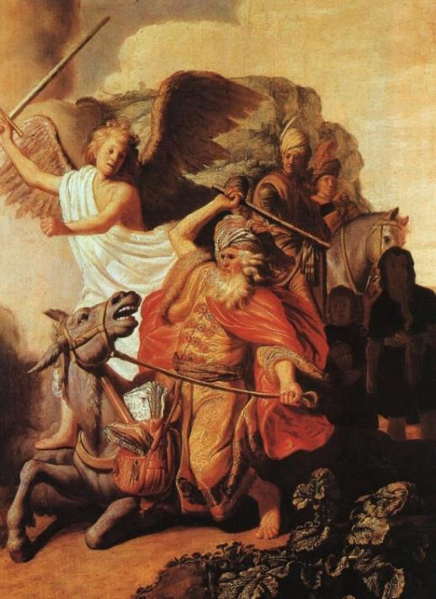
Balaam – A Prophet of God
Balaam’s persistence Causes Problems
  It was against God’s will
Received more than he really wanted
  Num 22:19-20, 22
  Num 22:33-35
  Num 23:11
  Num 24:10-11

Slide 7
Balaam – A Prophet of God
God was not going to Curse Israel
  Num 22:12
  Num 24:1

Slide 8
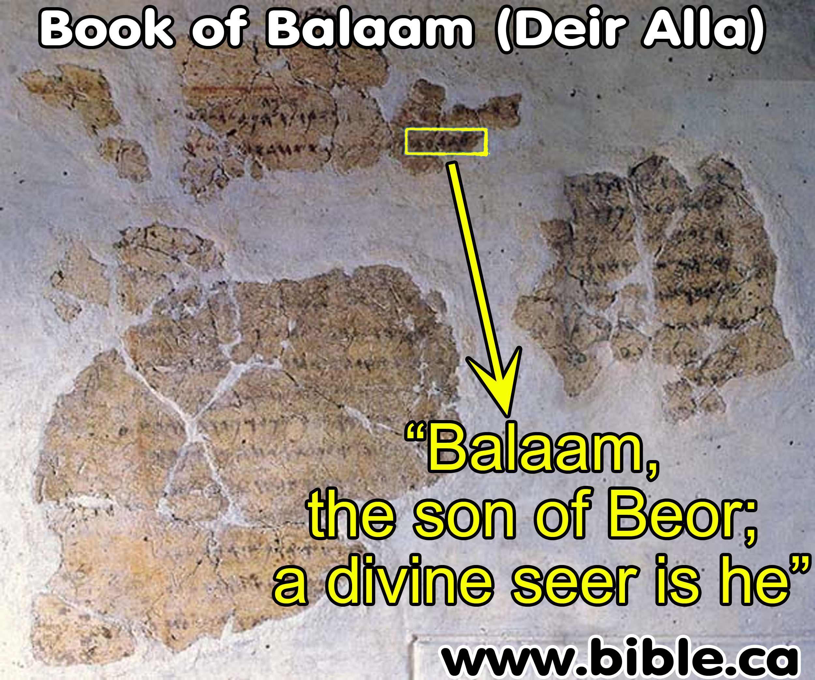
Notes:
Historical records about Balaam

Slide 9
Lessons from Balaam
Authority of God’s Command
Authority of God’s Prophets
Temptation of Wealth and Flattery
Intimidation from the World
Be Careful What You Ask
God’s Will Would not be Changed
Be Converted

Slide 10
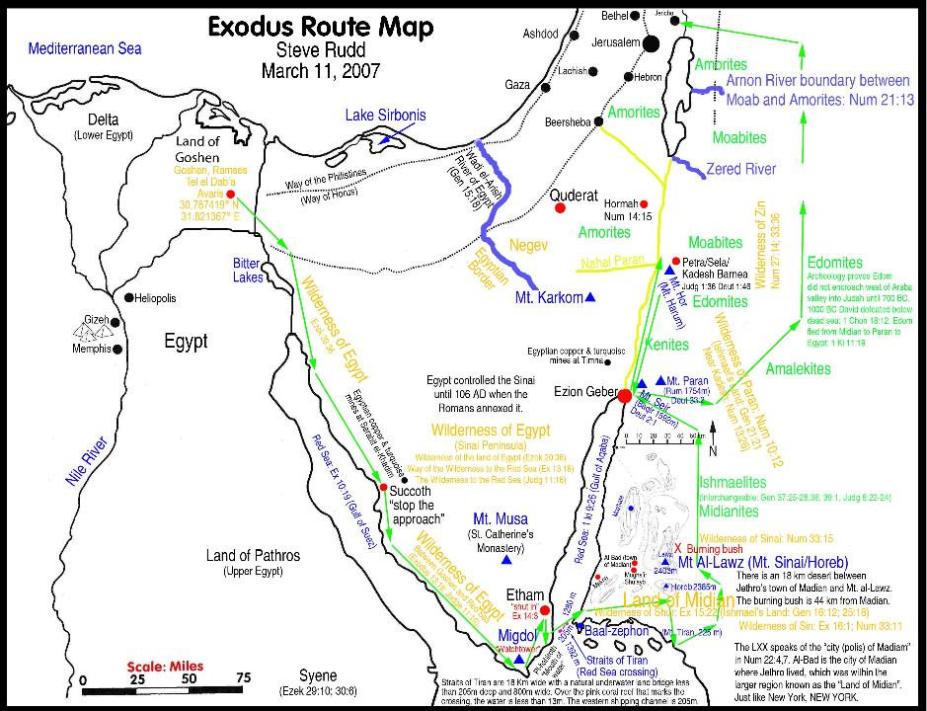
Exodus Into Canaan
Jericho
Amon
Amon
Moab
Midian

Slide 11
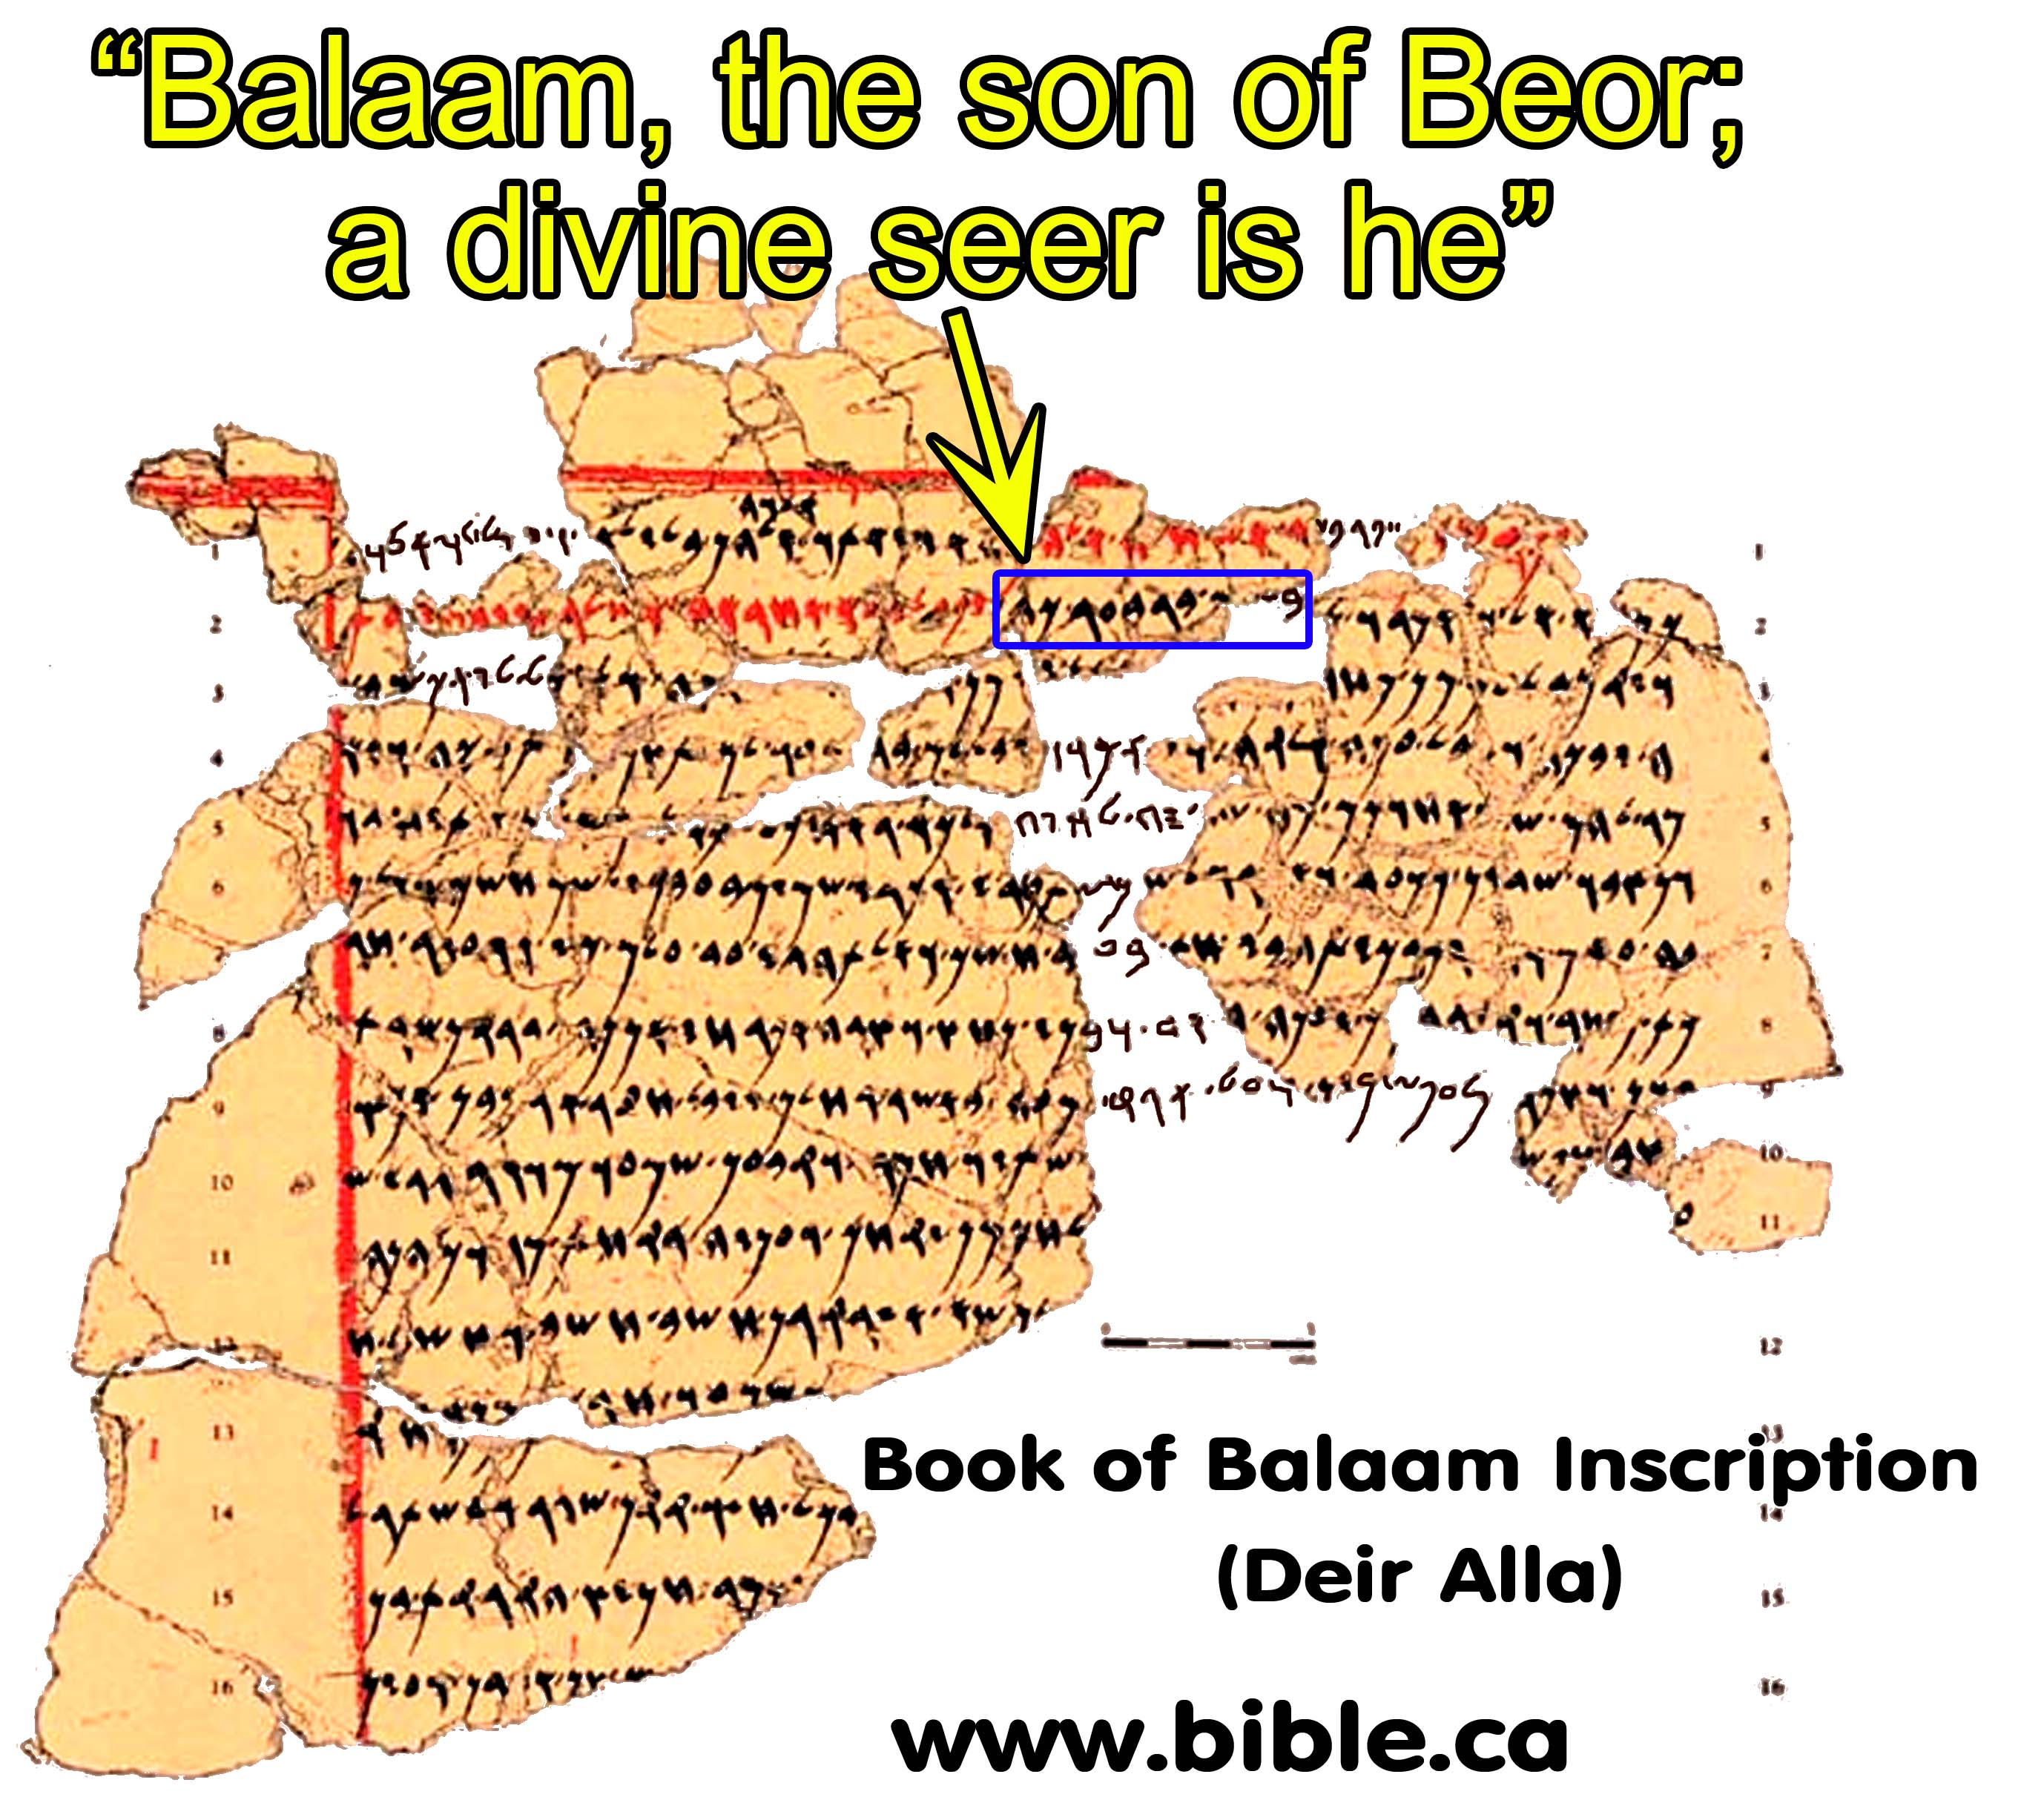

Slide 12
