Slide 1
Pure & Genuine Religion
Steadfast – Jas 5:7-11
Notes:
Putting Religion into practice: Pure and Genuine Religion
True for the Jew (Especially the Pharisee), True for all Christians

Slide 2
Pure & Genuine Religion
James & Suffering
  1:2-18, Blessing of Trials
  5:7-11, be Anchored and Strong in face of Persecution
    Seems to indicate something more severe than trials
Context

Slide 3
Pure & Genuine Religion
Persecution of the Christian
  Oppression of the Rich
    Jas 5:4-6 Withheld wages from labors, condemned and killed the just
    Jas 2:6-7, In Synagogues
      Beaten
      Put out of the synagogues
      Even killed
      Mt 10:17, Mt 23:34, prophecy by Jesus
Context

Slide 4
Pure & Genuine Religion
Christian Response
  Vs. 8, Patient
    Thayer
      1a) to persevere patiently and bravely in enduring misfortunes and troubles
      1b) to be patient in bearing the offenses and injuries of others
    Bear Up Under
    Vs. 7, Like the Farmer
Be Steadfast

Slide 5
Pure & Genuine Religion
Christian Response
  Vs. 8, Established Heart
    Thayer
      1) to make stable, place firmly, set fast, fix
    Strength of Mind
      Anchored deep and braced
Be Steadfast

Slide 6
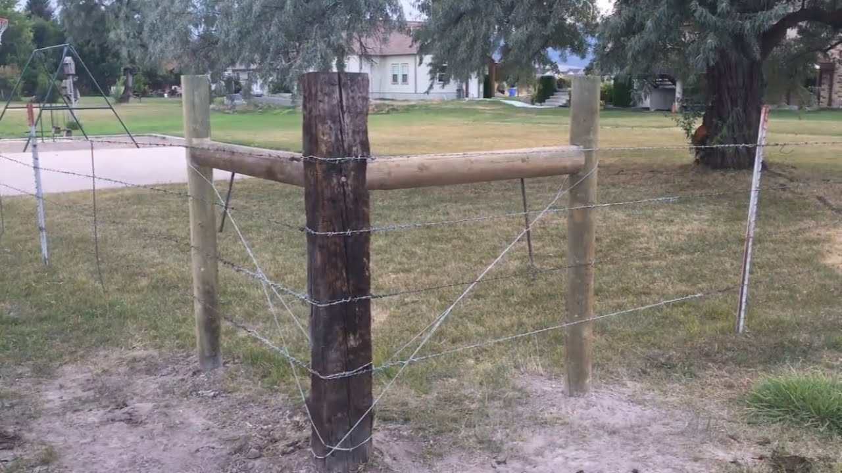
Notes:
Long fence lines are held steadfast by properly designed corner post setup
Set deep and braced.

Slide 7
Pure & Genuine Religion
Christian Response
  Vs. 9, do not Grudge
    Thayer, 1) a sigh, to groan
    Murmur, complain
    Lest you be condemned
Be Steadfast

Slide 8
Pure & Genuine Religion
Encouragement
  Persevere till “Your Day”
    Vs. 7, Coming of the Lord
    Vs. 8, Coming of the Lord is near
    Vs. 9, Coming of the Lord is Very Near
      Judge is at the door
    Hang on, you are almost there
      Vindication will soon come
      Warning to get house in order
Be Steadfast
Notes:
James seems to take on the roll of cheerleader here.

Slide 9
Pure & Genuine Religion
Encouragement
  Blessings of God
    Vs. 11, we count them blessed
      Mt 5:10-12, Blessed are those persecuted for righteousness sake…
Be Steadfast
Notes:
Are persecutions blessings?
Trials are said to be

Slide 10
Pure & Genuine Religion
Encouragement
  Blessings of God
    Vs. 11, “the end of the Lord”
      conclusion brought
    Vs. 11, Lord is very pitiful, and of tender mercy
      In feeling & action
      Job 42:12-13, So the LORD blessed the latter end of Job more than his beginning:
Be Steadfast

Slide 11
Pure & Genuine Religion
Persecution
  2 Tim 3:12, Yea, and all that will live godly in Christ Jesus shall suffer persecution
Christian Response
  Vs. 8, Patient (Bear up Under)
  Vs. 8, Established Heart
  Vs. 9, Do not Grudge
Encouragement
  Vindication is soon
  God Blesses
Summary

Slide 12
Pure & Genuine Religion
Blessings of Discipleship
  Jas 5:13-20, Power in Brotherly Love
    Rejoice & Pray Together
    Lift each other up
  Power in Prayer
Summary

